Slide 1
MatSci YAMZ Instructions
https://matsci.yamz.net

Slide 2

First Steps
Getting Started
  Go to https://matsci.yamz.net
  Start by logging in, updating your profile, and saving your changes
Tabs Overview
  Search: Search terms and definitions
  Browse: Browse through terms and how many definitions they each have
  Add: Create a definition
  Tags: Browse through tags and definitions associated with them

Slide 3
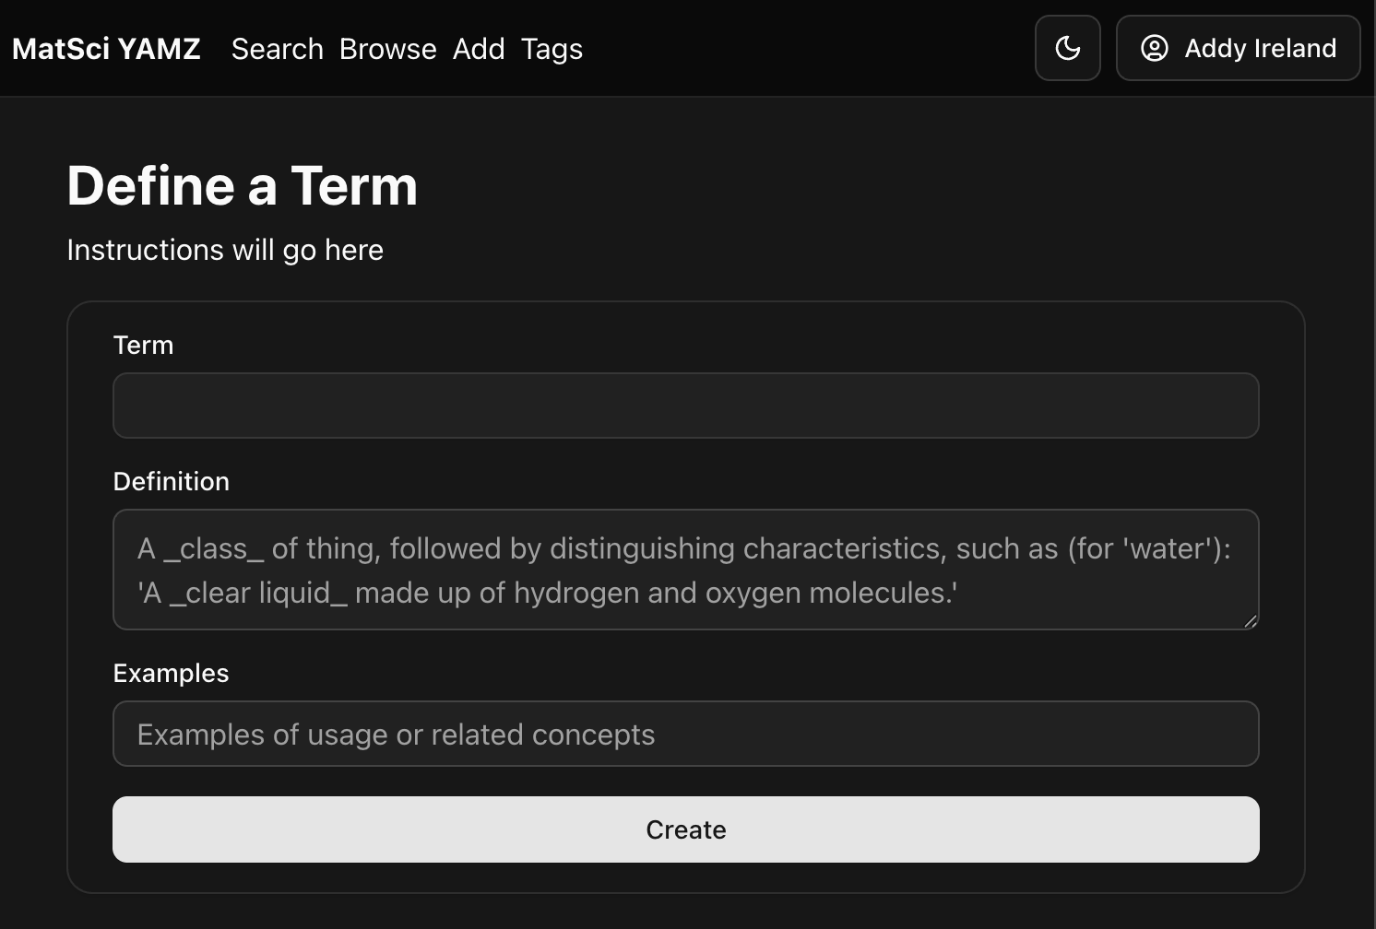
Creating a definition
Enter your term
  Either define a new one or select one from the dropdown
Enter a definition and example
  Can be as brief or extensive as necessary
  Example is required
Finally, create your definition
  You can also edit your definition after posting it

Slide 4
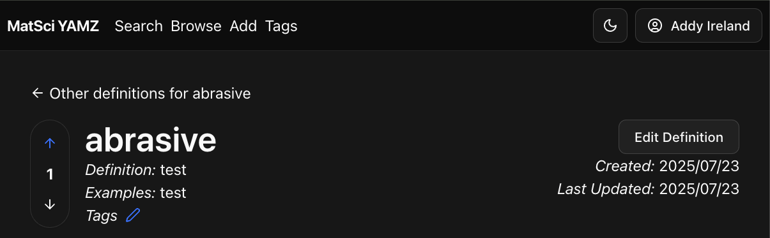
Editing Your Definition
Once you’ve created a definition…
Edit it by clicking the “Edit Definition” button
Tags, to denote community or category
  New tags can be created by clicking the tags button and clicking “Add Tag”
  Add a tag by clicking the blue edit button next to tags
Browse all your definitions by
  Clicking your name in top right, then selecting “Definitions” from the dropdown

Slide 5
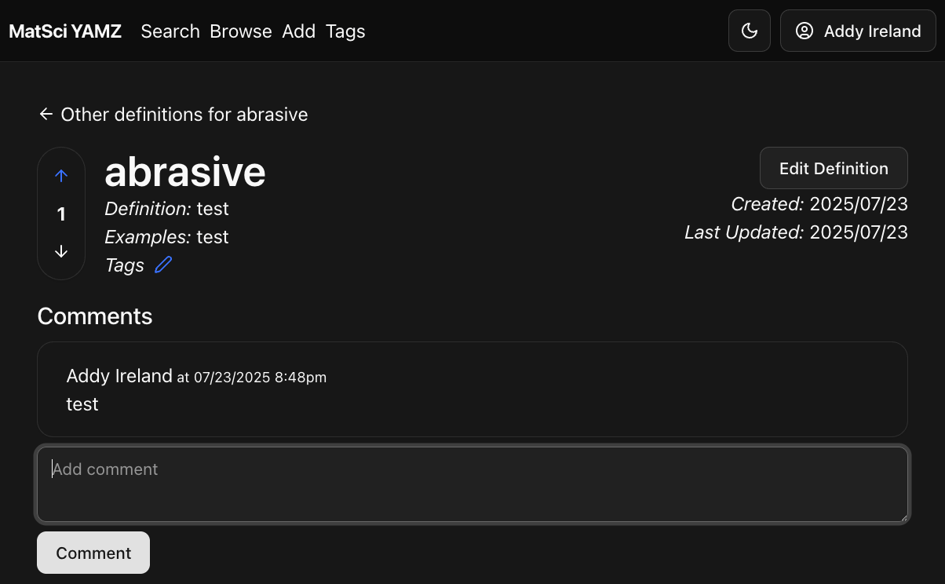
Commenting + Voting
Find terms by going to the search or browse tab
Upvote/Downvoting
  Vote for the best definition using the up/down arrows
Comments
  Post a comment by writing in the “Add comment” box and clicking comment

Slide 6
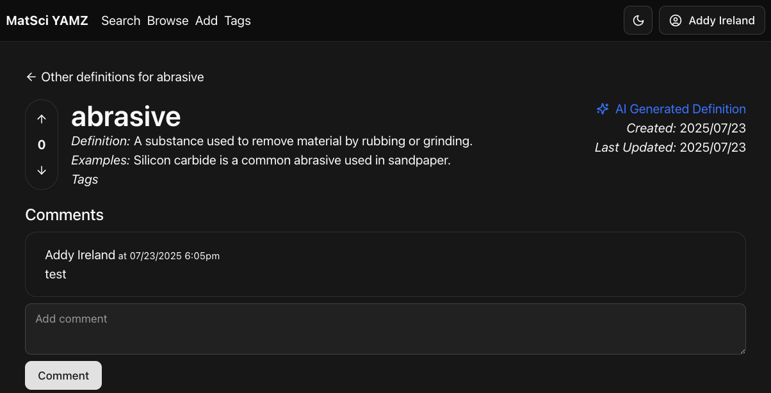
AI Definitions
Denoted by “AI Generated Definition”
Automatically generated from user-provided examples by an LLM (Gemma3)
LLM refines its definition based on users’ comments to it

