Slide 1
Research Data Alliance-US
Rob Quick
Research Data Alliance - US
Cyberinfrastructure Integration Research Center
Pervasive Technology Institute
Indiana University
rquick@iu.edu

Slide 2
Research Data Alliance
Community-driven organization that aims to build the social and technical bridges necessary to enable open data sharing
Researchers, data scientists, policymakers, and other stakeholders to collaborate developing and adopting infrastructure, standards, and best practices for managing and sharing data
Finding solutions to challenges in data sharing, interoperability, and stewardship
Addressing barriers to data sharing, such as technical compatibility, disciplinary differences, and policy issues
Facilitates collaboration and consensus-building among diverse stakeholders to accelerate the progress of research and innovation by enabling efficient and effective data-driven approaches
Notes:
Bottom up, multi-sector, multi-domain organization focused on building sociotechnical bridges to enable data sharing.
Look at developing and adopting infrastructure, best practices, and standards for managing and sharing data.
Solving issues and overcoming barriers within a community.

Slide 3
Research Data Alliance
Established in 2013
Over 14,500 members from 151 countries
~100 Working Groups and Interest Groups are the heart of the Research Data Alliance
Plenary events twice yearly
Globally informed standards, best practice, and infrastructure outputs

Slide 4
RDA Activities in AI-Ready Data
FAIR4ML Working Group
Artificial Intelligence and Data Visitation Working Group
Building Immune Digital Twins Working Group
Digital Twin Interest Group
Many groups working in the area of metadata
Generalist and domain specific
Many groups working in FAIR related groups

Slide 5
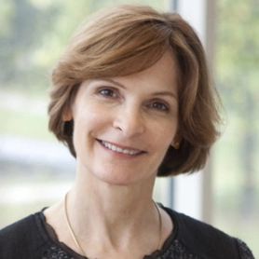
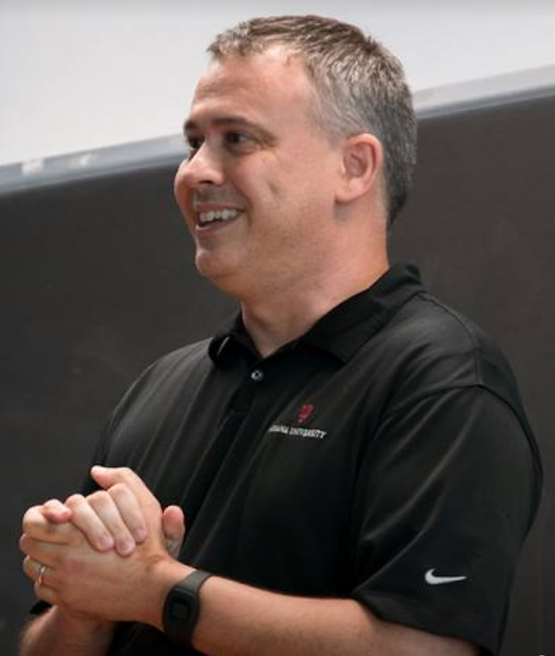
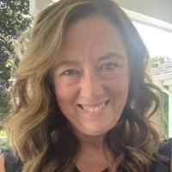
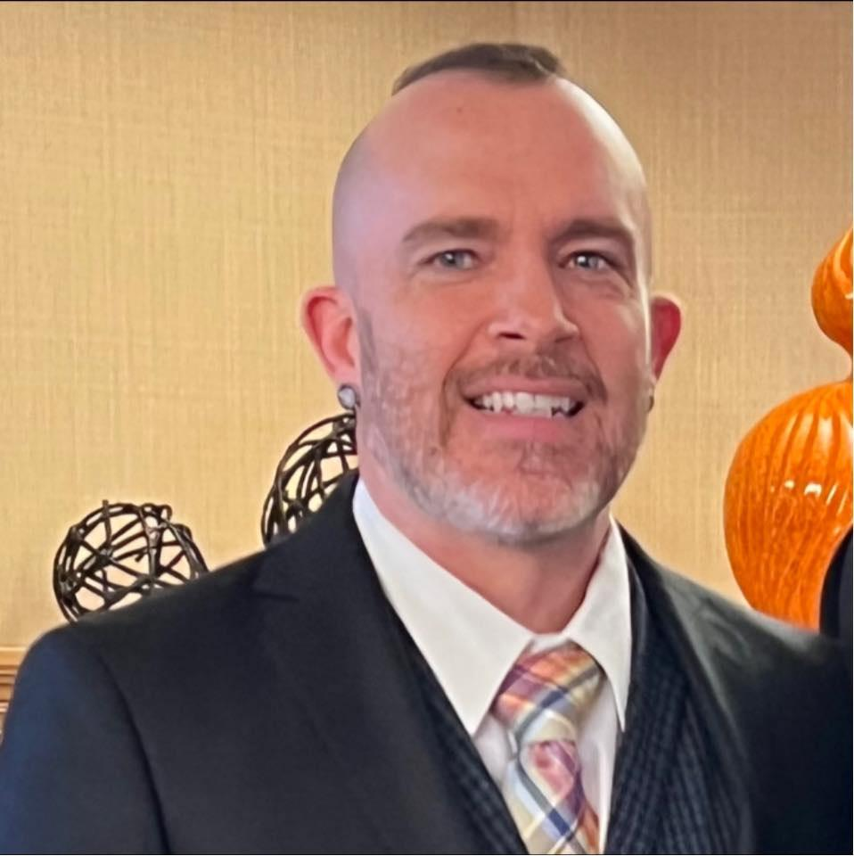
RDA-US - Program Officers
Beth Plale
Executive Director
Rob Quick
TIGRUS Program Manager
Yolanda Meleco
Strategic Communications
Robert Ping
RDA-US Program Manager

Slide 6
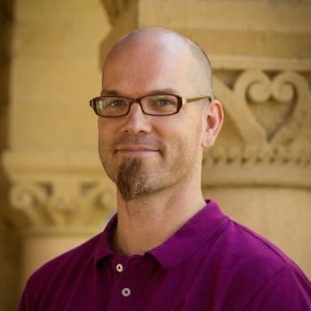
RDA-US - Thrust Leaders
Zach Chandler
Open Science
Sayeed Choudhury
Software
Vacant
Cyberinfrastructure
Notes:
Zach Chandler, Director of Open Scholarship Strategy, Stanford Data Science Initiative, Stanford University
Sayeed Choudhury, Associate Dean for Digital Infrastructure, Carnegie Mellon University

Slide 7
RDA-US - Big Picture
Official partner with the global RDA, representing the US region
Recognized advocate for open science
Amplifies the impact of RDA’s WG Outputs
Brings US-based issues in open science and data sharing to RDA through working groups, so together, we accelerate standardization
Administers US-funded programs that manage the success of these working groups

Slide 8
RDA-US Addresses Open Science and Scholarship
The RDA / RDA-US partnership is advancing research and education across our region and globally
RDA-US brings US a global perspective to the challenges of open science
By bringing solutions developed within the RDA to the US, RDA-US is helping US become an international leader in the implementation of open science standards
By bringing regional specific challenges to a global audience of experts, RDA is supporting the US to find solutions

Slide 9
RDA-US community
Partner orgs
Int’l perspec-tives
Engages expertise of
Involves representation of
Individuals / organizations
US Open Science need
TIGRUS facilitation program
RDA
Global
Works through
Facilitates successful execution of
WG
Promotion and Dissemination
Globally informed result
US Open Science Stake-
holders
TIGRUS facilitation program
Notes:
PIDS, National Strategy
Data Visitation and AI – ethics of
Early career fellowship experiences

Slide 10
TIGRUS* Facilitation Program
RDA-US run facilitation program that facilitates outcomes through RDA Working Group activity. The program takes in ideas for new RDA WG activity, facilitates fleshing out the working group proposal, facilitates execution of WG and fastlane to standards where available.
Once a WG is accepted by RDA, the program staff will help facilitate meetings, help with communication, help disseminate outputs.
*Targeted International working GRoup - US Program

Slide 11
Get Involved
Most RDA-US project communication is happening via Slack
Send me an email at rquick@iu.edu if you’d like an invite
If you are part of an existing RDA WG or would like to start an RDA WG please let me know, TIGRUS can be of assistance
Go to www.rd-alliance.org to review current WGs and IGs.

Slide 12
Current TIGRUS Efforts
National PID Strategies WG
Common Standards for Machine-Actionable Data Management Plans WG
Looking for additional WGs to support

Slide 13
Contact us
ResearchDataAllianceUS@gmail.com

