Slide 1
AI-ready Geospatial Data: Structured Hypercube for Geospatial Knowledge Understanding
Presenters: Wei Hu
University of Illinois Urbana-Champaign
I-GUIDE the Hypercube Team
AI-ready Data
Award #: 2118329
April 15, 2024

Slide 2
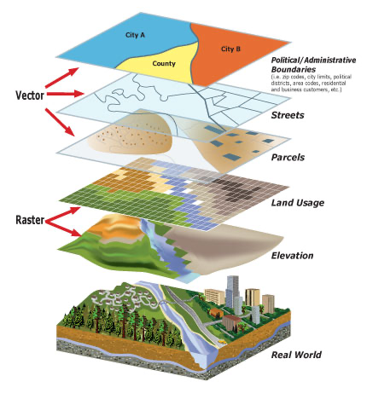
Geospatial Big Data Volume, Velocity, Variety, Variability, Veracity, Value, etc.
Heterogeneous
Syntactic
Semantic
Dynamic
Spatial and temporal
E.g. social media
Massive
Produced by individuals
Accessible to individuals
Large-scale
Global coverage
Fine granularity
Individual-level
High-resolution
Distributed access
Interoperability
Privacy
Security
Image: https://guides.lib.uw.edu/research/gis
Image: (Yang et al., 2017, p. 120)
‹#›
Notes:
Digital divide

Slide 3
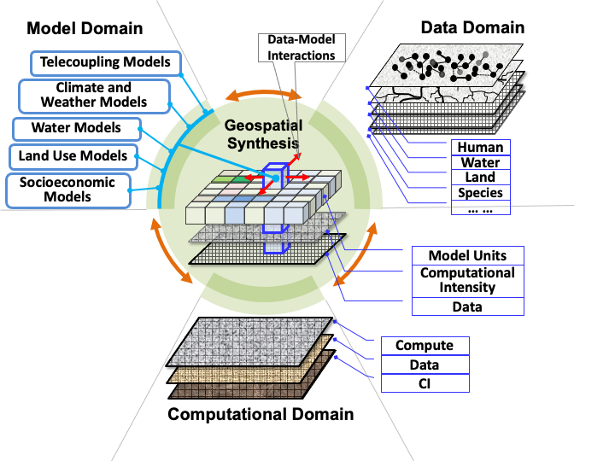
Geospatial Knowledge Hypercube
Convert unstructured information to structured knowledge
Synthesis geospatial knowledge into AI-ready hypercube
Digital discovery and innovation through harnessing the geospatial data revolution
Zhaonan Wang, Bowen Jin, Wei Hu, Minhao Jiang, Seungyeon Kang, Zhiyuan Li, Jiawei Han, and Shaowen Wang (2023) Geospatial Knowledge Hypercube. Proceedings of the 31st ACM SIGSPATIAL International Conference on Advances in Geographic Information Systems (ACM SIGSPATIAL 2023), Hamburg, Germany, November 13 – 16, 2023
‹#›

Slide 4
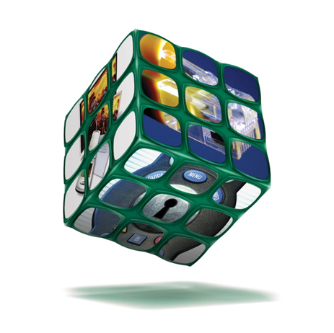
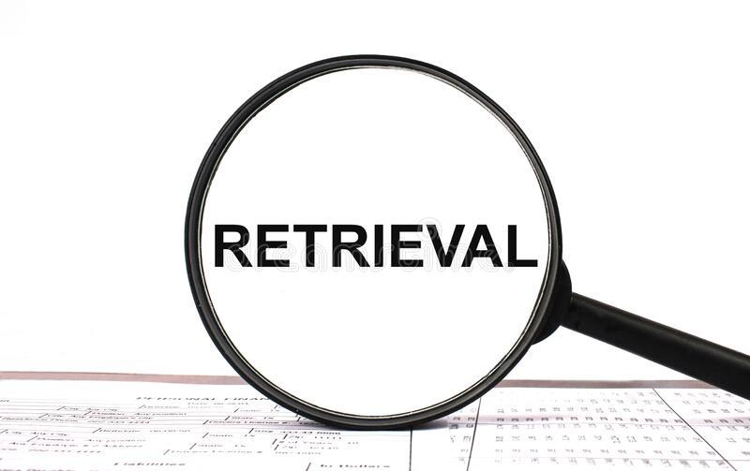
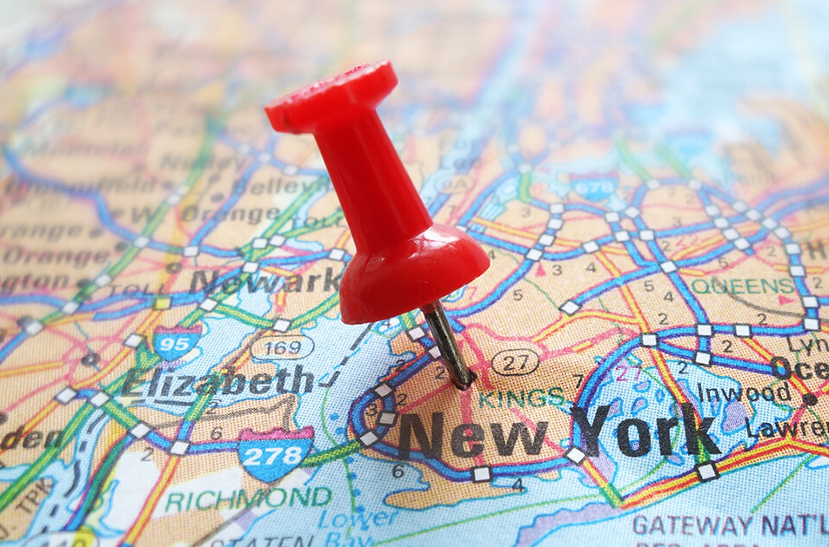
AI-ready Hypercube
Unstructured Data
Hypercube
Downstream Tasks
Multi-modality: text, map, etc.
Multi-source: news, social media, VGI, etc.
Diverse, dynamic, massive, and unstructured
Structured knowledge representation
Avoid heavy human labeling work
Text analysis
Information retrieval
Mapping
Knowledge discovery
LLMs QAs
‹#›
Notes:
understand text, generate structure representations for texts

Slide 5
Knowledge Hypercube for Aging Dams
Construct Hypercube as Metadata for Articles
Corpus
Weakly supervised input
domain knowledge/ontology guided
Aging Dams Hypercube
Edenville Dam
ID | Document Content
1 | Midland-area residents evacuate to high school after dam failure threatens city … on May 19, 2020 … Midland-area residents gathered to seek refuge within the walls of Midland High School Tuesday night after the Edenville Dam failed to hold back a deluge of water …
2 | …
Wilmore Dam
Sanford Dam
2019
1. Pre-defined cube dimensions:
<ID, dam, year, impact, …>
2. Impact taxonomy: Human, Economy, Ecosystem, Infrastructure
2020
2021
Ecosystem
Economy
Human
Cell: < 1, Human, Edenville Dam, 2020, …>
Zhaonan Wang et al. Geospatial Knowledge Hypercube, In Proc of 31st ACM International Conference on Advances in Geographic Information Systems (SIGSPATIAL’23). Hamburg, Germany, November 2023.
‹#›
Notes:
A simple illustration of aging dams hypercube:
News corpus related w/ dam failures
A few domain knowledge (hypercube design, and taxonomy for some dimensions)
Construct aging dams hypercube
Explicit representation + implicit representation

Slide 6
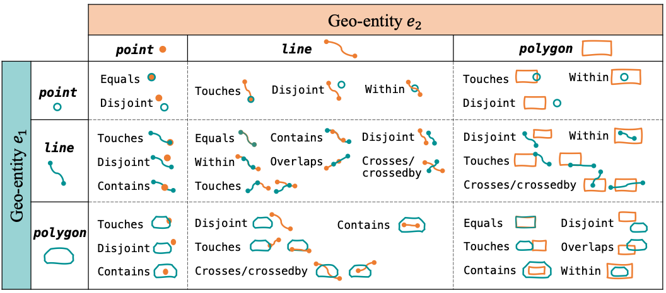
Knowledge Augmented Relation Extraction
Ontologies Facilitate Hypercube Construction
Domain definition for geospatial topological relations
Integrate domain knowledge bases
Wei Hu. et al. “Geospatial Topological Relation Extraction from Text with Knowledge Augmentation”, in Proc of 2024 SIAM Int. Conf. on Data Mining (SDM’2024), Houston, TX, April 2024

Slide 7
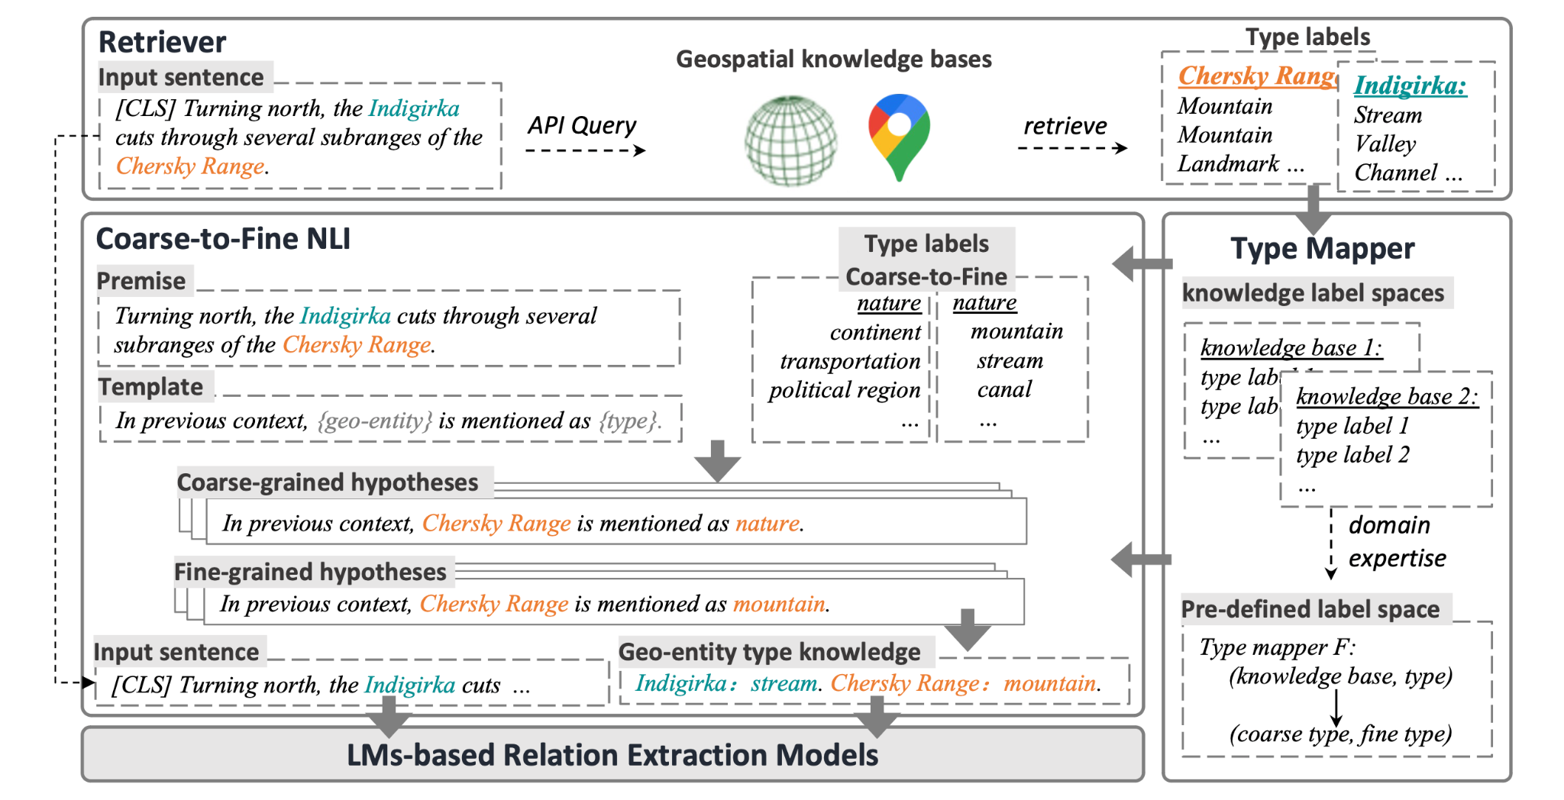
Knowledge Augmented Relation Extraction
Ontologies Facilitate Hypercube Construction
Text+Map
Integrate multi-source map data
Domain-knowledge guided: natural language & domain terminology
Wei Hu. et al. “Geospatial Topological Relation Extraction from Text with Knowledge Augmentation”, in Proc of 2024 SIAM Int. Conf. on Data Mining (SDM’2024), Houston, TX, April 2024

Slide 8
Challenges
Retrieval augmented generation
Geospatial constraint to generative AI output
Unify multi-source data ontology and taxonomy (AI vs Human)
Multimodal geospatial hypercube
Multi-source heterogeneity of geospatial data
Synthesis knowledge from multi modalities
Maps (cartography) as human intelligence for real-word observation (not AI-ready)
Benchmarks for intelligence knowledge understanding

Slide 9
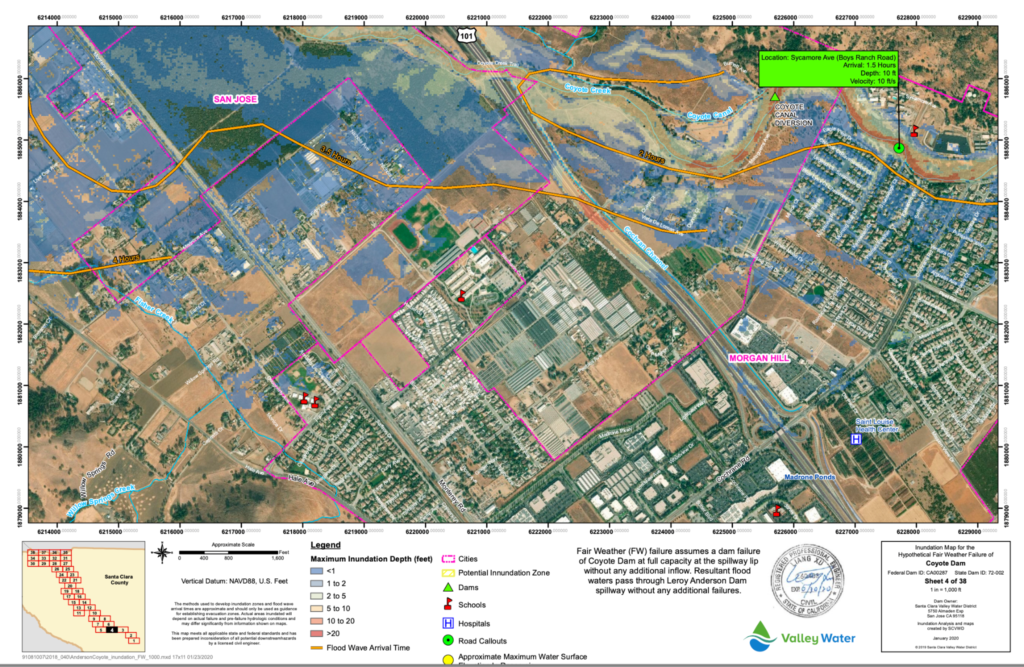

Slide 10
Challenges
Retrieval augmented generation
Geospatial constraint to generative AI output
Unify multi-source data ontology and taxonomy (AI vs Human)
Multimodal geospatial hypercube
Multi-source heterogeneity of geospatial data
Synthesis knowledge from multi modalities
Maps (cartography) as human intelligence for real-word observation (not AI-ready)
Benchmarks for intelligence knowledge understanding

Slide 11
Opportunities
Retrieval augmented generation
Unifying ontology and taxonomy for different data sources
Geospatial constraint for generative AI
Understand locations
Hypercube construction for multiple modalities
Sophisticated dimensions such as summary, causes, etc.
Hypercube construction with vision LLMs
Maps (cartography): theme, projection, area, knowledge conveyed
Hypercube-augmented LLMs for QA
Trustworthiness and robustness
‹#›
Notes:
Emphasize on weak supervision.
Network can 1) provide auxiliary signal onto text understanding; 2) provide distant supervision.

Slide 12
Thanks！
Comments / Questions?
Contact: weih9@illinois.edu
‹#›
Notes:
Flexible, first step, any ideas and thoughts

Slide 13
Understanding Dam Failure Events
with the Metacoupling Framework
 | Causes | Effects | Flows | Agents associated
Types | construction quality, dam age, weather, management, financial, human errors, etc. | demographic, economy, ecosystem, infrastructure, etc. | movement of information, water, goods, services, people, organisms, sediments, etc. | residents, NGOs, dam managers and owners, government agencies, etc.
At the dam site | dam age, construction quality, rainfall, human errors, etc. | infrastructure collapse, water loss, economic loss, etc. | movement of water, sediment, organisms, etc. | dam managers and owners
Near the dam site | rainfall flow to reservoir, etc. | deaths, injuries, flooding, damage to land, crops, livestock, roads, etc. | movement of information, financial capital, organisms, goods, services, people, etc. | farmers, residents, workers, teachers, students, etc.
Far away from the dam site | rainfall flow to reservoir, financial support, etc. | support for rescue and recovery, species invasion, economic production, etc. | movement of information, water, financial capital, sediment, people, etc. | government agencies, factories producing goods and products, etc.
‹#›

Slide 14
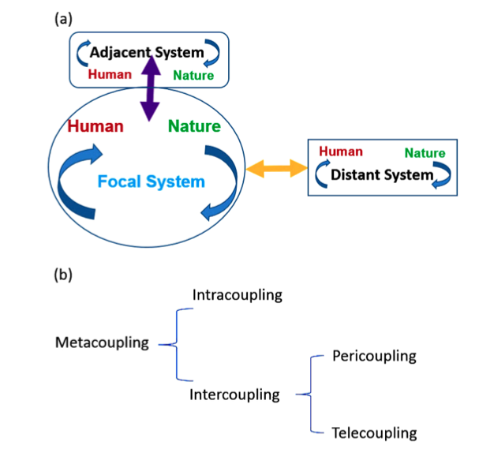
Metacoupling Framework
(a) A schematic diagram illustrating a focal coupled human and natural system, an adjacent system, and a distant system, as well as their interactions (indicated by arrows). (b) Metacoupling consists of intracoupling and intercoupling, which in turn includes pericoupling and telecoupling. “Integration across a metacoupled world” (Liu, 2017)
‹#›
Notes:
Understanding more with metacoupling framework

Slide 15



