Slide 1
Open Knowledge Networks, Knowledge Graphs, and AI-Ready Data
The NEBDHub, CIC and Proto-OKN
AI-Ready Data: Navigating the Dynamic Frontier of Metadata and Ontologies
Drexel University - Philadelphia, PA
April 15, 2024
Florence D. Hudson, Executive Director, Columbia University
PI NSF Northeast Big Data Innovation Hub, COVID Information Commons, Proto-OKN; US DOT FHWA TDSP
Founder, National Student Data Corps
Founder & CEO, FDHint, LLC; Editor & Author; IEEE Engineering in Medicine & Biology Society

Slide 2
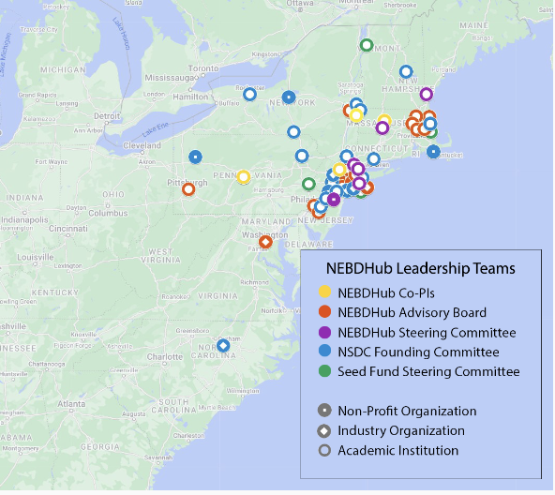
The Northeast Hub is a community convener, collaboration hub, and catalyst for data science awareness, education and innovation.
Our mission is to build a diverse, equitable, and inclusive community for data science learners, educators, researchers and professionals with open, free, online, accessible resources.
We strive to increase data science capacity and talent, emphasizing underserved communities.
PI Institution
Funded by NSF grants #1550284, 1748395, 1916585, 2028999, 2139391, 2333532;
NIH AIM-AHEAD;
US Department of Transportation.
Education + Data Literacy
Health
Urban to Rural Communities
Responsible Data Science: Security + Privacy + Ethics
http://nebigdatahub.org/about/

Slide 3
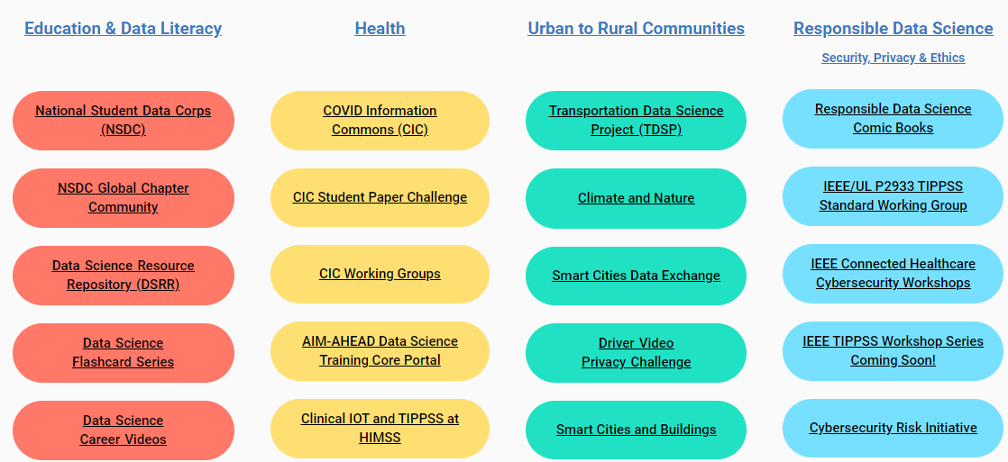
Northeast Big Data Innovation Hub
The NEBDHub is a community convener and collaboration network that fuels data science and AI innovation through diverse and inclusive partnerships, with a focus on underserved communities.
http://nebigdatahub.org/about/

Slide 4
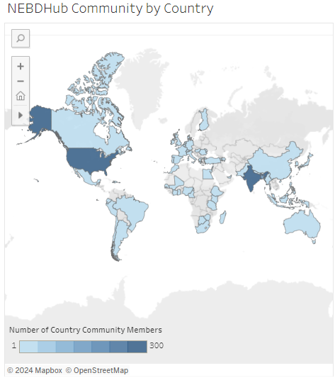
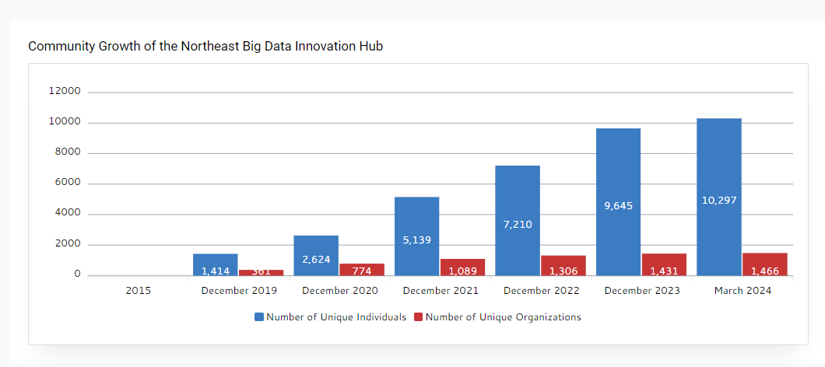
Northeast Big Data Innovation Hub Community
NEBDHub Community includes 10,297 individuals representing 1,466 organizations, from all 50 States, plus Puerto Rico and Washington, D.C.,
and 62 other countries!
https://nebigdatahub.org/hub-community-engagement/

Slide 5
COVID Information Commons (CIC)
Portal and Community
Supported by National Science Foundation awards #2028999 and #2139391.
https://covidinfocommons.net/

Slide 6
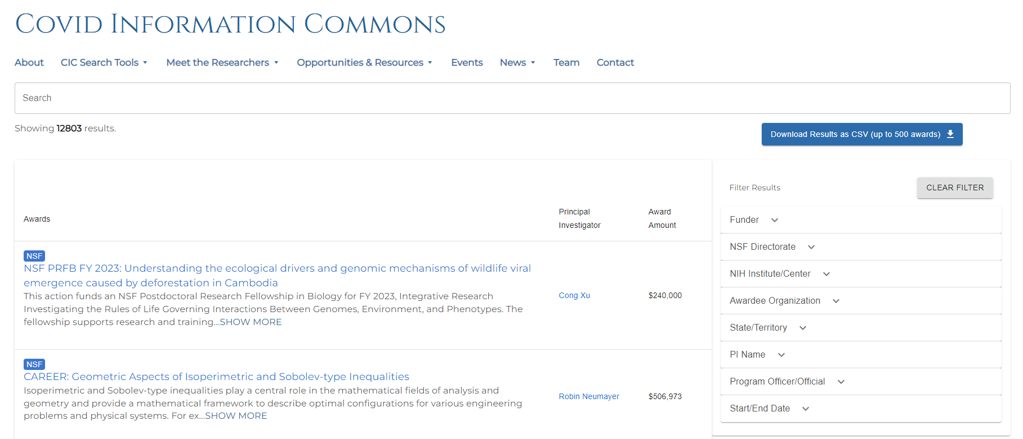
COVID Awards and Researcher (PI) Database
CIC Database includes
12,800+ NSF & NIH
COVID-related awards.
Browse the Database: https://bit.ly/cic-award-search
System Architect - Ryan Scherle
https://covidinfocommons.net/

Slide 7
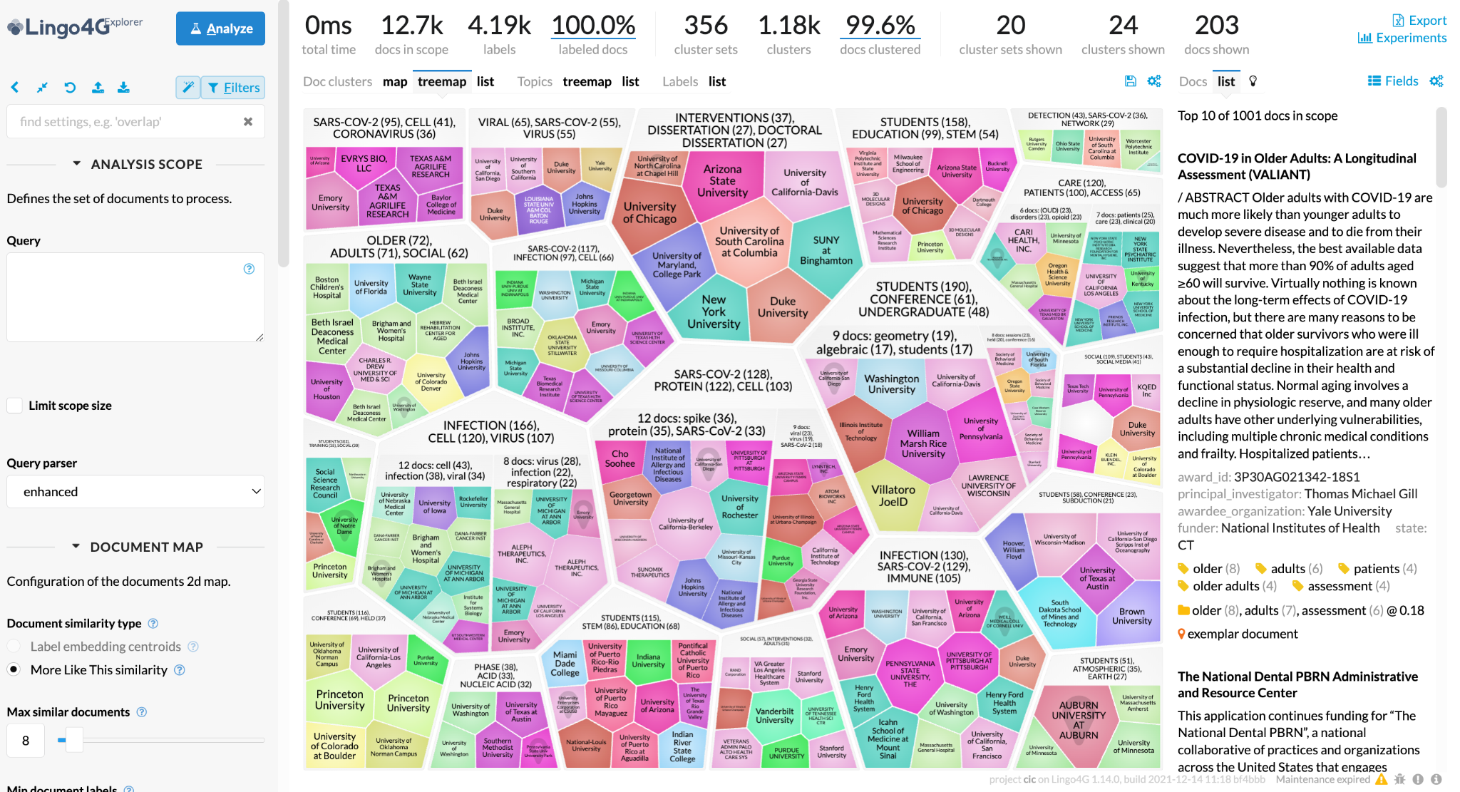
COVID Information Commons - COVID Research Explorer
Clusters projects by topic
Finds semantically-similar documents, even if the documents don't share common words or phrases.
Presents maps of COVID research and researchers by topic or Principal Investigator (PI) name, institution, location
User inputs keyword queries to focus on target domains
https://covidinfocommons.net/

Slide 8
https://www.proto-okn.net/

Slide 9
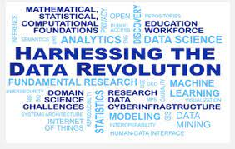
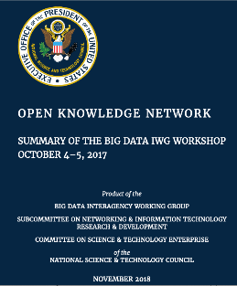
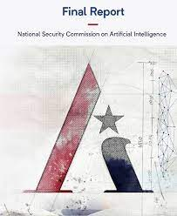
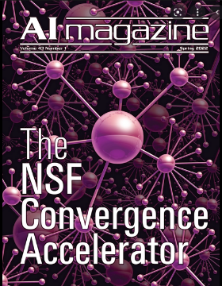
Proto-OKN Background
OKN Vision: An interconnected network of public data to help power the next wave of AI exploration, while addressing various societal challenges.
Convergence Accelerator
Track A: Open Knowledge Network 2019-2022
Report of the National Security Commission on AI. Recognizes the need for OKN
NSF Harnessing the Data Revolution Big Idea
Big Data Interagency Working Group Workshop on OKN @ NLM
2017
Oct 2018
Sept 2019
March 2021
March 2022
Sept 2022
March 2023
Oct 2023
Proto-OKN Kickoff
Proto-OKN Innovation Sprint, Feb-June 2022.
Design Workshop, June 2022,
OKN Roadmap Report, Sept 2022
Special Issue of the AI Magazine on OKN
“Knowledge Graphs”—a data-driven definition: Real-world entities and the relationships among them

Slide 10
Proto-OKN Program Structure
Theme 1 Awards: Use Case Projects (15)
Focus on the creation of knowledge graphs to address specific societal challenges
Theme 2: Proto-OKN Fabric Projects (2)
Develop and deploy a platform to interconnect KGs and create a cloud-based infrastructure
Theme 3: Education and Outreach Project (1)
Develop education and outreach resources for a variety of stakeholders
All 18 projects required to work together as a single cohort

Slide 11
Proto-OKN Use Cases: 15 Theme-1 Projects
BioBricks- Environmental Health
Space Biology
Biomedical and Social Determinants of Health Data
SAWGraph – Safe Agricultural Products
WEN-OKN: The Water-Energy Nexus
Wildlife Management
Search/Discovery of Climate Models
Soil Carbon Information (with USDA)
Health + Justice Data for Rural Resilience
IJP - Integrated Justice Platform
A KG Warehouse for Neighborhood Information
Information to Assist Homeless populations
CollabNext – People Network
Software Supply Chains
SUDOKN – Supply and Demand for Manufacturing Supply Chains
https://www.proto-okn.net/theme-1-projects/
Notes:
Biology and Health (3)
BioBricks-OKG An Open Knowledge Graph For Cheminformatics And Chemical Safety
Connecting Biomedical information on Earth and in Space via the SPOKE knowledge graph
A Dynamically-Updated Open Knowledge Network for Health: Integrating Biomedical Insights With Social Determinants of Health
Environment (5)
Safe Agricultural Products and Water Graph (SAWGraph)
WEN-OKN: The Water-Energy Nexus OKN
KN for Comprehensive Wildlife Management under Climate Change
Knowledge Graph to Support Evaluation and Devt of Climate Models
Digging Into Soil Carbon With USDA: A Knowledge Graph Informing Soil Carbon Modeling
Justice (4)
Cross-Domain KG to Integrate Health + Justice for Rural Resilience
IJP - Integrated Justice Platform to connect criminal justice data across data silos
A KG Warehouse for Neighborhood Information
DREAM-KG: Develop Dynamic, Responsive, Adaptive, and Multifaceted KGs to Address Homelessness With Explainable AI
Technology and Manufacturing (3)
CollabNext: A Person-Focused Metafabric for Open Knowledge Networks
Knowledge Graph Construction for Resilient, Trustworthy, and Secure Software Supply Chains
Supply and Demand Open Knowledge Network (SUDOKN)

Slide 12
Proto-OKN Fabric – 2 Theme-2 Projects
Work with Theme-1 projects to develop and prototype a robust, scalable, cloud-based technical infrastructure.
Support Theme-1 projects in deploying their prototypes on common infrastructure for Beta demonstrations in Year 2.
Develop a common infrastructure to be supported in Years 3 and 4.
https://www.proto-okn.net/theme-2-projects/
Notes:
Anish -> Ashish

Slide 13
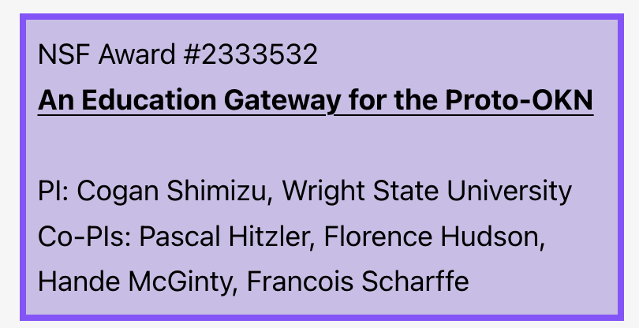
Theme 3 – Proto-OKN Education and Public Engagement
Create educational and training materials and tools addressing the broad range of users of the Proto-OKN.
Goal of the education and training materials is to help explain how the Proto-OKN impacts society and help prospective users understand how to engage.
https://www.proto-okn.net/theme-3-projects/

Slide 14
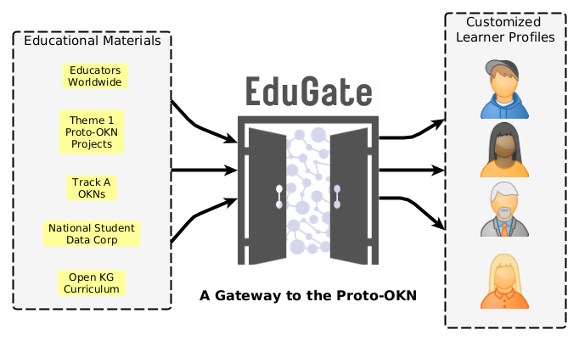
Proto-OKN Education and Training:
1 Theme-3 Project - EduGate
Educational gateway to the Proto-OKN
We are collecting educational materials/ tools from around the world to enable OKN + KG use by industry, government, nonprofit, and academic users - leaders, developers, students, educators.
Organizing materials into customized learning paths for different users.
Seeking OKN + KG educational materials from KG and ontology experts - like you!.
Email us! edugate@proto-okn.net

Slide 15
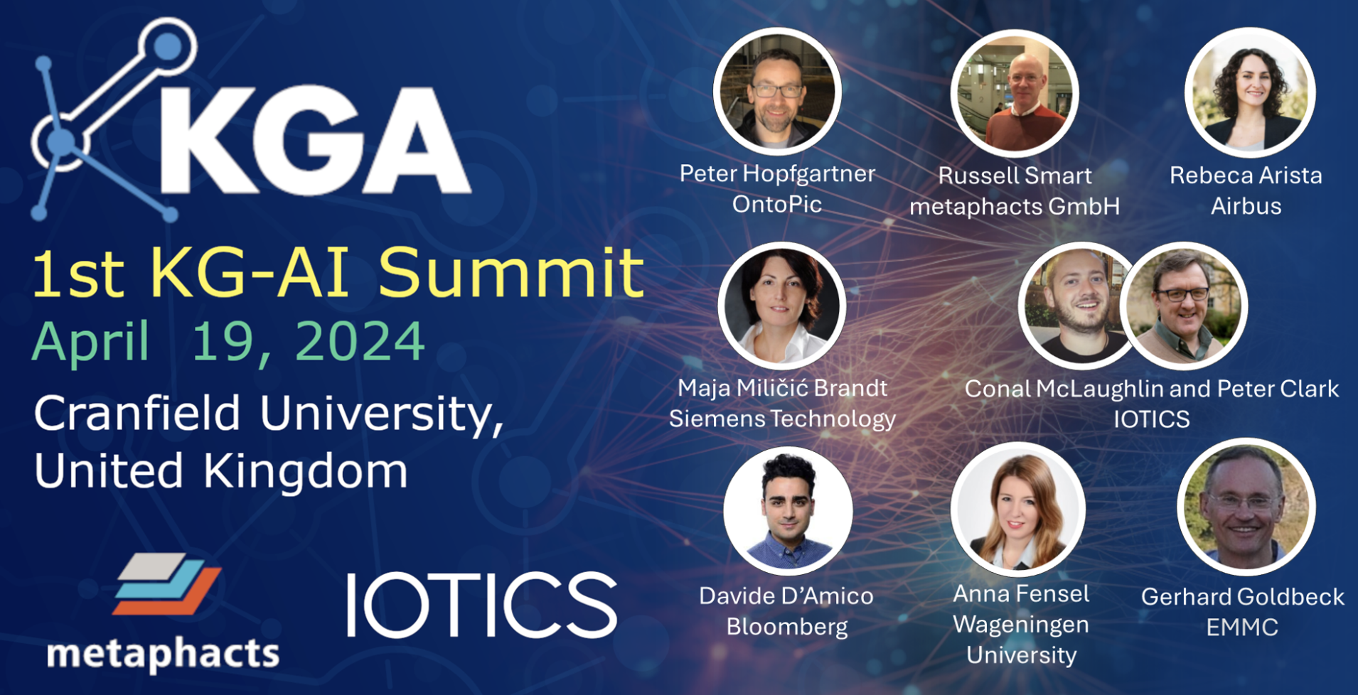
Virtual Knowledge Graphs
for making your data AI-ready
In person and online - https://www.kg-alliance.org/kg-ai-summit-april-19/

Slide 16
Q&A
Thank you!
Florence D. Hudson
Executive Director, Northeast Big Data Innovation Hub at Columbia University
florence.hudson@columbia.edu
https://nebigdatahub.org/about

Slide 17
Proto-OKN Program Deliverables
6 Months
15 Months
24 Months
36 Months
48 Months
Presentation of concept:
alpha-level deliverable
Presentation of concept: beta-level deliverable
Demonstration of beta version
Project closeout presentations
02
04
05
Proto-OKN Fabric
FY24
FY25
FY26
Q1
Q2
Q3
Q4
Q1
Q2
Q3
Q4
Program kickoff
October 2023
Q1
Q2
Q3
Q4
Q1
Q2
Q3
Q4
Q1
Q2
Q3
Q4
FY27
FY28
Theme 1, Theme 3
Theme 2
01
03
06
3 Months
12 Months
30 Months
Definition of alpha-level deliverables
Demonstration of alpha version
Deployment

Slide 18
Proto-OKN Cross-Domain Working Groups
Multi-Agency KG Task Force
Census data-based data integration
AI, Ethics, and Data Governance Advisory Board
Geospatial data representation and KnowWhereGraph
Use of LLM’s

Slide 19
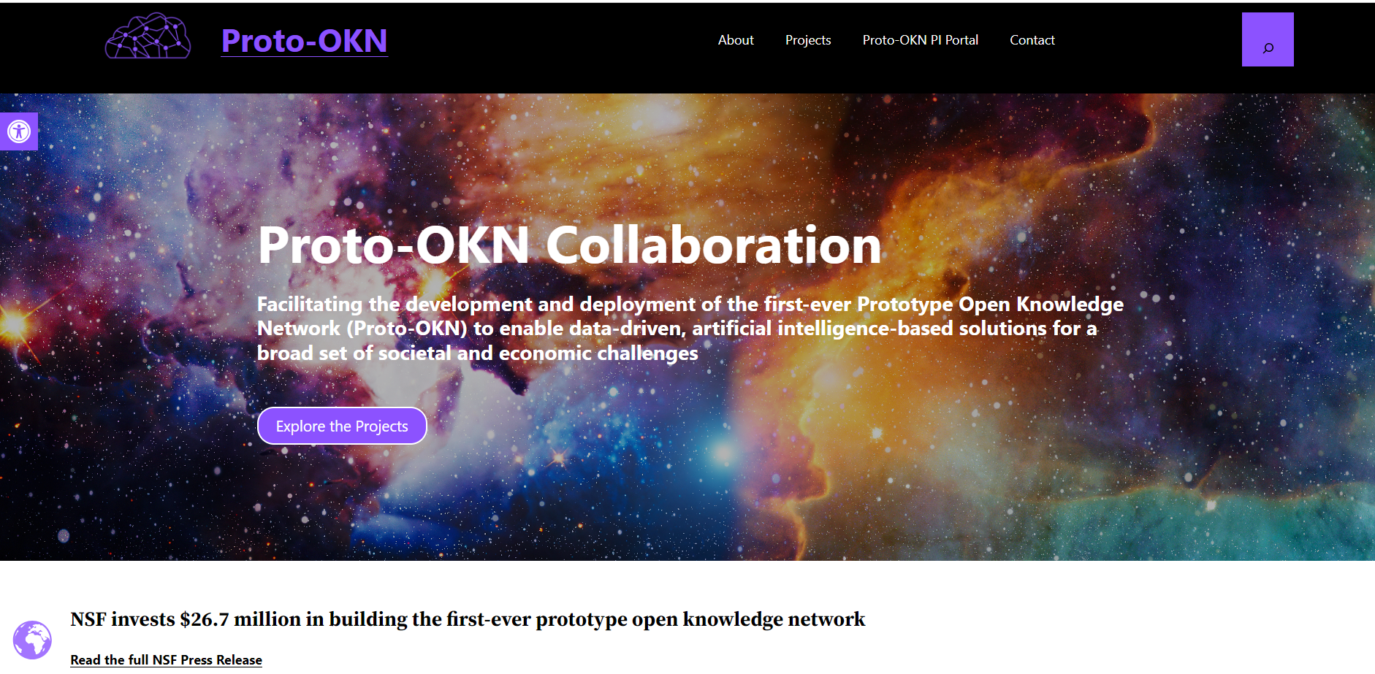
Program Site: proto-okn.net

Slide 20
Acknowledgements
NSF: Jemin George, Program Director for Proto-OKN, TIP/ITE
FRINK: Chris Bizon, UNC, PI
SPIDER: Jayachandran Guha, ONAI, PI
EduGate: Cogan Shimizu, Wright State, PI
Entire Proto-OKN team/cohort!

Slide 21
Proto-OKN Team: Multi-Agency Effort
 | National Science Foundation Directorate for Technology, Innovation and Partnerships
 | National Aeronautics and Space Administration Biological and Physical Sciences Division
 | National Institutes of Health Office of Data Science Strategy
 | National Institute of Justice
 | National Oceanic and Atmospheric Administration National Centers for Environmental Information
 | U.S. Geological Survey National Geospatial Technical Operations Center

Slide 22
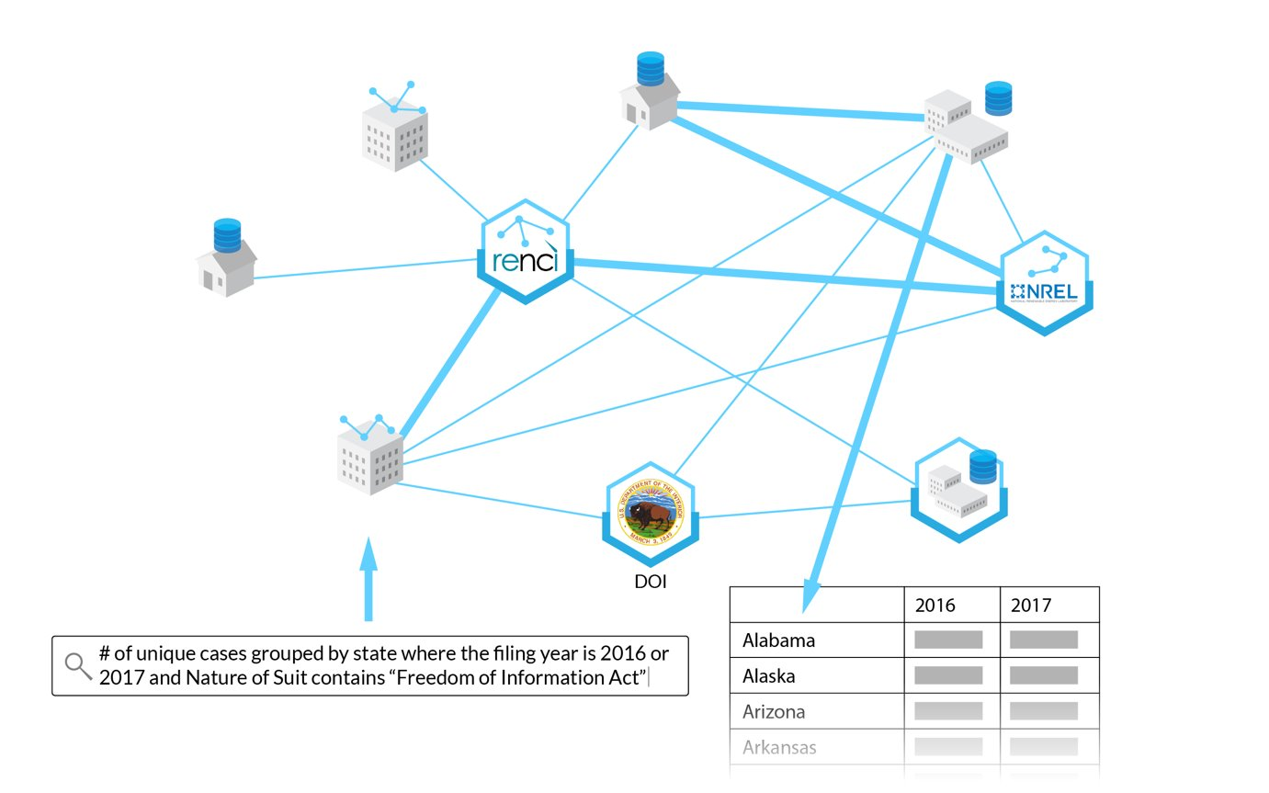
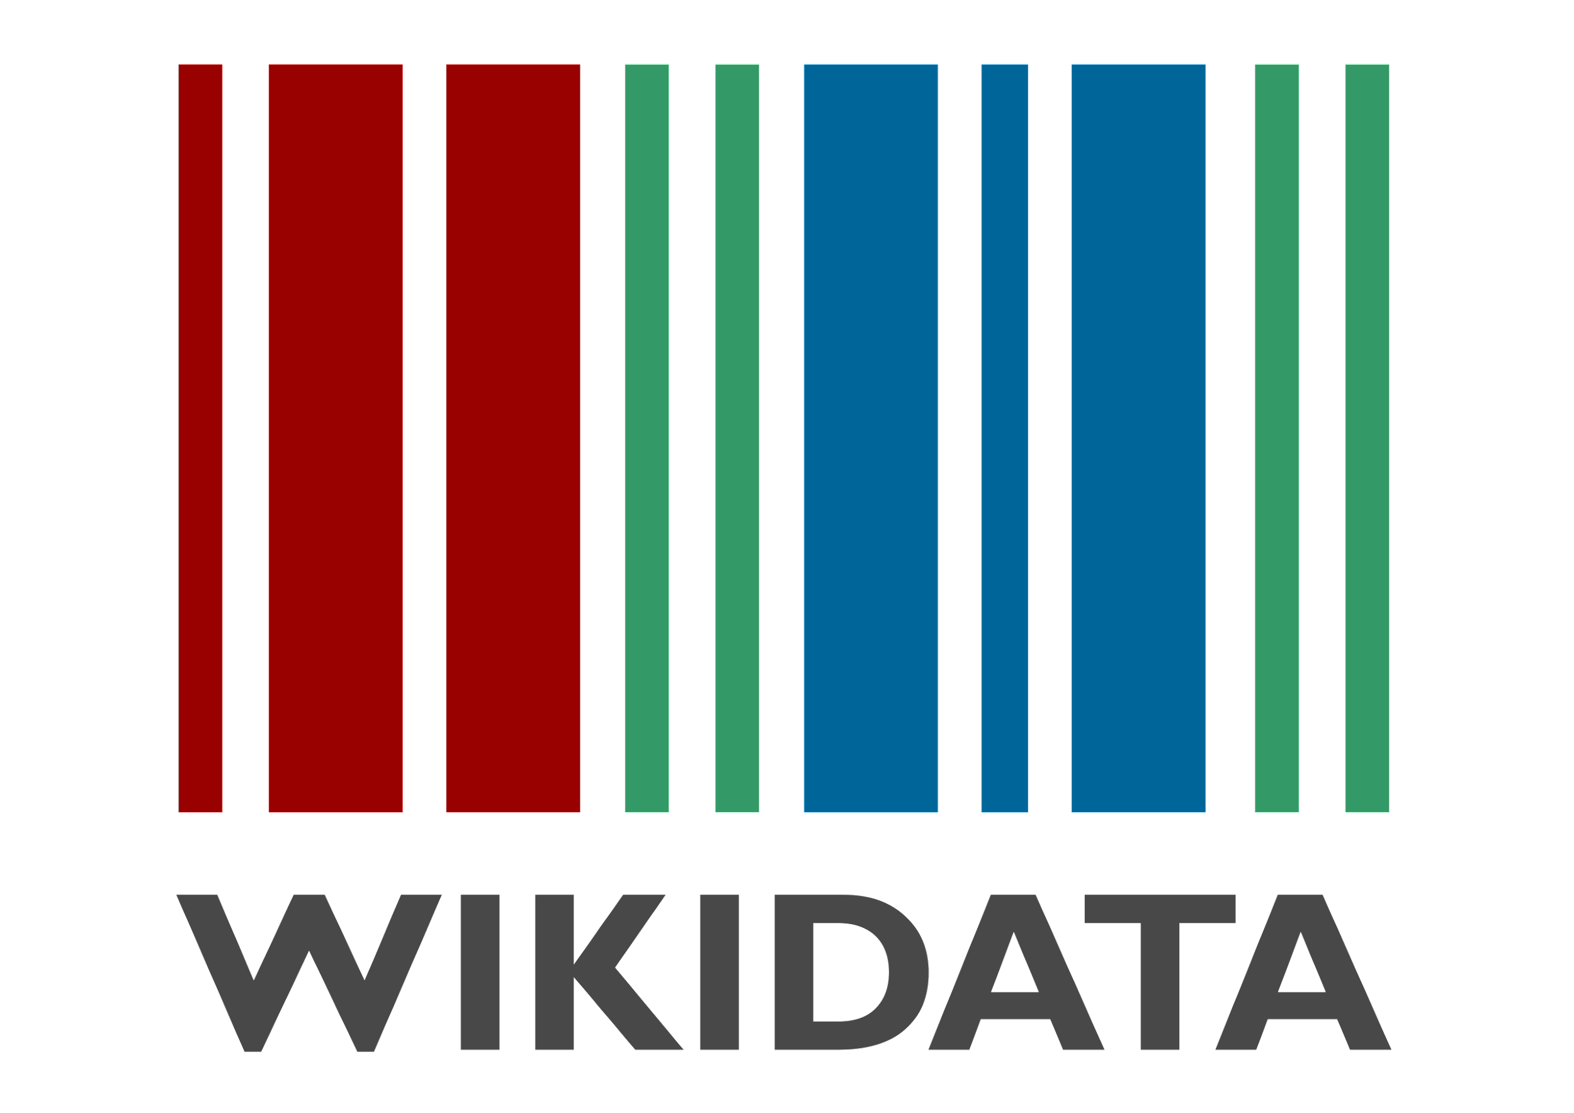
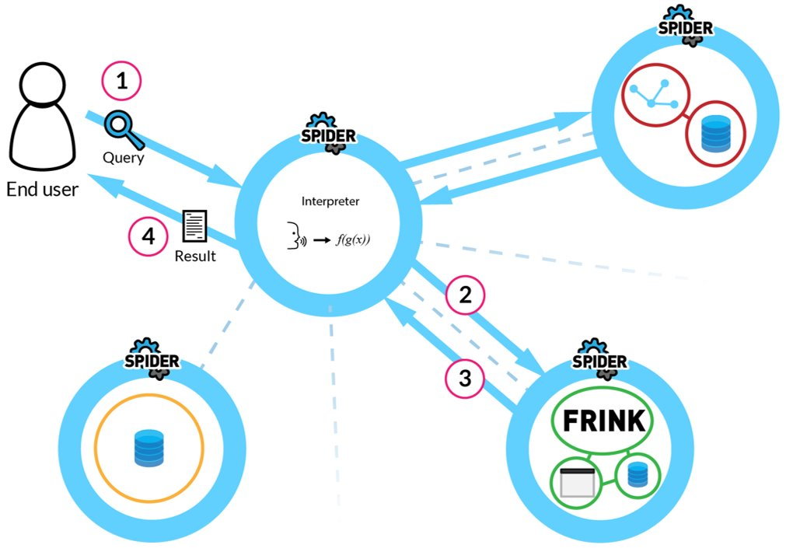
Proto-OKN Fabric Concepts
Social Fabric
From the FRINK Project
KG1
Use Wikidata as a shallow but broad graph fabric to link Proto-OKN deep graphs (requires entity-mapping)
Knowledge Fabric
KG2
KG3
Federated
System
Use of LLM and other technologies for
request processing
From the SPIDER Project
Technical Fabric

Slide 23
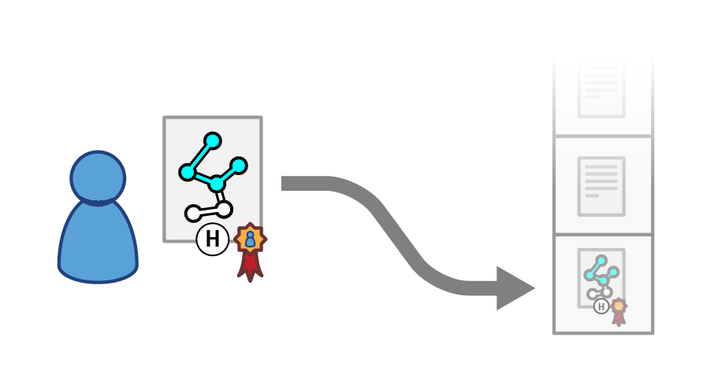
Theme 2 - SPIDER - Scalable Public Infrastructure for Distributed Entity Relationships
Target: Scalable decentralized infrastructure for knowledge graph applications, enabling powerful queries, artificial intelligence training/inference, provenance, and more.

Slide 24
Theme 2 - SPIDER - Scalable Public Infrastructure for Distributed Entity Relationships
SPIDER provides the underlying base layer and also handles top level user input – Example:
Query sent to a SPIDER "Interpreter" instance, which leverages an LLM to convert the query to specific calls
Interpreter invokes the determined functionality at other relevant instances​ (including FRINK)
Response is returned for presentation preparation​
Result presented to user​

Slide 25
Theme 2 – FRINK - FabRic Integrating Network Knowledge
Project Overview
Knowledge Fabric: Standardization and Transformation of Theme 1 projects into a common knowledge framework.
Technical Fabric: Deployment of standardized KGs into a common framework, and expose graphs and derivatives through an API toolkit.
Social Fabric: Work with Themes 1, 2, and 3 to establish a common vision and set of goals, as well as agreement on technical details.

Slide 26
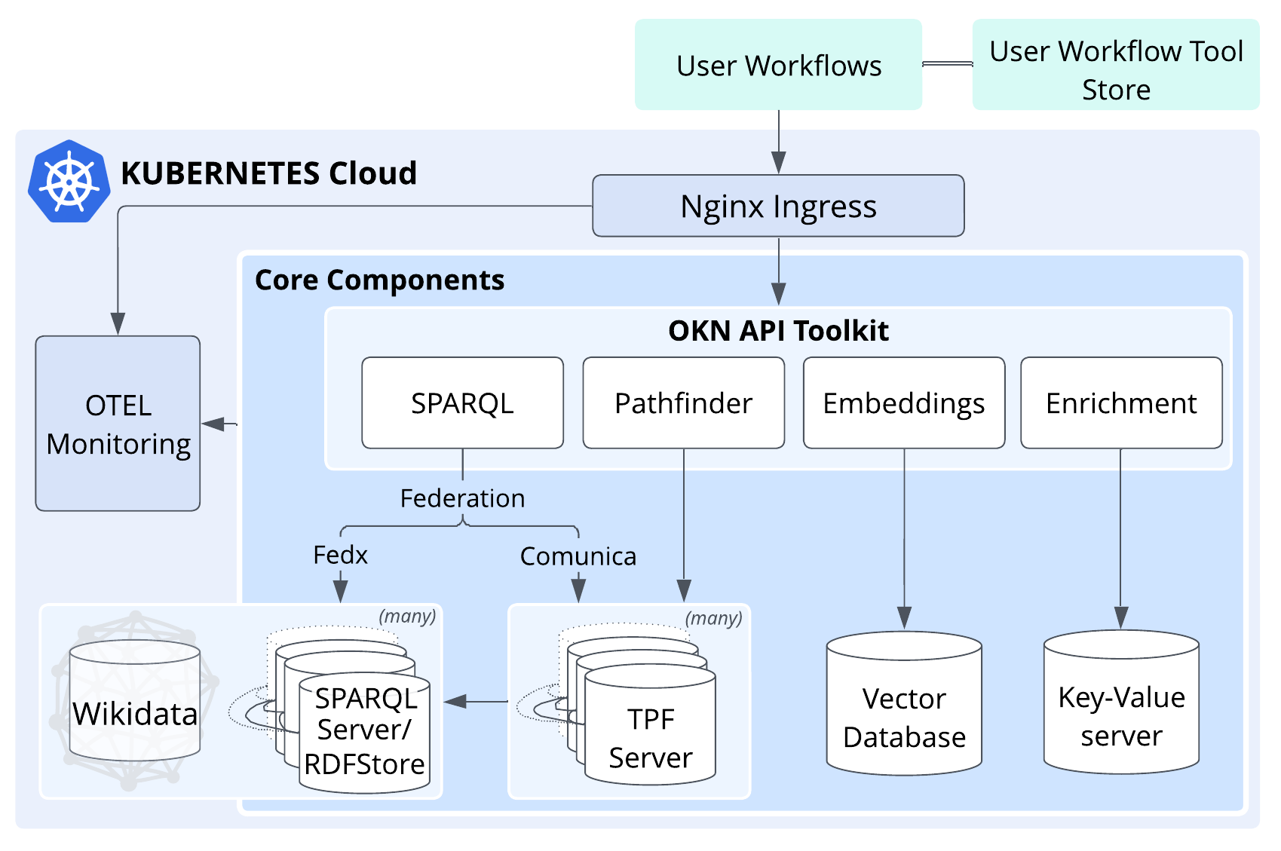
Theme 2 – FRINK - FabRic Integrating Network Knowledge
Technical Fabric: Deployment and OKN API Toolkit
FRINK will deploy these standardized graphs into a common cloud-based framework.
This framework will implement numerous APIs to provide apparently merged access and analytics to the internally federated graphs.
RDF A
RDF B
RDF C

