Slide 1
Large Language Models and Knowledge-Indicative Graphs
Bowen Jin
Department of Computer Science
University of Illinois at Urbana-Champaign
Apr 15, 2024

Slide 2
Outline
Why Mining Knowledge-Indicative Graphs with Large Language Models?
Three Main Scenarios
Current Progress on AI-ready data
Challenges and Future

Slide 3
Knowledge-Indicative Graphs
Graph data is ubiquitous in real world.
Knowledge-Indicative graph: graphs which contains knowledge.
Traffic Graphs
Protein Graphs
Molecule Graphs
Academic Graphs
Social Graphs
H
V
L
“Benzene is toxic”
T
P
E
E
H
K
O
“Water is less toxic”
“Myoglobin holds oxygen in muscles.”
H

Slide 4
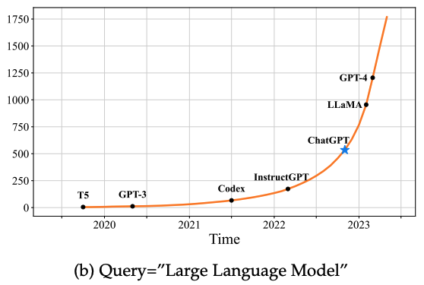
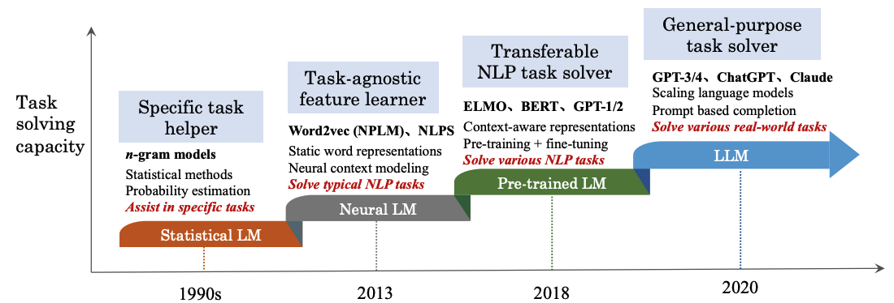
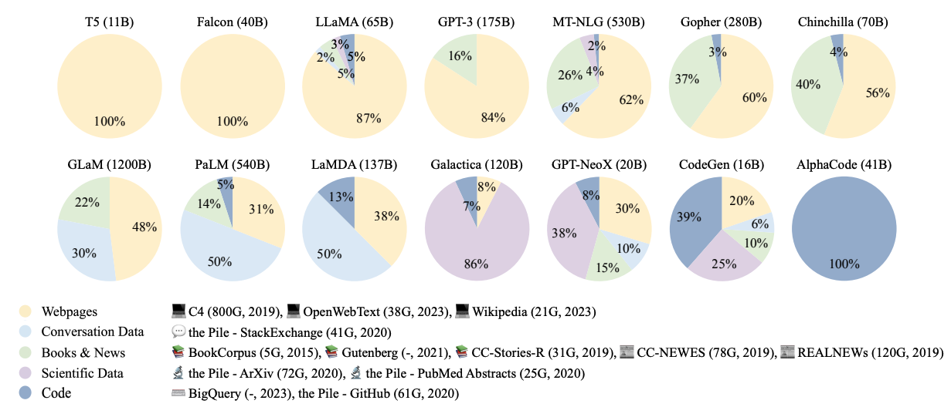
Large Language Models (LLMs)
LLMs have demonstrated their strong text encoding/decoding ability.
LLMs have shown newly found emergent ability (e.g., reasoning).

Slide 5
Why LLM on Graphs?
In real world, text and graph usually appears simultaneously.
Text data are associated with rich structure information in the form of graphs.
Graph data are captioned with rich textual information.
blog corpus
paper corpus
POI corpus
Academic Network
paper
`
Social Media Network
author
blog
venue
user
tag
H
V
L
“Benzene is toxic”
T
P
E
Protein Graphs
E
Molecule Graphs
K
H
O
“Water is less toxic”
“Myoglobin holds oxygen in muscles.”
H
Notes:
Large language models (LLMs), such as ChatGPT and LLaMA, are creating significant advancements in natural language processing.

Slide 6
Why LLM on Graphs?
Although LLMs have shown their pure text-based reasoning ability, it is underexplored whether such ability can be generalized to graph scenarios (i.e., graph-based reasoning)
Notes:
Large language models (LLMs), such as ChatGPT and LLaMA, are creating significant advancements in natural language processing.

Slide 7
Knowledge-Indicative Graphs
Three main scenarios
Traffic Graphs
Protein Graphs
Molecule Graphs
Academic Graphs
Social Graphs
H
V
L
“Benzene is toxic”
T
P
E
E
H
K
O
“Water is less toxic”
“Myoglobin holds oxygen in muscles.”
H
Text-Paired Graphs
Text-Attributed Graphs
Pure Graphs
Jin, et al. Large Language Model on Graphs: A Comprehensive Survey. Arxiv. 2023.12.

Slide 8
Outline
Why Mining Knowledge-Indicative Graphs with Large Language Models?
Current Progress on AI-ready data
MAPLE: AI-ready text-attributed graph data
GRBench: AI-ready LLM graph reasoning data
Challenges and Future

Slide 9
Text-attributed Graph
A graph where nodes/edges are associated with rich text information.
blog corpus
paper corpus
POI corpus
paper
`
author
blog
venue
user
Academic Network
tag
POI Visit Network
E-commerce Network
Social Network

Slide 10
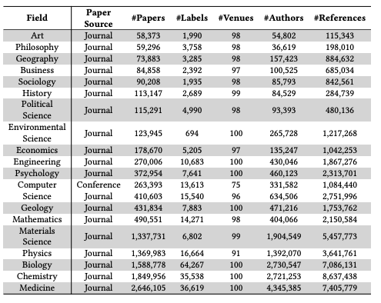
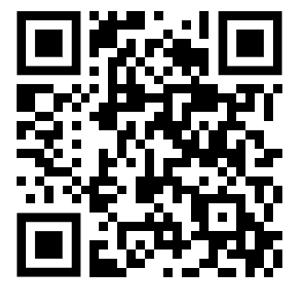
MAPLE Benchmark
Academic text-attributed graphs cross 20 domains.
Constructed with academic paper meta-data
data
code
Zhang, et al. The Effect of Metadata on Scientific Literature Tagging: A Cross-Field Cross-Model Study. WWW 2023.

Slide 11
LLM Reasoning on Knowledge-Indicative Graphs
Graph CoT
Iteratively traverse on graph & reasoning with LLM
Jin, et al. Graph Chain-of-Thought: Augmenting Large Language Models by Reasoning on Graphs. Arxiv’24.

Slide 12
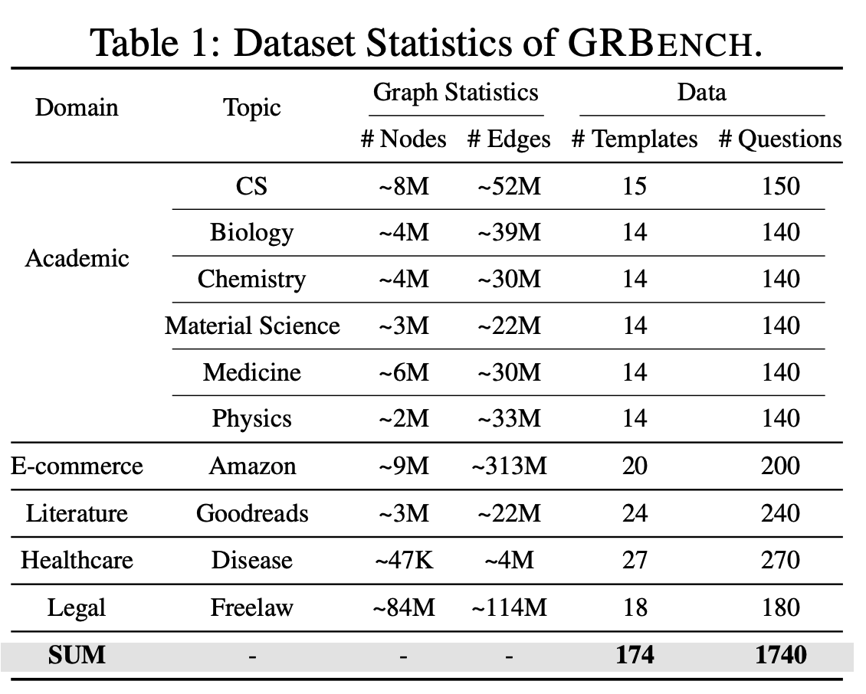
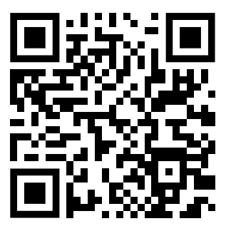
GRBench
LLM reasoning with knowledge-indicative graph data
data
code
Jin, et al. Graph Chain-of-Thought: Augmenting Large Language Models by Reasoning on Graphs. Arxiv’24.

Slide 13
Outline
Why Mining Knowledge-Indicative Graphs with Large Language Models?
Current Progress on AI-ready data
Challenges and Future

Slide 14
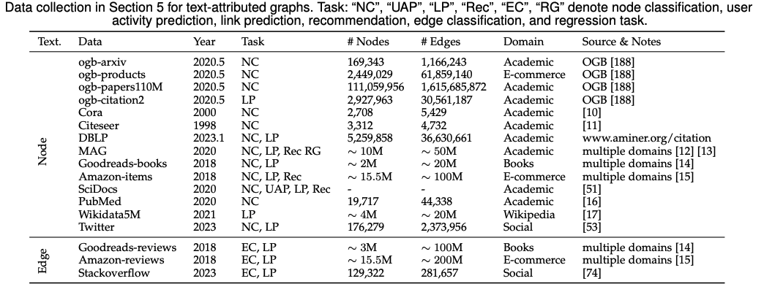
Future Directions
More diverse datasets from multiple domains are needed (e.g., legal and healthcare).
Jin, et al. Large Language Model on Graphs: A Comprehensive Survey. Arxiv. 2023.12.

Slide 15
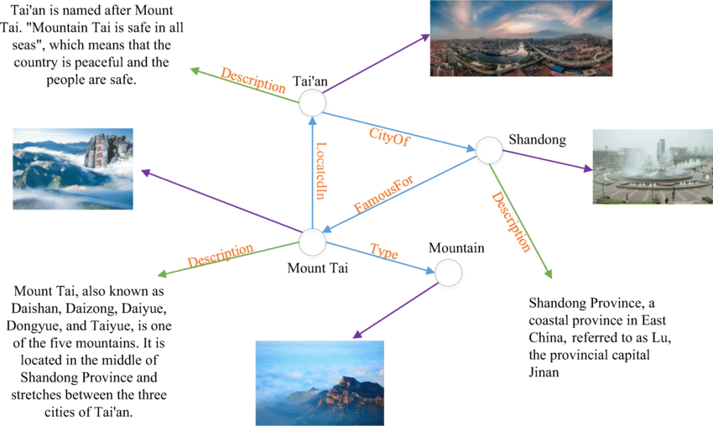
Future Directions
Multi-Modal data (e.g., image, text, audio, etc) are linked as a graph.
Song, et al. How to Bridge the Gap between Modalities: A Comprehensive Survey on Multimodal Large Language Model. Arxiv. 2023.11.

Slide 16
Q&A

