Slide 1
Knowledge Graph Question Answering for
Materials Science (KGQA4MAT)
  College of Computing and Informatics, MRC, Drexel University
  Dr. Yuan An, Dr. Jane Greenberg, Alex Kalinowski, Xintong Zhao, Dr. Xiaohua Hu
  ~
  Dept. of Chemistry, University of Central Florida
  Dr. Fernando J. Uribe-Romo, Kyle Langlois, Jacob Furst
  ~
  Dept. of Chemical and Biological Engineering, Colorado School of Mines
  Dr. Diego A. Gómez-Gualdrón,

Slide 2
Scope
In this project, we investigate natural language interfaces for querying structured MOF data stored in a MOF knowledge graph.
With the exceptional NLP abilities of LLM, we develop and evaluate strategies to prompt LLM for translating NL questions to KG queries.

Slide 3
Building a Knowledge graph for mof (mof-kg)
We built a knowledge graph that integrates disparate MOF databases and extracted property data and synthesis procedures from publications
It enables query, computation, reasoning for deriving new knowledge

Slide 4
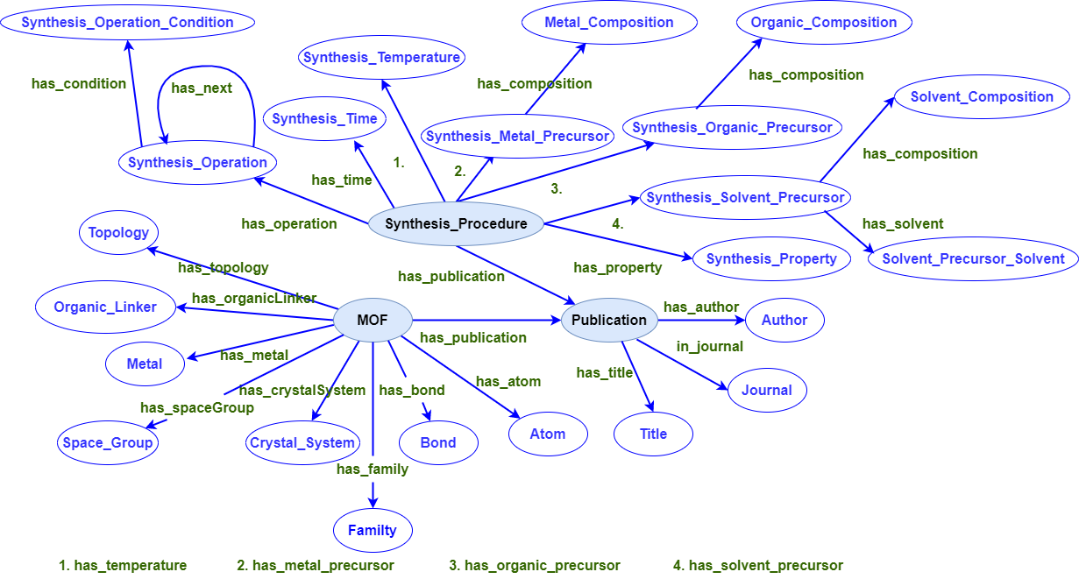
Mof ontology for the mof-kg

Slide 5
Sources for Building mof-kg
Structured databases:
  Cambridge Structural Database (CSD)
  Materials Project
  MOFXDB
  CoRE MOF
  ToBaCCo
  More
Unstructured data: scholarly articles describing MOF synthesis procedures

Slide 6
What is knowledge graph question answering (KGQA)?
KGQA aims to enable end users to pose natural language questions and receive answers from knowledge graphs (KGs)
The MOF-KG in the Neo4j platform requires a formal query language, Cypher, to access the information.
Writing Cypher queries is a significant technical barrier for domain experts.
It is crucial to devise a natural language query interface.

Slide 7
Progress and challenges
Existing KGQA systems employ rule-based, template-based, machine learning, and deep learning methods.
Benchmark datasets are crucial for evaluating the performance of KGQA systems and fostering advancements in the field.
Well-known benchmark datasets: QALD series, LC-QuAD series, and SciQA.

Slide 8
Progress and challenges
Our first task was to develop a benchmark data.
Incorporate a diverse range of question types, domain-specific language, and complex relationships found within the MOFKG.
Contains 161 unique questions each of which has 3 different variations, totaling 644 questions.
Split the data into train and test sets by the ratio 80:20.

Slide 9
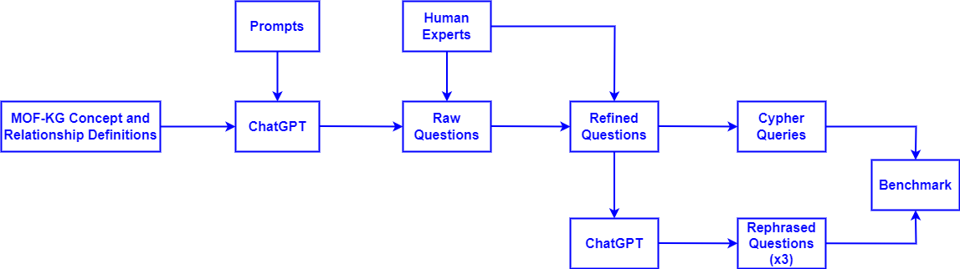
Building the kgqa4mat benchmark
Leveraged the exceptional capacity of ChatGPT to generate questions and variations involving facts, comparison, superlative, and aggregation.
Manually created corresponding Cypher queries

Slide 10
Developing LLM-based strategies for kgqa4mat
Employed zero-shot, few-shot, and chain-of-thought strategies.
For few-shot learning, embedded all the training and test questions to compute the cosine similarity between the two questions.
For chain-of-thought reasoning, instructed the LLM to generate the chain of thought for a given Cypher query, then refine the reasoning steps manually.

Slide 11
Kgqa4mat results
Method | F1 Score
Method 1: Zero-shot learning from MOF-KG ontology only | 0.411
Method 2: 1-shot learning from a pair of train question and query | 0.829
Method 3: 1-shot learning from the MOF-KG ontology and a pair of train question and query | 0.845
Method 4: 1-shot learning from a pair of train question and query, and the chain-of-thought of the train query | 0.876
Method 5: 1-shot learning from the MOF-KG ontology and a pair of train question and query, and the chain-of-thought of the train query | 0.891

Slide 12
Evaluation on qald-9
QALD-9 contains natural language questions and corresponding SPARQL queries over DBpedia.
A multilingual question answering benchmark containing 408 train questions and 150 test questions.
Evaluated its English version of train and test questions.
Assuming ChatGPT has already learned from Wikipedia and DBpedia ontology.

Slide 13
Qald-9 results
Evaluation Method | F1-Score
Baseline 1: SGPT Q,K, 2022, top 1 in the KGQA Leaderboard | 0.67
Baseline 2: SGPT Q, 2022, top 2 in the KGQA Leaderboard | 0.60
Baseline 3: Stage I No Noise, 2022, top 3 in the KGQA Leaderboard | 0.55
Baseline 4: GPT-3.5v3, 2023, top 6 in the KGQA Leaderboard | 0.46
Baseline 5: ChatGPT, 2023, top 7 in the KGQA Leaderboard | 0.45
Method 0: Answer the QALD-9 questions directly | 0.33
Method 1: Translate QALD-9 questions directly. | 0.30
Method 2: 1-shot learning from a pair of train question | 0.40
Method 3: 1-shot learning from a pair of train question and query, and the chain-of-thought of the train query | 0.66

