Slide 1
Semantic Technology and Artificial Intelligence Applications in Earth and Environmental Science
Anne E Thessen
University of Colorado Anschutz

Slide 2
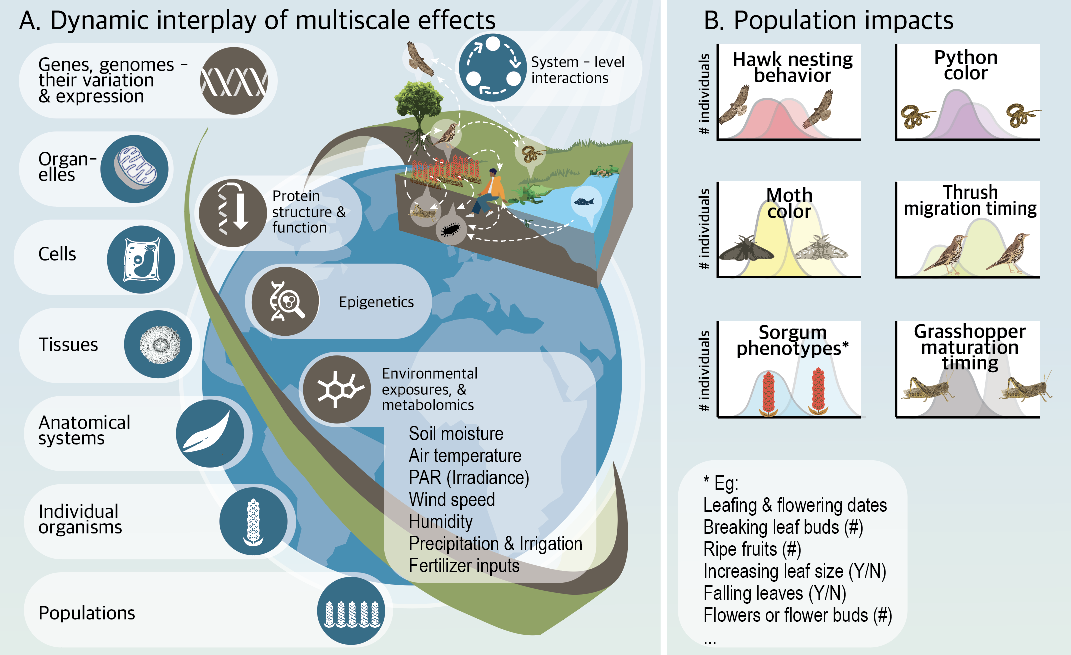
Addressing Societal Needs Requires Multiple Data Sets From Multiple Disciplines

Slide 3
Need To Integrate VERY Heterogeneous Data

Slide 4
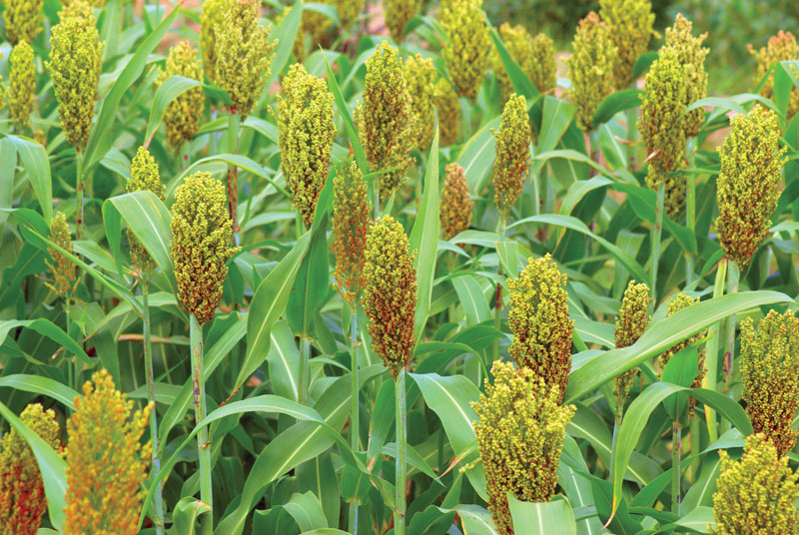
Predicting Phenotype Given Genotype and Environment- Limitations
Explorations in sorghum, black cottonwood, maize
Always missing something…..
Not the size of the data set, it's the consistency and size of the overlapping data
Hard to know before spending time if data set is appropriate
Genomic feature selection
Currently exploring LLM and RAG strategies using Genomes 2 Fields maize data

Slide 5
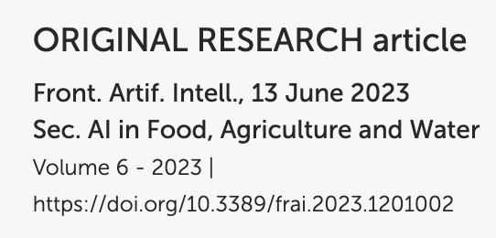
Predicting Phenotype Given Genotype and Environment-Products
Gene expression knowledge graph
Five species
Phenotype, Genotype, Environment
Planteome, Gramene, Gene Expression Atlas, etc
Plant Ontology, Plant Trait Ontology, Gene Ontology,etc
LinkML and BioLink
Enabled by layers of data and metadata standards

Slide 6
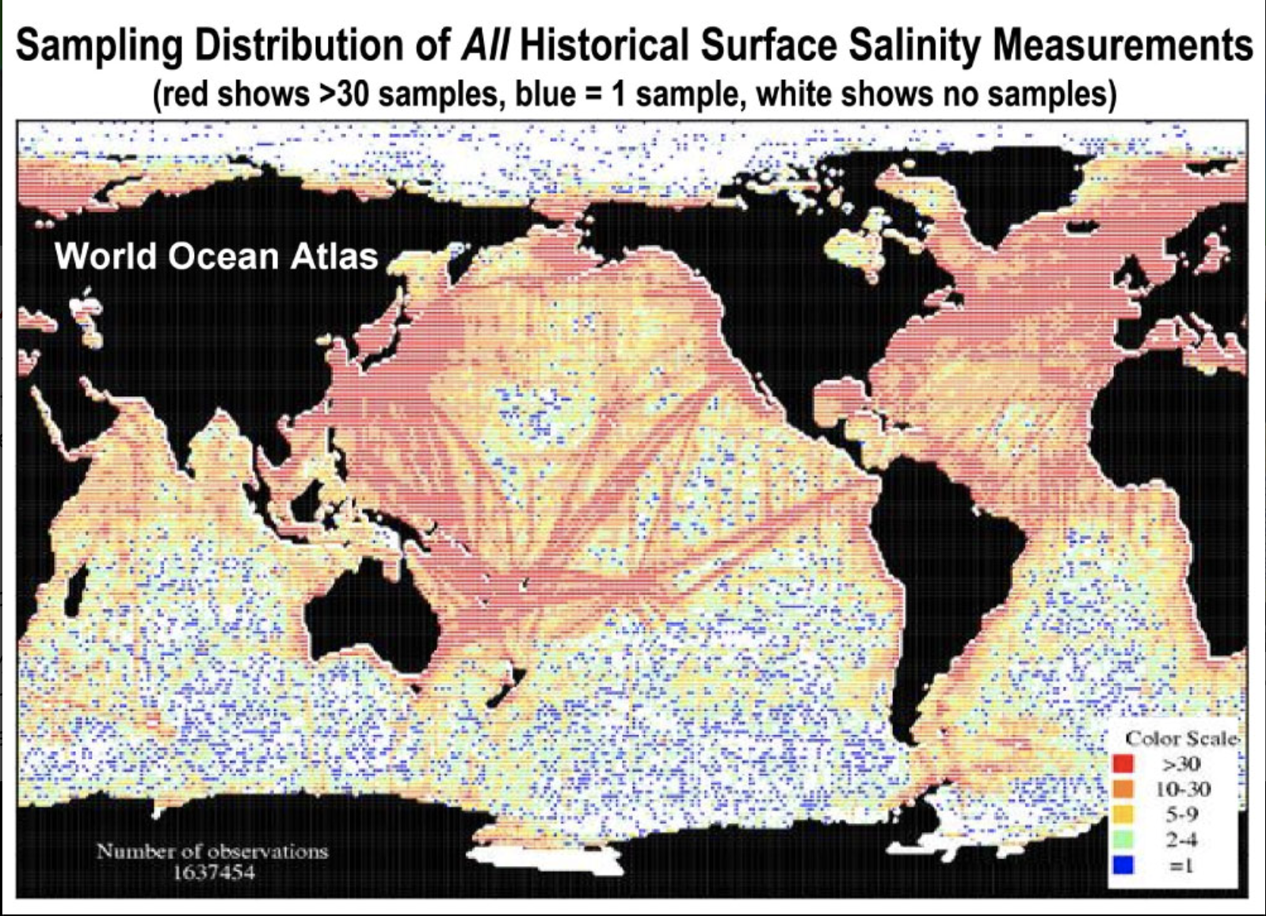
Challenges: Are “We" Willing To Make the Investment?
The world is undersampled
Basic science work needed
Make best use of existing data to support AI solutions
Feature selection (genomic)
Need advanced data stewardship infrastructure
Bias detection
Performance measures
Attribution, provenance, and trust
Maintenance and sustainability (process)
1637454 measurements, from NASA

Slide 7
Opportunities
Developing standards and practices to maximize data combination
Wealth of interoperable ontologies
LinkML
SSSOM
Automated mapping and transformation tools and strategies (LLM)
Developing platforms for access to data to create AI/ML supportive products
Sequencing projects that focus on more species
Defining data set metrics for AI/ML readiness, including tools to assess readiness
Making knowledge available for LLM via ontologies or other knowledge structures (RAG)

Slide 8
Acknowledgements
Translational and Integrative Sciences Lab (tislab.org)
Curtis Lisle at Purdue University
NSF Ideas Lab
NSF Awards 1939945, 1940059, 1940062, 1940330 Harnessing the Data Revolution

