Slide 1
Preparing Vocabulary and Text for Algorithms and Machine Learning
NSF-OAC #2118201
For the AI Ready Data Workshop at Drexel
Presentation by Kio Polson
with support from colleagues Jane Greenberg and Scott McClellen
From the Metadata Research Center
College of Computing and Informatics, Drexel University

Slide 2
What is HIVE/HIVE-4-MAT?
An Acronymn:
Helping
Interdisciplinary
Vocabulary
Engineering
(for, MATerial science)
Vocab Software with Features:
Navigating
Searching
Indexing
(More???)

Slide 3
Common Confusion About HIVE
NOT a repository
Don’t log in and share your vocab
Don’t edit or add to vocab
YES a “Vocab Crawler”
Explore existing vocabs
Find appropriate terms and concepts

Slide 4
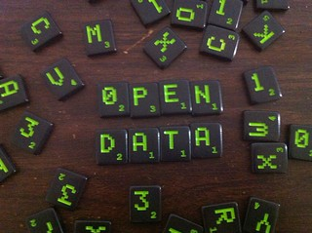
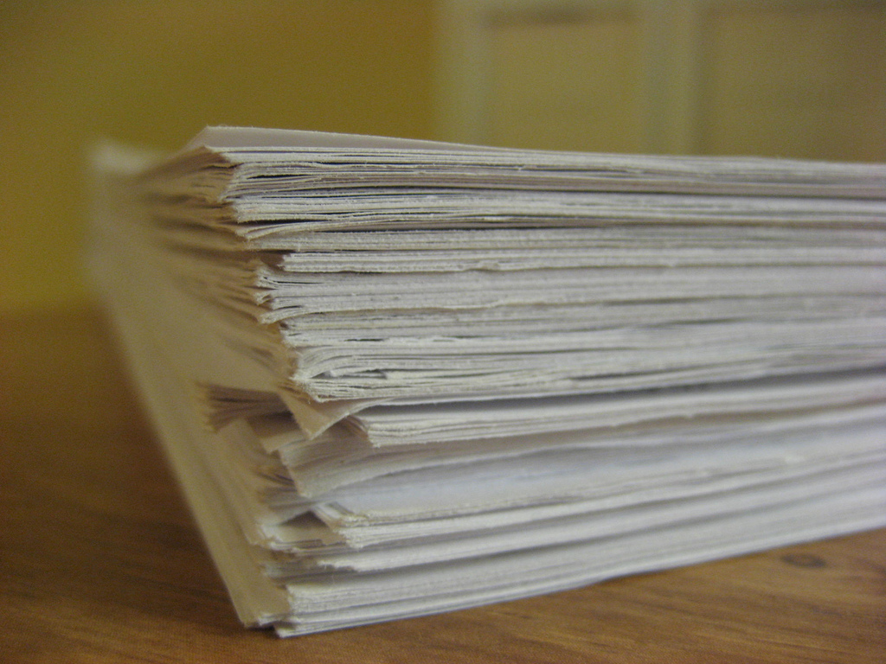
Relevant Data/Metadata
Controlled Vocabulary Terms
Material Science Articles
Algorithms
Keyword Extraction
Keyword Alignment
Information Retrieval
Vocab Search?

Slide 5
What is “Clean” Data?
Web Crawling
Menus
Style tags in HTML
Headers/Footers
Vocabulary
xray vs x-ray vs x ray
Color vs Colour
RDF – SKOS Mappings
Keyword Extraction Algorithms
Use capitalization and punctuation
Can be confused by diacritics

Slide 6
Progress
Improved Keyword Alignment Algorithm
Automating Updating Vocabularies
Improved Security

Slide 7
Challenges
UI makes new features hard
Decentralized interdisciplinary vocabularies
Normalizing Vocabularies
Entirely new searching paradigms

Slide 8
Opportunities
New Searching Scenarios
Testing Precision
Algorithm supported ML?
Keyword Alignment/Extraction
Helpful to researchers
Helpful to vocab authors?

Slide 9
Thank you!

