Slide 1
Metadata, LLMs and Materials Synthesis Mining
Author: Xintong Zhao
Drexel University
#2118201

Slide 2
SCOPE
Our research interest:
Discover knowledge of materials science through large scale text mining
Convert information in unstructured text to structured knowledge

Slide 3
SCOPE
A conceptual map plays an essential role to guide the text mining process.

Slide 4
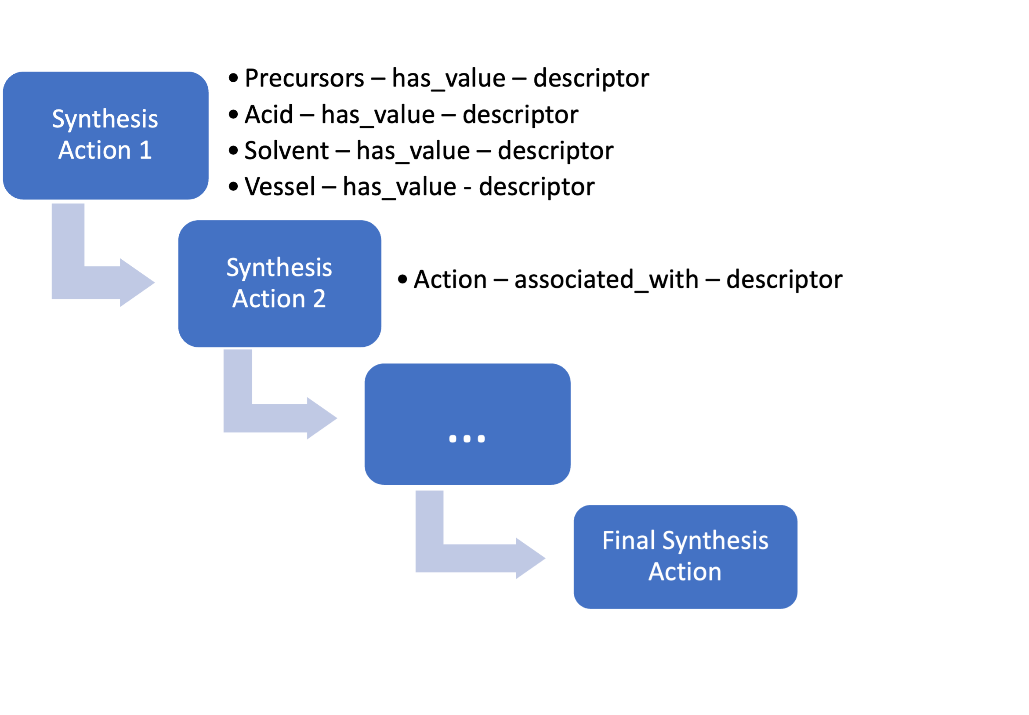
SCOPE

Slide 5
AI-READY DATA WORKFLOW

Slide 6
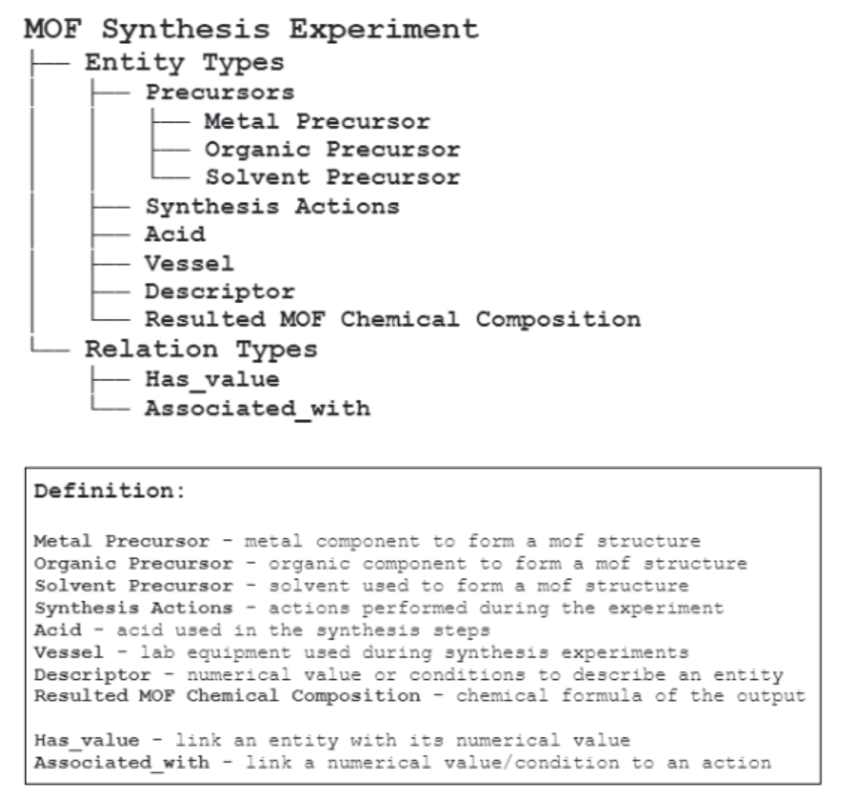
SCOPE

Slide 7
CHALLENGE
Volume of materials literature
Scientific annotation is time-consuming and requires significant domain expertise
Inter-annotator agreement rate
Knowledge adaptation of LLMs

Slide 8
OPPORTUNITIES
Large Language Models (LLMs) combined with few-shot learning shows high-potential to address these challenge
Good semantic understanding of scientific texts

Slide 9
APPLICATIONS
Synthesis dataset generated from large number of scientific outputs
Knowledge graph construction
Information Retrieval

Slide 10
CURRENT PROGRESS
Training GPT4 to teach BERT
Precision – 87%
Lower Recall

Slide 11
THANK YOU!
#2118201

