Slide 1
Ground Truth: Metadata Accuracy Dilemmas in Training 3D AI/ML Models
Bahareh Shakibajahromi
Dr. David Breen
Dr. Edward Kim

Slide 2
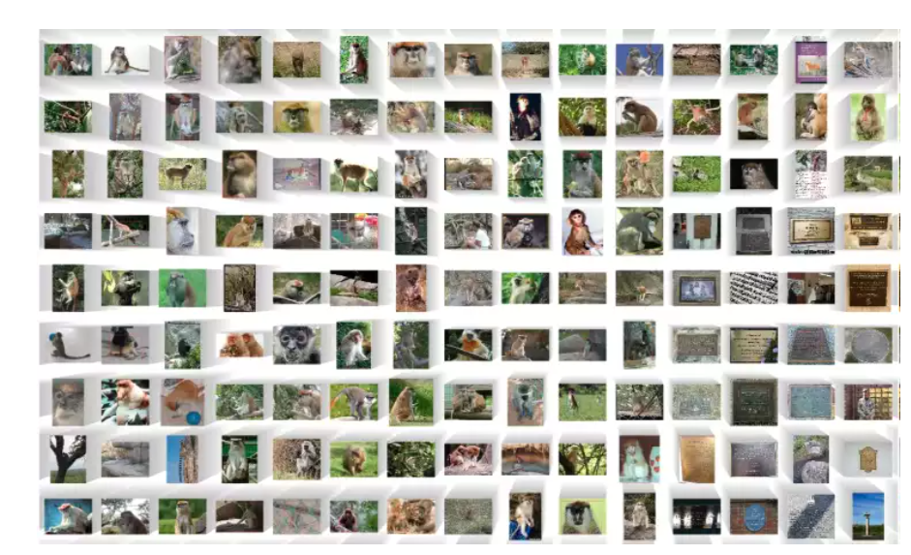
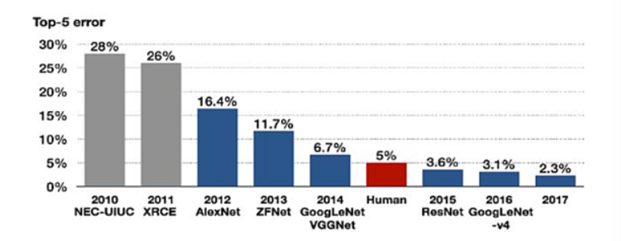
Labeled Data: Quality, Availability, and Its Impact on ML Accuracy
The availability of labeled datasets like ImageNet has been instrumental in advancing the development of accurate supervised models, providing the foundational data necessary for training and refining complex algorithms.
2006 – AI scientist Fei-Fei Li starts the ImageNet project. Most AI researchers are focused on AI algorithms, and Li wanted to enlarge and improve the image database for training computer vision models.
2015 – Breakthrough improvement in CV (computer vision), top performers are below a 5% error rate. This marks the start of an industry-wide artificial intelligence boom.
https://viso.ai/deep-learning/imagenet
Notes:
Let's start by considering the example of ImageNet. It was Initiated in 2006 by Fei-Fei Li. ImageNet was designed to address a significant gap in the availability of quality data for training computer vision models. At that time, while many researchers were focused on developing AI algorithms, Fei-Fei Li recognized the need for a more extensive and improved image database.
By 2015, the field of computer vision saw breakthrough improvements, with top performers achieving error rates below 5%. This marked a significant milestone in AI accuracy

Slide 3
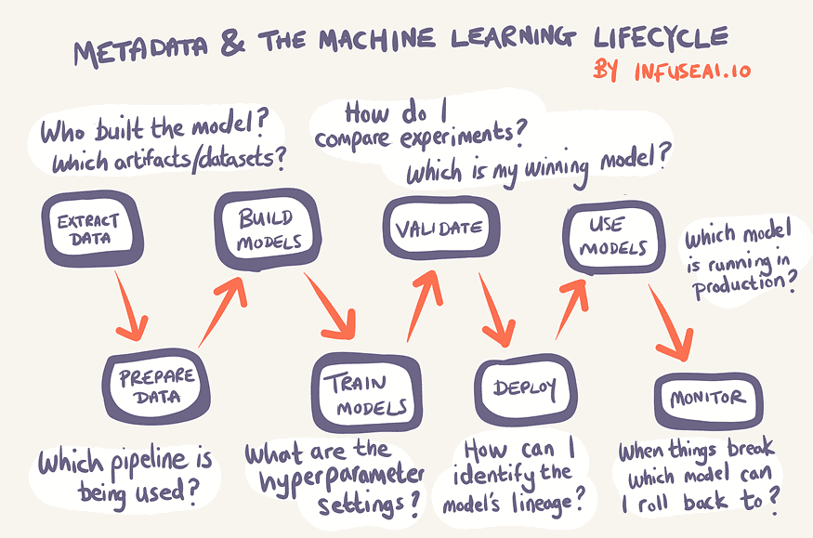
Metadata in Machine Learning Systems
What is Metadata?
Metadata is data that describes other data. It provides structured information to help identify, manage, or audit the data it describes.
Metadata types in AI/ ML
Dataset Metadata: Details about the datasets and their versions used.
Audit Metadata: Tracks changes in the pipeline, user and model creation.
Experiment Metadata: Information from model training and experiments.
Performance Metrics: Statistical metrics like accuracy and error rates.
Metadata acts as the backbone of artificial intelligence and machine learning systems, enhancing their efficiency, reliability, and compliance by providing crucial information about the data and processes involved.
Notes:
What is Metadata?
Metadata is data that describes other data. It provides structured information to help identify, manage, or audit the data it describes.
Type of metadata: Metadata not only helps in identifying and correcting issues that affect the model’s performance but also provides insights that guide improvements to make the model more robust, fair, and accurate.

Slide 4
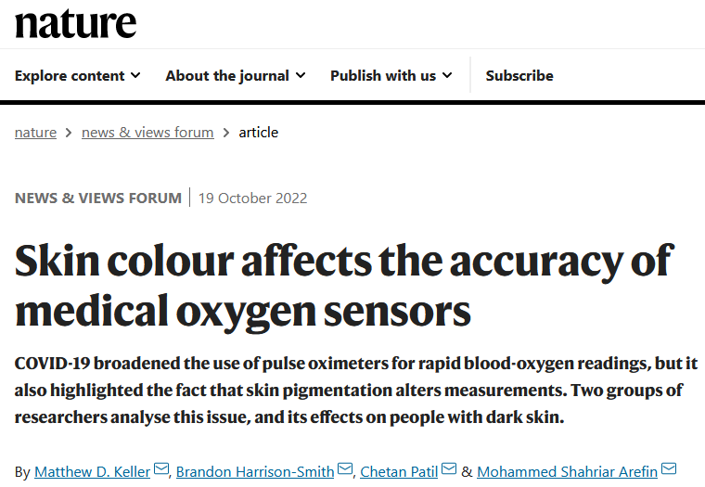
From Academic Ideals to Real-World AI Challenges
Despite technological advancements, failures in AI algorithms can still occur.
https://www.nature.com/articles/d41586-022-03050-7
https://www.nature.com/articles/d41586-022-03161-1
Notes:
Despite technological advancements, failures in AI algorithms can still occur.

Slide 5
Examples of Metadata in AI for Medical Imaging
Scenario: A machine learning model is developed to classify images of skin lesions as benign or malignant. The dataset consists of thousands of dermatological images from various clinics.
Key Examples of Metadata in Medical Imaging
Patient Information: Age, gender, medical history, relevant symptoms or prior conditions.
Image Acquisition Details: Type of imaging equipment, settings, and parameters of the equipment.
Clinical Context: Reason for examination, area of the body imaged, presence of any implants or devices affecting imaging
Diagnostic Annotations: Annotations by radiologists identifying regions of interest, labels for abnormalities, severity and stage of detected conditions.
Treatment Data: Information on any prior treatments.
Environmental conditions: such as lighting.

Slide 6
Challenges Addressed by Metadata
Model Performance Variability
Problem: Initially, the model shows unexplained variability in performance across different test sets.
Role of Metadata: Analysis of metadata reveals that images from one camera type are misclassified.
Bias in Dataset
Problem: The model performs well on the training set but poorly on external datasets.
Role of Metadata: Metadata analysis shows that the training data is predominantly from older male patients.
Solution: Using this metadata, the dataset is augmented with more diverse images to better represent different demographics, improving the model's generalizability.
Debugging Anomalous Results
Problem: Benign lesions mislabeled as malignant.
Role of Metadata: By examining the environmental conditions metadata, poor lighting is identified as an error source.
Solution: Model updated to correct lighting, or poor-quality images flagged for review.
Metadata not only helps in identifying and correcting issues that affect the model’s performance but also provides insights that guide improvements to make the model more robust, fair, and accurate.
Notes:
Let’s look at how metadata helps us tackle challenges that can affect a machine learning model’s performance.

Slide 7
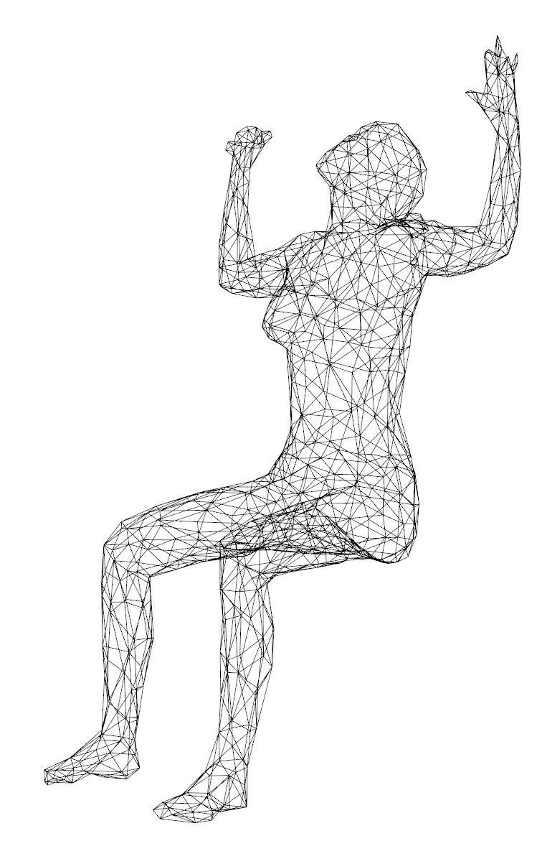
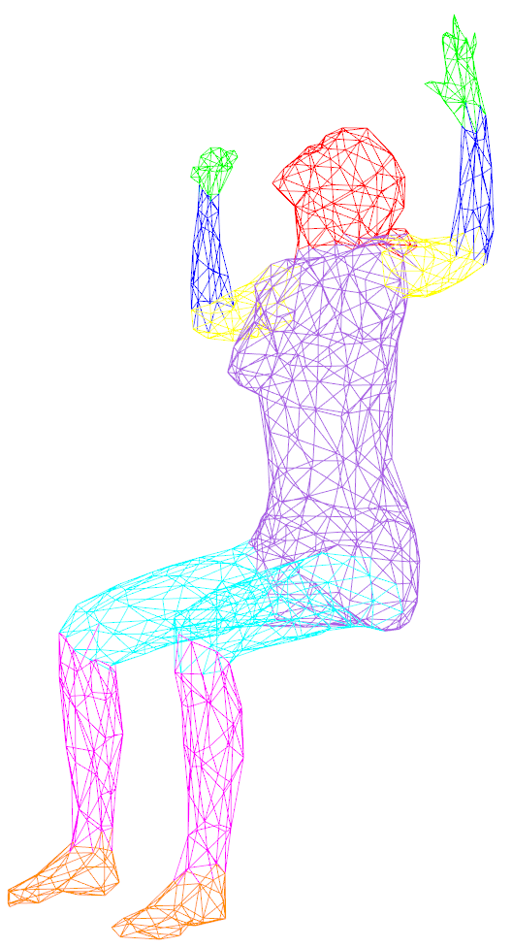
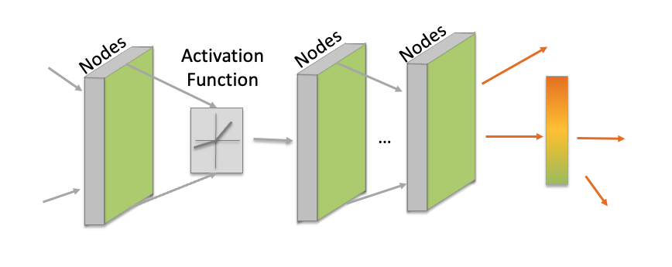
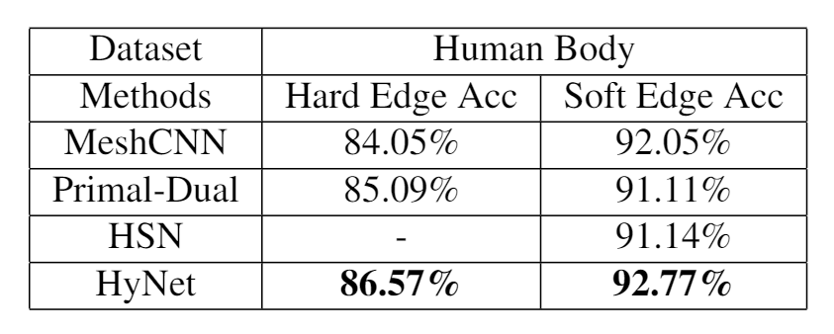
The Advantage of a Clean Dataset
Segmentation
Raw Data
COSEG Dataset
Human Body Dataset
Effort Distribution: 10% Data Preparation 90% Model Creation
A well-curated dataset shortens data prep and shifts focus to the complex task of model development and enhancement.
Notes:
Now, let's shift to my personal research journey, where I understood the crucial role that clean ground truth and comprehensive metadata play. The first part of my PhD research was on 3D mesh segmentation, The problem is to divide 3D shape into multiple segments or parts. Each segment typically represents a meaningful or functional part of the object.
I dedicated just 10% of my time to prep the data and 90% to crafting my model, which led to outstanding results that surpassed previous work.

Slide 8
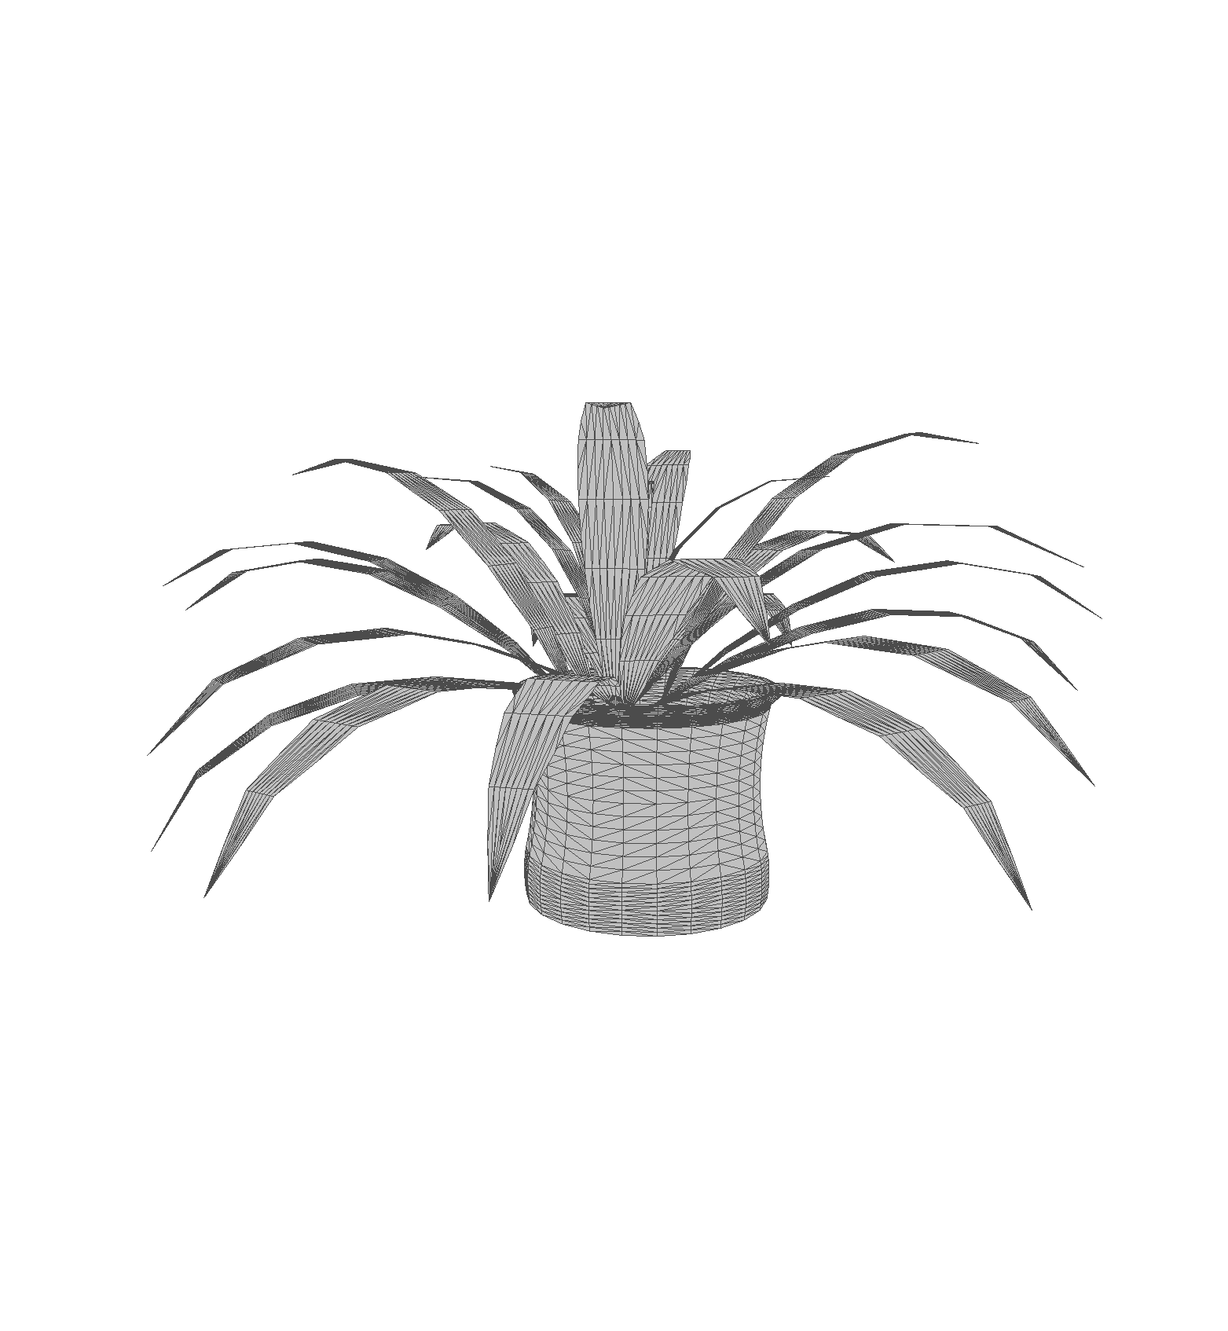
The Critical Role of Ground Truth and Metadata in Model Success
ModelNet40
Classification
plant
Shape matching
1st Phase
Effort Distribution: 10% Data Preparation 90% Model Creation
2nd Phase
Effort Distribution: 2% Data 98% Model Creation
The success of model development relies heavily on the quality of ground truth data.
Notes:
In the second and third projects of my PhD, which focused on mesh classification and shape matching, I initially allocated 10% of my time to data preparation and the remaining 90% to model design. Unfortunately, I didn't achieve the accuracy I was hoping for. During the second phase, I devoted most of my effort to pinpointing issues in my model design, but still, No success!

Slide 9
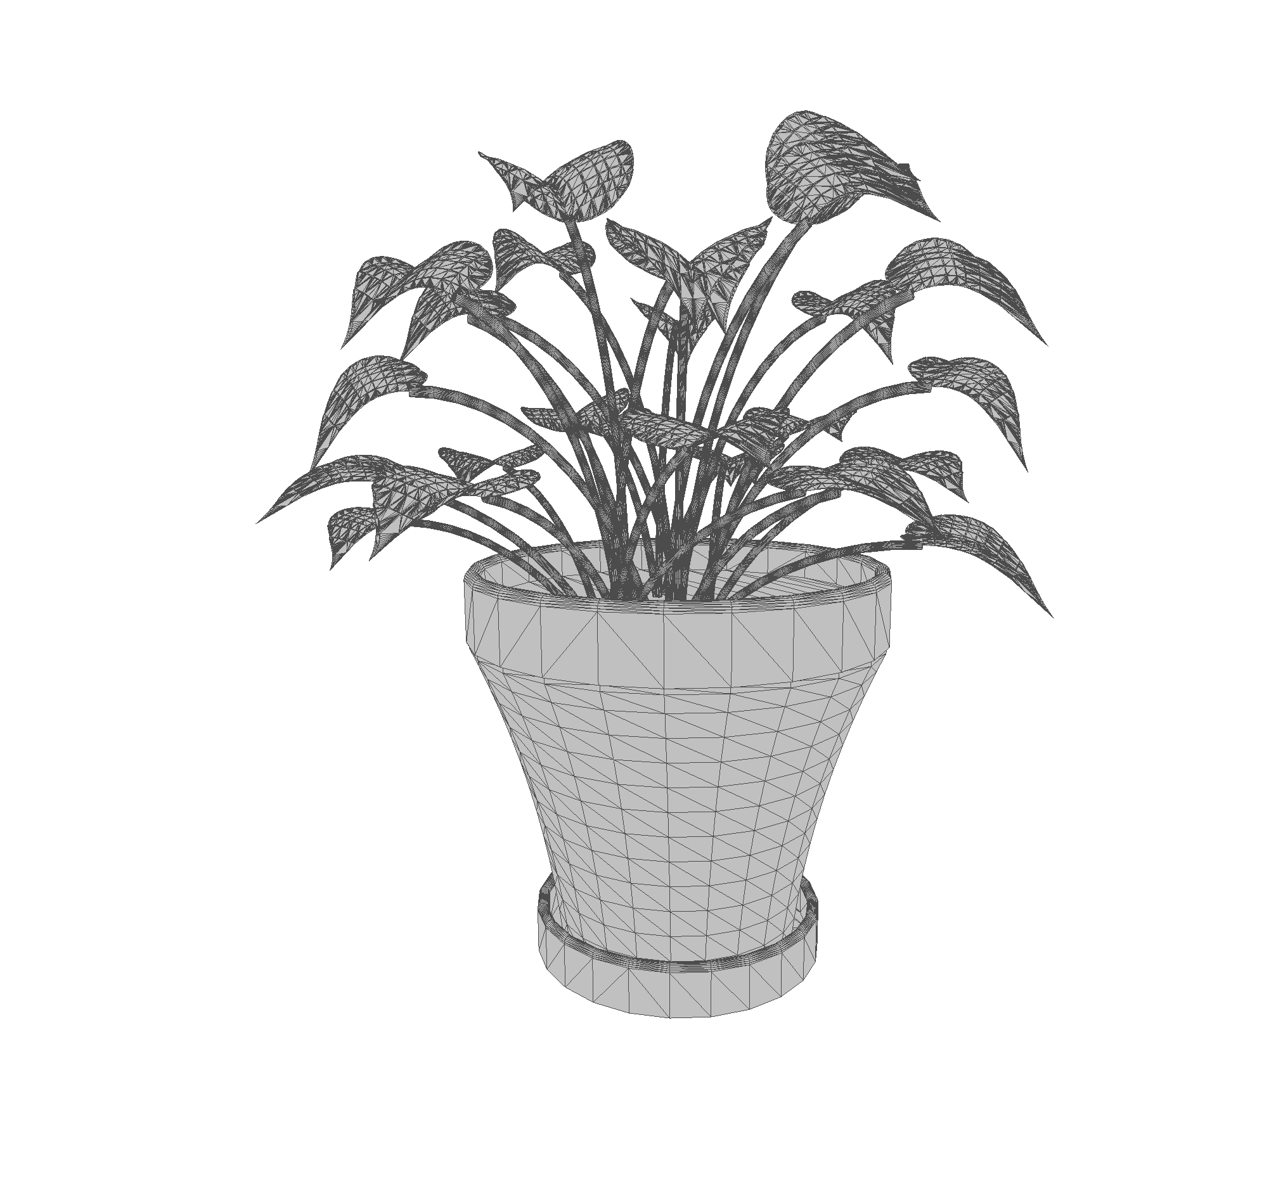
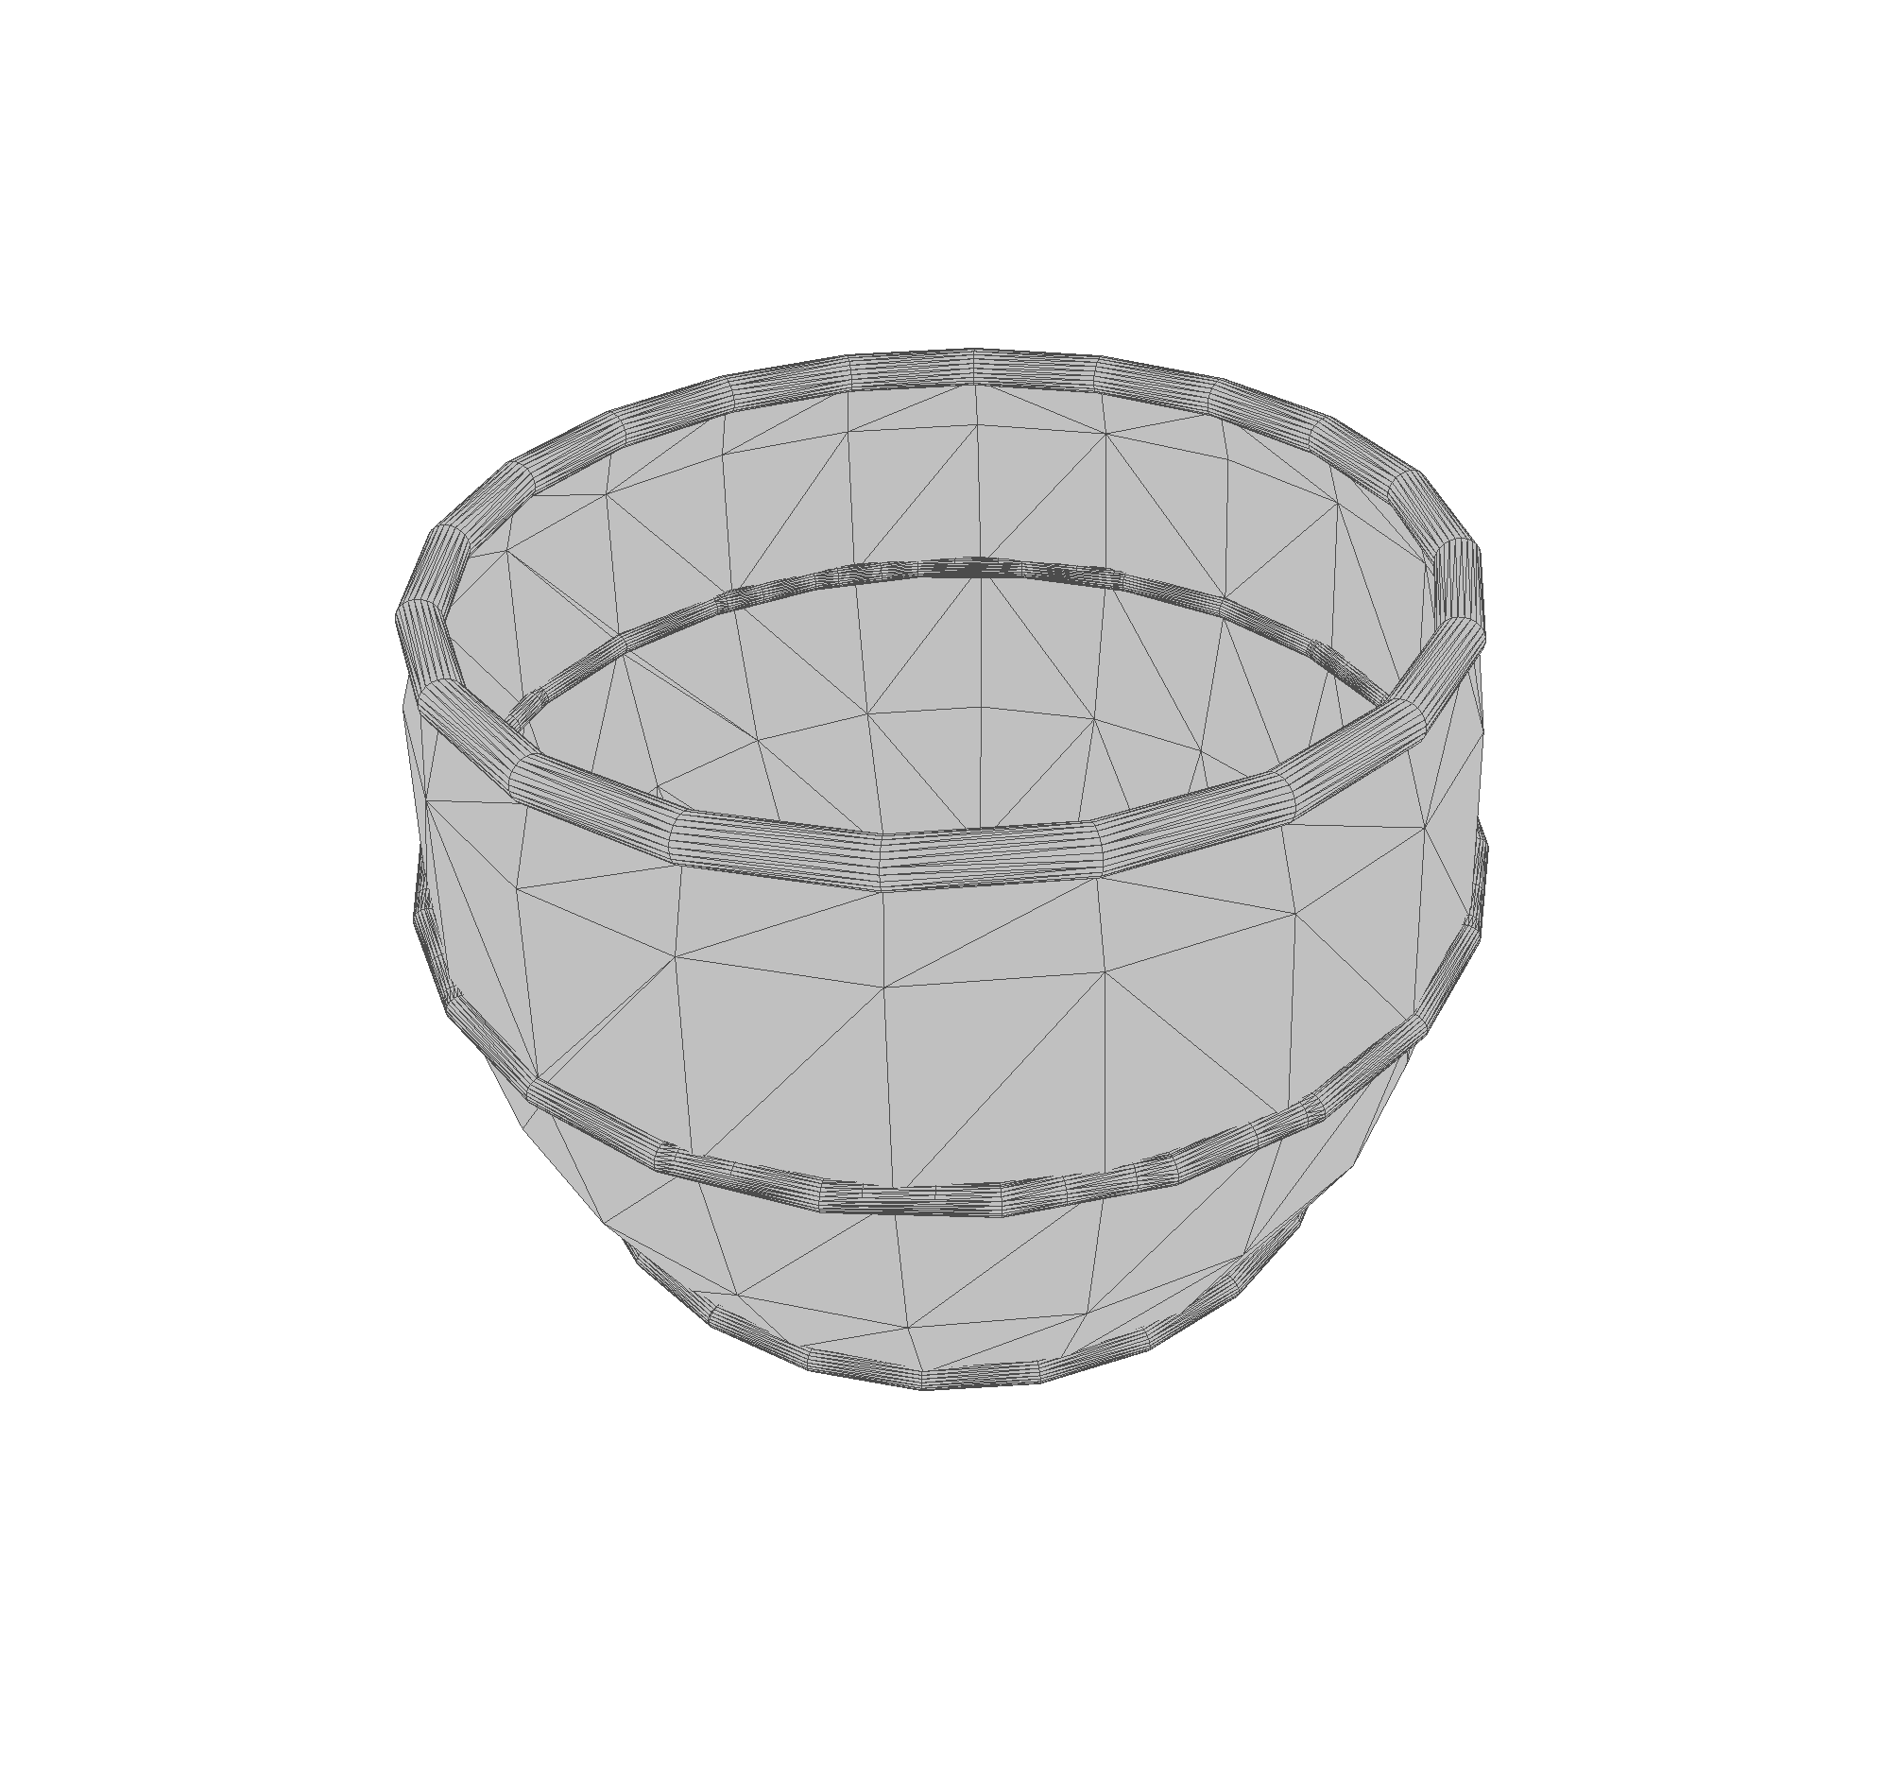
Model Prediction
Test Set
20 labeled samples in the "Flowerpot" class.
Model Predictions
All Flowerpot test samples were misclassified as:
Bowl: 25%
Cup: 25%
Plant: 25%
Vase: 25%
Notes:
Then, I examined the test samples that my model incorrectly predicted. The findings from this investigation were quite interesting. At this point, I realized the importance of auditing the dataset to gain deeper insights.

Slide 10
Challenges with ModelNet40 Dataset
Inconsistent Resolutions:
Presence of samples lacking true 3D form
Noisy Labels
Plant
Flowerpot
Chair
Stool
Notes:
I discovered that the meshes in the ModelNet40 class had inconsistent resolutions. Additionally, some samples lacked a true 3D form. For example, there was a 2D tree that had been triangulated to appear as 3D. Additionally, I found instances where identical shapes were labeled differently. Two identical samples were labeled as "Plant" and "Flower Pot," and another pair as "Chair" and "Stool."

Slide 11
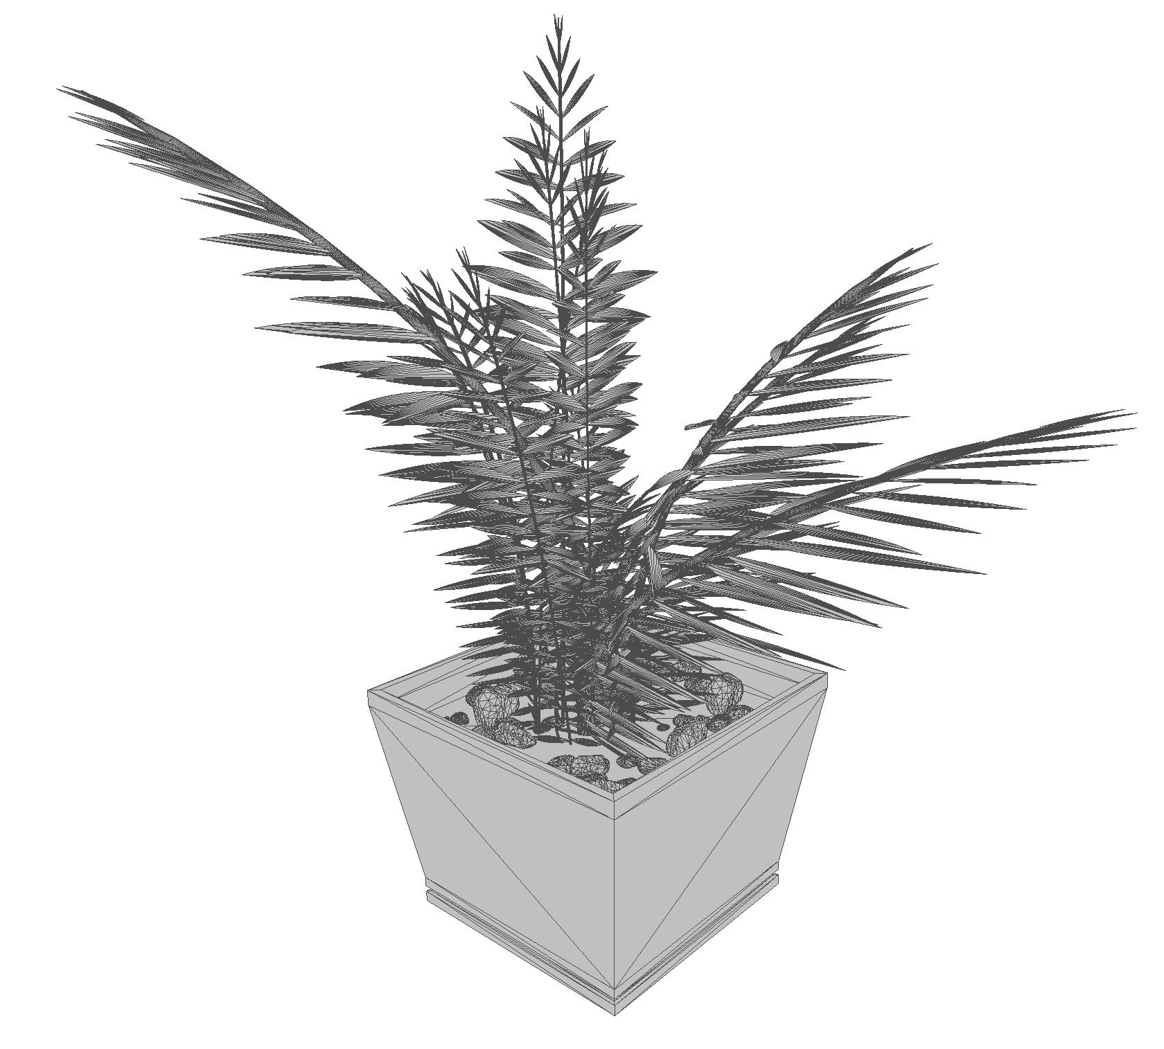
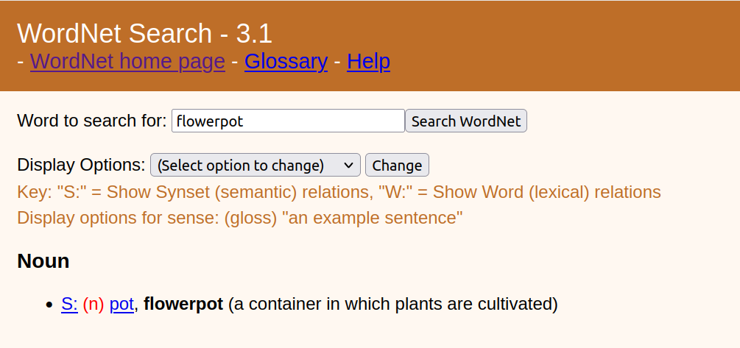
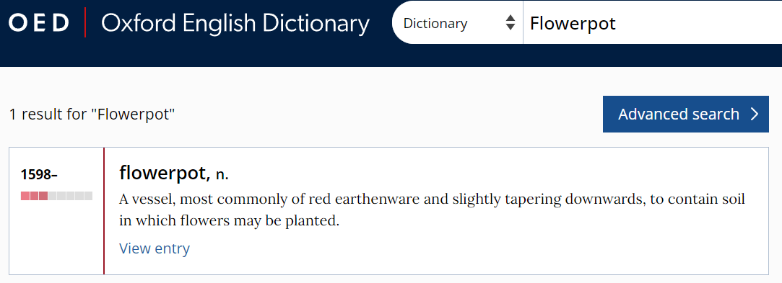
Challenges with ModelNet40 Dataset
Subjectivity and Ambiguity (All samples form flowerpot class)
Solution: Clear Annotation Guidelines and standardized definition
Notes:
I also discovered that some samples were ambiguous and could be labeled differently by different people, due to lack of clear and standardized definition. For instance, all these samples belong to the "Flowerpot" class in ModelNet40, which includes a variety of objects such as flowerpots with plants, empty flowerpots, empty vases, and flowers in vases. we have distinct labels like "Plant," "Vase," and "Flowerpot" available in the 40 classes of ModelNet40, which adds to the labeling confusion.
Resources such as WordNet and the Oxford Dictionary provide well-defined descriptions of object classes, to ensure consistency and accuracy in our dataset annotations.

Slide 12
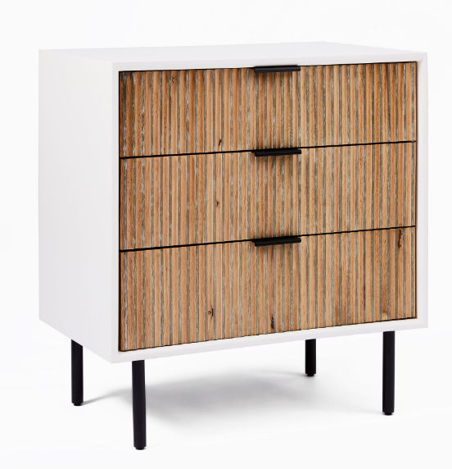
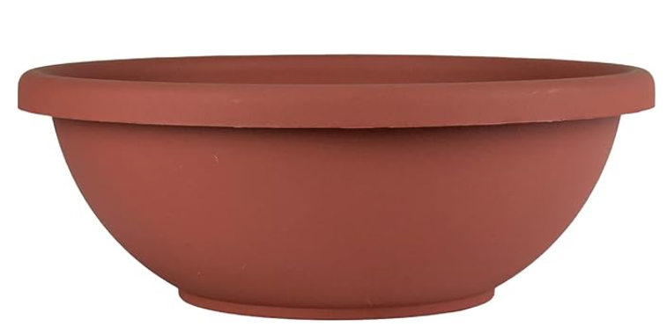
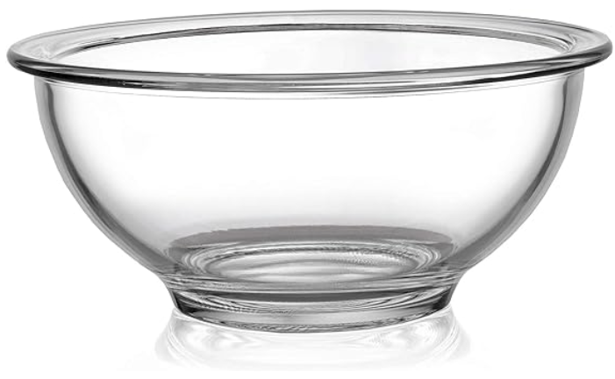
Challenges in Obtaining Accurate Ground Truth in 3D Object Classification
Lack of contextual cues
Scale ambiguity
Design overlap
Lack of color and texture
Notes:
Lack of Contextual Cues:
In many 3D datasets used for classification, objects are presented in isolation, stripped of the environmental context that often provides important clues about their identity and function. For instance, a nightstand and a dresser might share similar design elements—like drawers, knobs, and overall shape. In a real-world setting, the size of these objects relative to other furniture (like a bed) helps to distinguish them. However, when these objects are presented alone in a 3D dataset, this contextual size reference is missing.
Scale Ambiguity:
Without surrounding objects for scale reference, determining the absolute size of a 3D object can be challenging. This is particularly problematic for objects that are similar in design but differ in size. For example, a small table could resemble a large coffee table or a nightstand if there's nothing in the scene to provide a sense of scale. This ambiguity can lead to misclassification, especially in automated systems that rely on geometric and visual features for object identification.
Design Overlap:
Many objects share design features and only differ in their dimensions or the context in which they are typically found. Without the environmental context or relative size comparisons, distinguishing between such objects becomes more difficult. This is compounded by the fact that 3D models often lack the texture or color cues that might be present in 2D images, making the classification rely more heavily on shape and structure.
lack of color and texture
The lack of color and texture in many 3D object datasets presents another significant challenge in 3D object classification. In real-world scenarios, objects are often distinguished not just by their shape and size but also by their color and texture. These features can provide critical information for identifying and classifying objects, especially when their shapes are ambiguous or similar to other objects.

Slide 13
Challenges in Obtaining Accurate Ground Truth in 3D Object Classification
Impact of Orientation
Rangehood? or Table ?
Object orientation significantly influences classification outcomes.

Slide 14
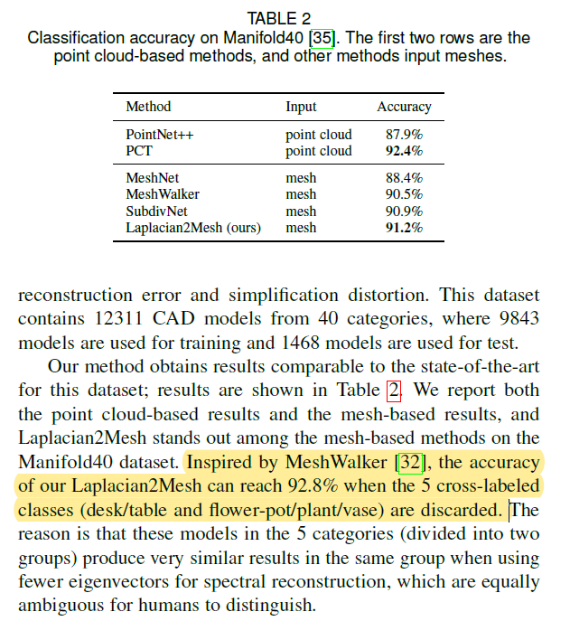
Addressing Noisy Labeling in Computer Graphics Community
Lahav, Alon, and Ayellet Tal. "Meshwalker: Deep mesh understanding by random walks." ACM Transactions on Graphics (TOG) 39.6 (2020)
Dong, Qiujie, et al. "Laplacian2Mesh: Laplacian-Based Mesh Understanding." arXiv preprint arXiv:2202.00307 (2022).

Slide 15
Ensuring Quality at Every Preprocessing Step
Step 1: Water-tight manifold generation
Curtain or Door ??
Notes:
Another crucial aspect to emphasize is the importance of verifying the outcomes at each preprocessing step before they reach the model. For example, my model specifically requires water-tight manifolds as inputs. During my investigation, I found that these two shapes were processed and fed into my model. How would you label these?
We cannot blame the model if it fails to distinguish between these models due to preprocessing errors.

Slide 16
Ensuring Quality at Every Preprocessing Step
Step 1: Water-tight manifold generation
Notes:
I took a step back and examine the original samples before they underwent preprocessing and these was the model.

Slide 17
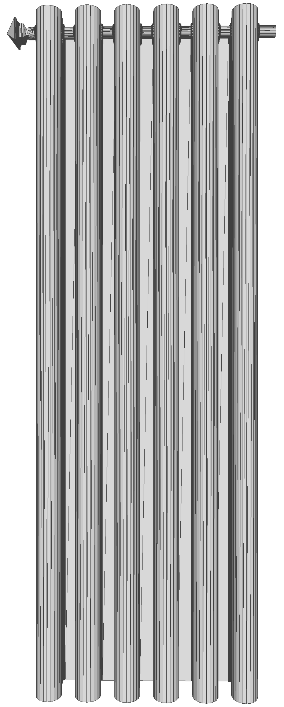
Ensuring Quality at Every Preprocessing Step
Step 1: Water-tight manifold generation
adjusting the 'depth' parameter as necessary to balance detail preservation
original
depth = 9
depth = 8
depth = 7
depth = 6
Adding the 'depth' parameter to our metadata is crucial for facilitating detailed analysis and troubleshooting during model evaluation.
Notes:
The Manifold generation algorithm has a depth parameter
I started with the depth parameter set to 6 for generating watertight manifolds. This looked alright at first glance for several classes. But, I soon realized it wasn't capturing the finer details of the objects. So, I had to tweak the depth to retain these crucial details. Plus, it's vital to include this depth setting in our metadata, as it's key for later analysis and fixing issues. We ended up choosing a depth of 9.

Slide 18
Ensuring Quality at Every Preprocessing Step
Step 2: Manifold Simplification
integrity checks to ensure the mesh structure still represents the original shape
Notes:
In the second step of preprocessing, I needed to simplify the manifolds from the previous step, as these had a large number of vertices and our computing resources were limited. However, I noticed that some of the simplified meshes were damaged and failed to represent the original shape.

Slide 19
Ensuring Quality at Every Preprocessing Step
Step 2: Manifold Simplification
integrity checks to ensure the mesh structure still represents the original shape
Manifold generation
Simplification Algorithm
depth=9
Numbers of faces = 750
Manifold generation
Simplification Algorithm
depth=7
Numbers of faces = 750
Including 'depth' and simplification parameters in the metadata is crucial for troubleshooting and analysis of models and datasets.
Notes:
Initially, our goal was to simplify the meshes to around 750 triangles or faces, with depth parameter 9 as previously discussed. However, we found that this combination of parameters doesn’t work for the shapes with intricate details. Therefore, we adjusted our approach by reducing the depth parameter to 7 to preserve less details.
Once again, I want to stress the importance of including all these parameters as metadata for facilitating future analysis and troubleshooting.

Slide 20
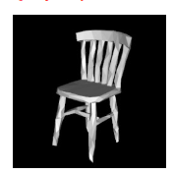
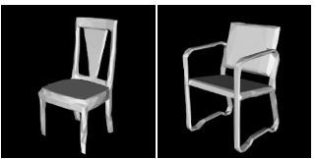
Ground Truth in Shape Retrieval Tasks
Traditional Shape Retrieval: Trained and evaluated on query shape category.
Our Advanced Goal: Retrieve objects by shape similarity, not just by category.
Notes:
Let me quickly share with you my experience with the shape retrieval task. Traditionally, shape retrieval systems were designed to recognize and match the category of the query shape. For example, if you input an image of a chair, the system retrieves various chairs, focusing on the categorical match rather than the details of shape geometry or design.
However, in our advanced goal, when we input a query, we're looking not just for any chairs but for chairs that share the closest design, structure, and geometry with our query object.

Slide 21
Overcoming the Lack of Ground Truth
Resource Constraints: Establishing a detailed ground truth for shape similarity would require extensive time and human resources, which were not available.
Our Solutions: We explored services and methods that could help us approximate a suitable ground truth:
Azure Vision Studio: Leveraged for image-based shape similarity by rendering 3D objects into 2D images from optimal viewpoints.
Chamfer Distance: Utilized for direct 3D shape similarity measurement, benefiting from our dataset's aligned nature.
ShapeDNA: Employed as a rotation invariant method to assess shape similarity based on eigenvalues of the Laplace-Beltrami operator.
Notes:
we didn't have ground truth data that aligned with our defined problem and establishing a detailed ground truth for shape similarity would have required extensive time and human resources, which were unavailable. To overcome this, we explored various services and methods that could help us approximate a suitable ground truth. We utilized Azure Vision Studio, originally for image retrieval. We projected 3D objects into 2D images from ideal viewpoints and then used the image retrieval service. we also used Chamfer Distance and ShapeDNA, both of which can be directly applied on 3D shapes.

Slide 22
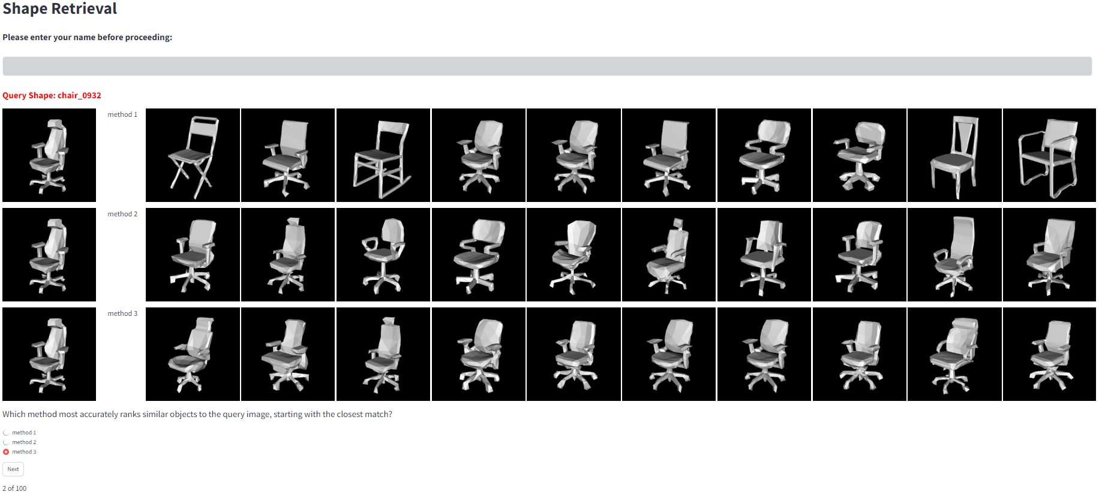
Establishing Ground Truth Through User Validation
User Study: Web-based study with 10 participants and 100 random objects.
Unanimous Choice: Azure Vision Studio
http://3.19.91.236:8501/
Notes:
To determine which service could best approximate ground truth for our shape retrieval or shape matching task, we conducted a web-based user study with 10 participants. We presented the results of each method and all participants favored Azure Vision Studio. This is an example of a case which relying on human-established ground truth was impractical for us, we needed to shift to automated methods.

Slide 23
Thank You!

