Slide 1
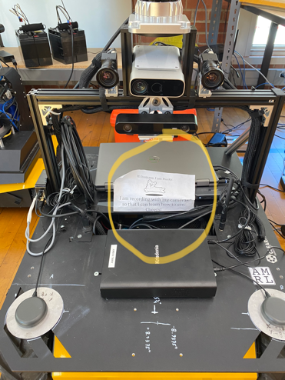
Curating Human-Robotics Training Datasets
AI-Ready Data: Navigating the Dynamic Frontier of Metadata and Ontologies
April 15 2024
Maria Esteva
Texas Advanced Computing Center
GCR-Community Embedded Robotics
Living and Working with Robots

Slide 2
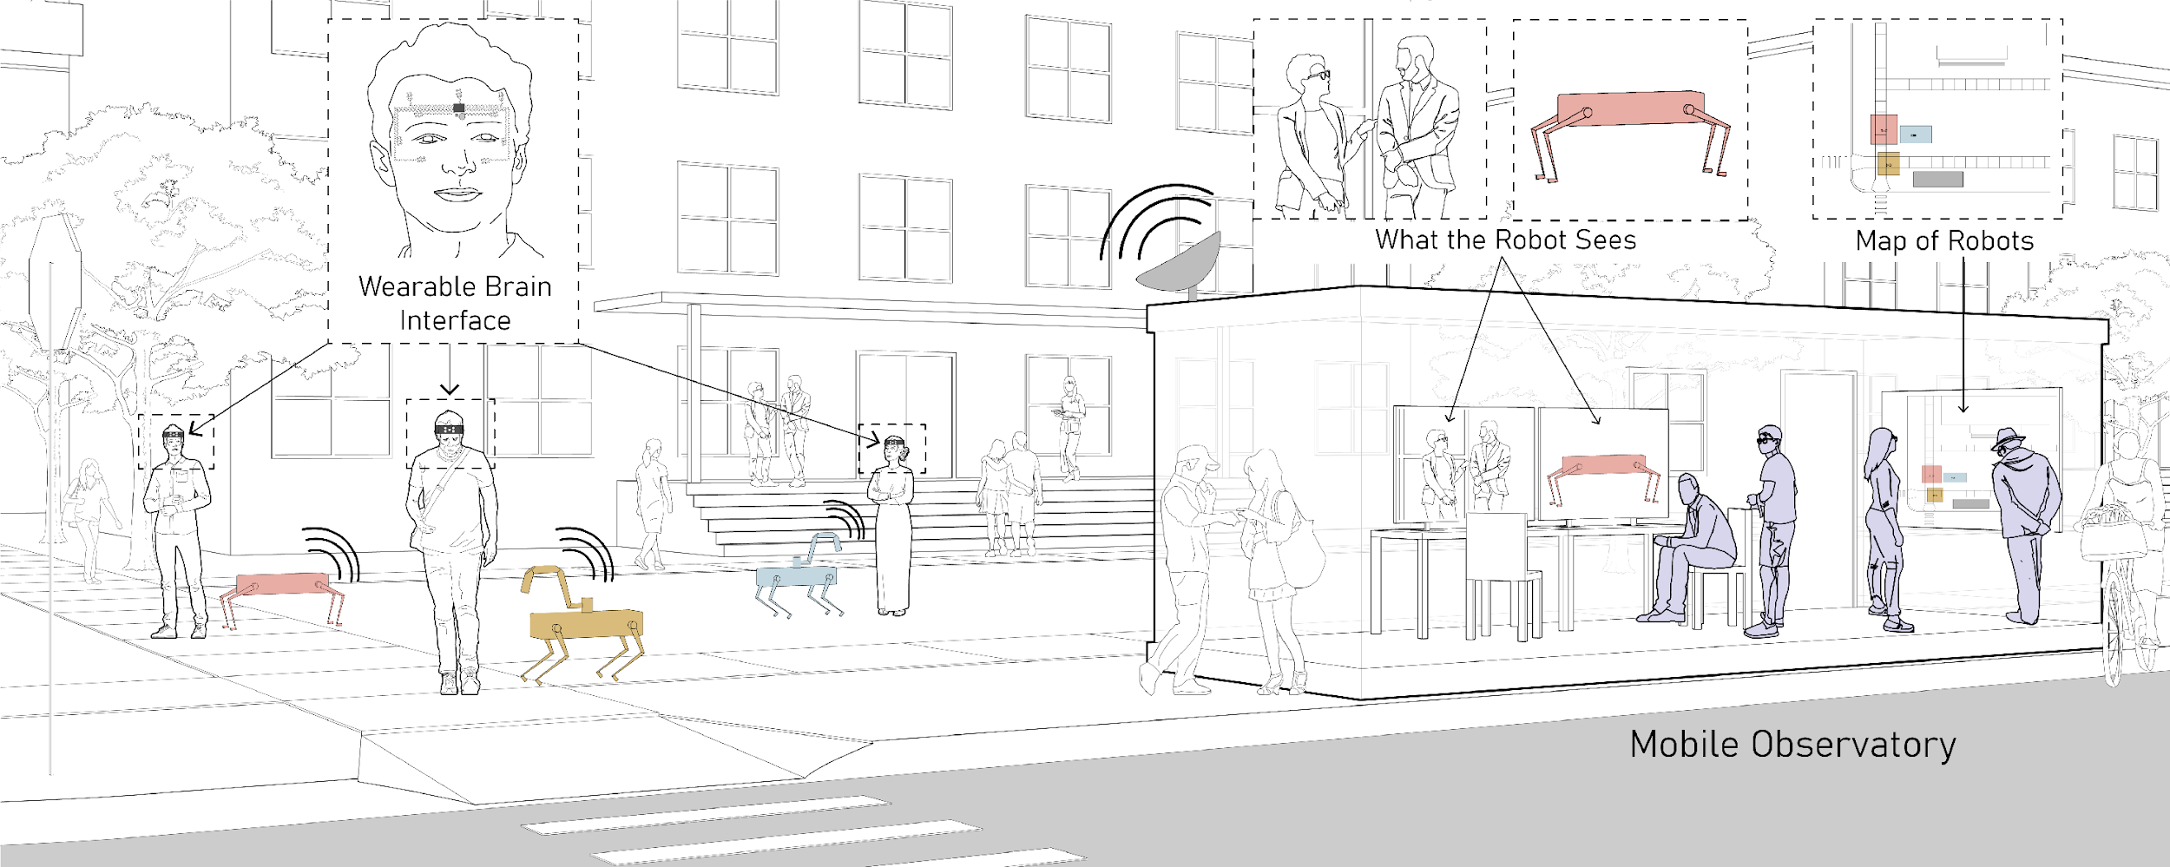

Slide 3
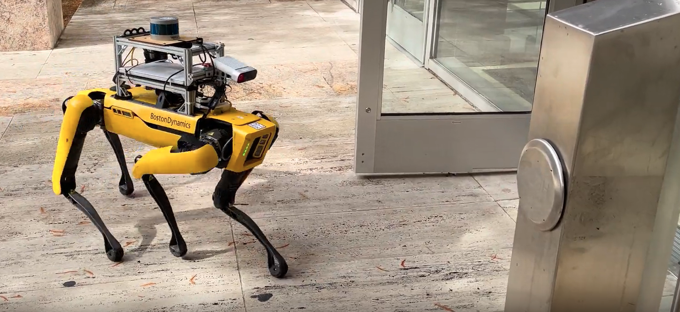
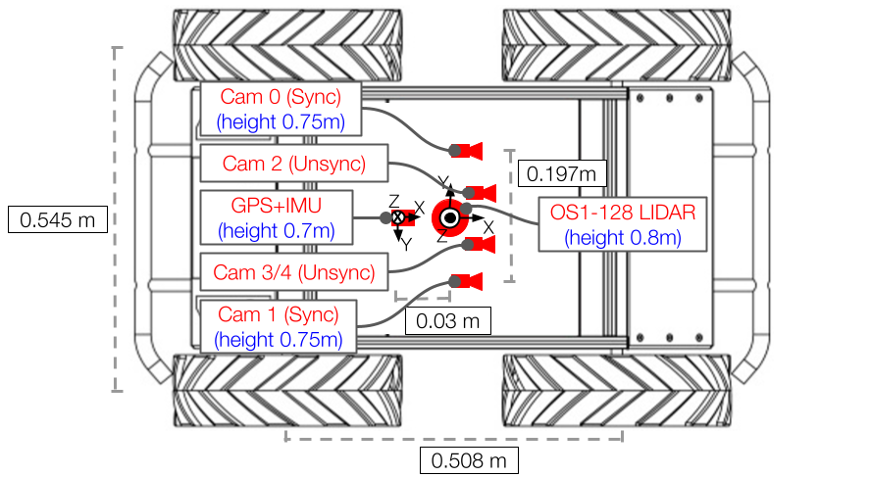
Curation Challenges for H-R Training Data
Ethics and human participants.
Data quality.
Data documentation.
Large data publication and access.
Shape the design of data and metadata, and the systems that we create to represent, preserve and provide access.

Slide 4
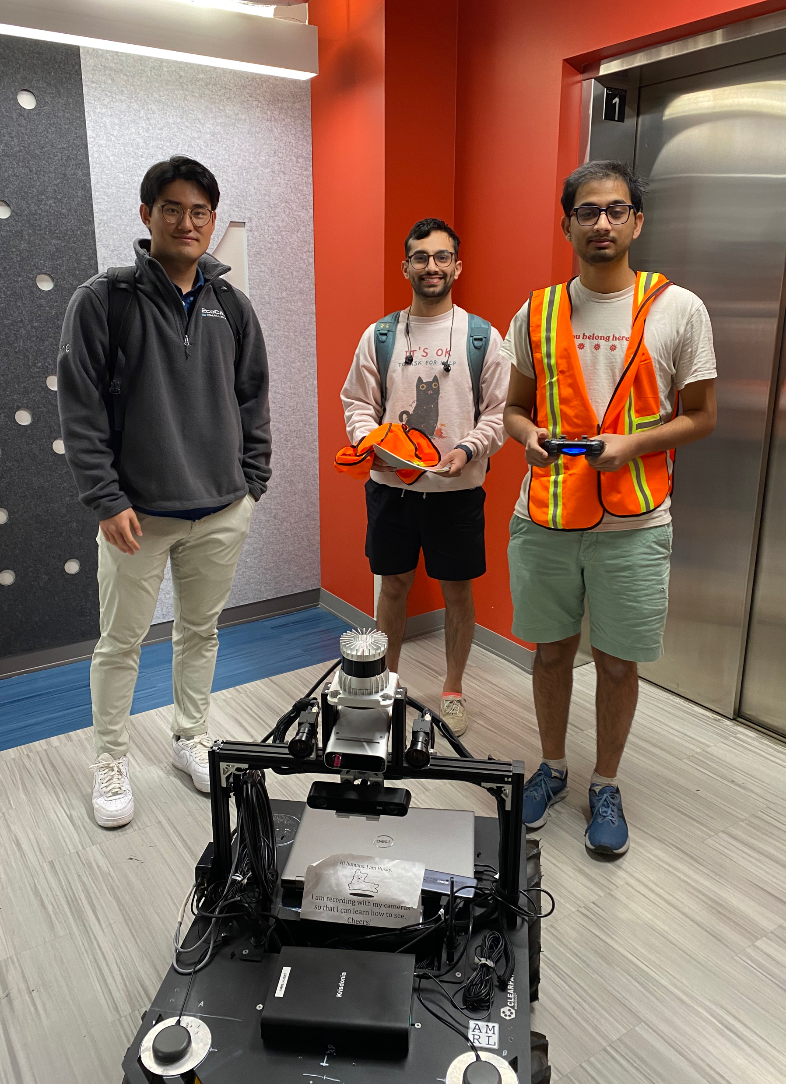
Ethics and Human Participants Data
Robots are deployed in social settings.
Lack of protocol for studies conducted in the “wild.”
Incidental participants can opt-out.
Different disciplinary views about sharing human subjects’ data.
Assess PII risks of different data types in a dataset.
Informed consent for sharing individual data types.

Slide 5
Data Quality
Diverse meanings.
User feedback.
Domain specific practices.
Data quality statement.
Completeness of multi-modal datasets.
Data annotation.
Qualitative coding.
Dataset performance and use cases.
Link to research software.

Slide 6
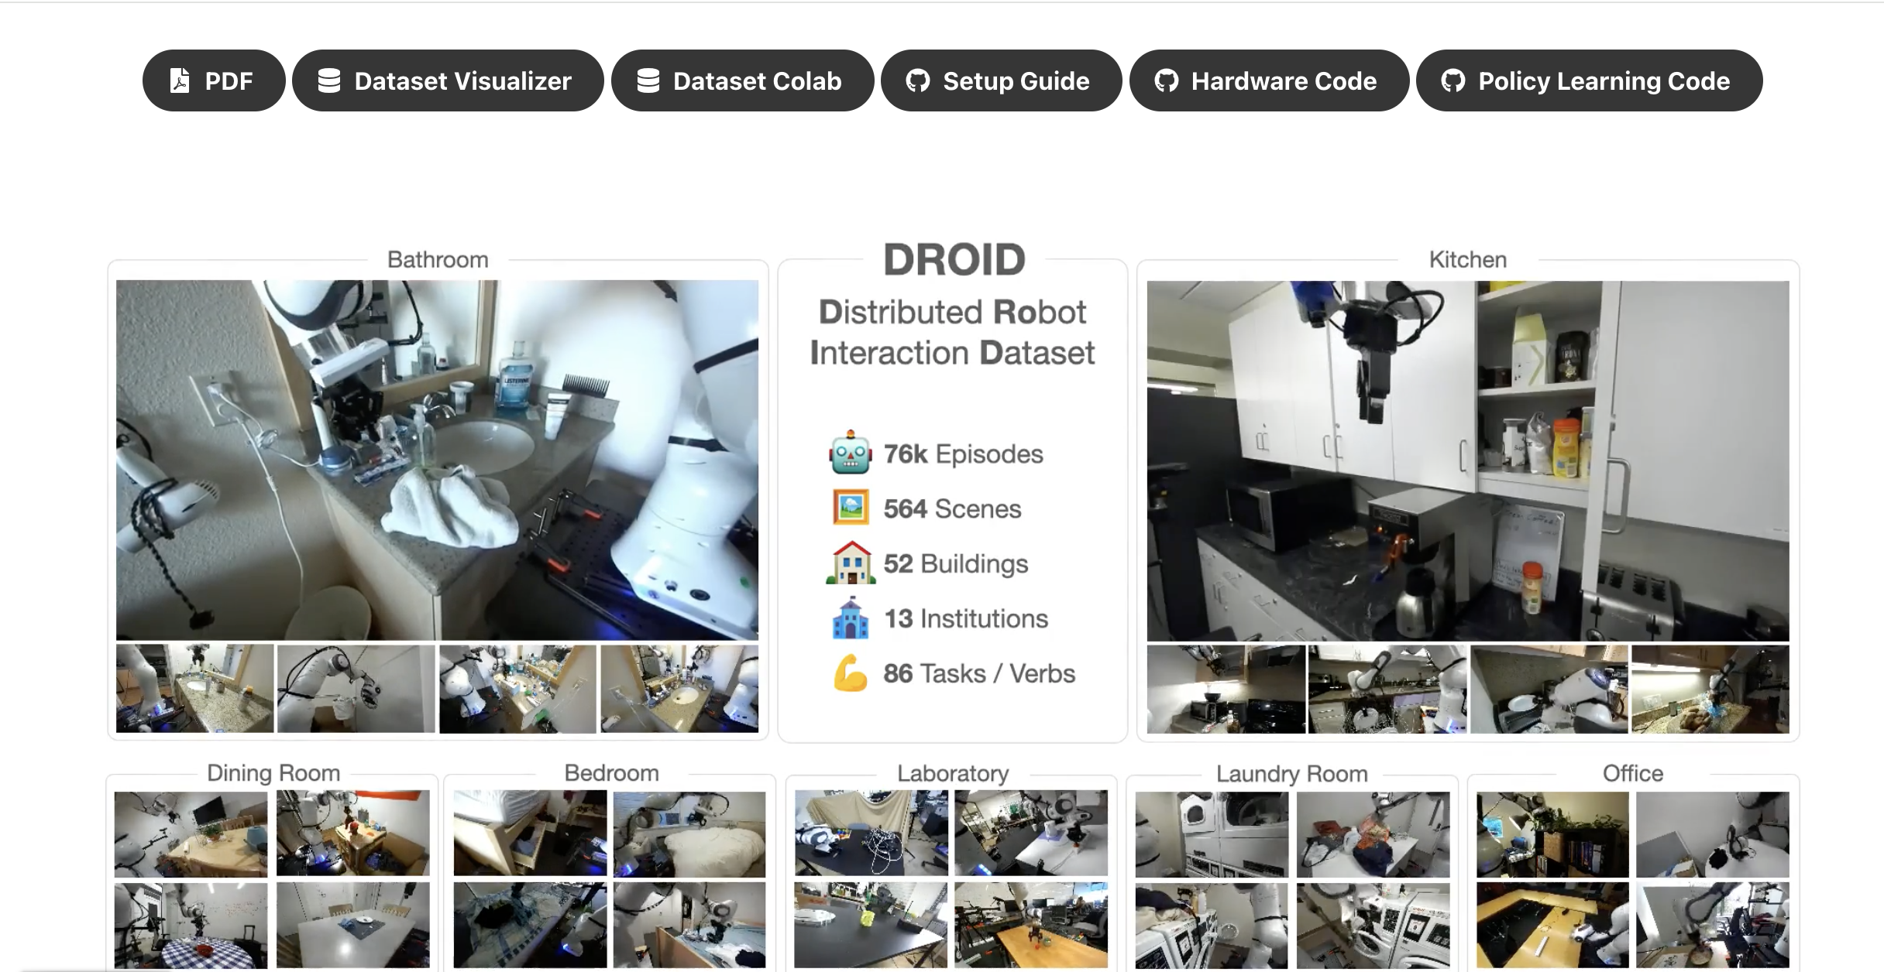
Data Documentation
No standards for H-R datasets.
Trends in robotics datasets representation.
Repository metadata is insufficient.
Modular data report.
Datasheets for Datasets.
Technical provenance
Extent of documentation.
Relevant to the study.
DROID dataset introduced in Github https://droid-dataset.github.io/
Notes:
/

Slide 7
Large Data Publication and Access
Disciplinary practices.
Bundle: data, documentation, benchmarks, use cases, and code.
Components are dispersed.
Institutional repositories
Storage and access limitations.
Hybrid storage approach.
Texas Data Repository and Texas ACC.
Still a compartmentalized system.

Slide 8
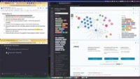
H-R Data and Metadata Model
Model individual studies.
Metadata elements emerge.
Knowledge system to retrieve data in context.
Exploring Language Model to interrogate datasets.
How many sessions has the experiment? How many robots are in session 2? Show me session’s 2 video. View Demo

Slide 9
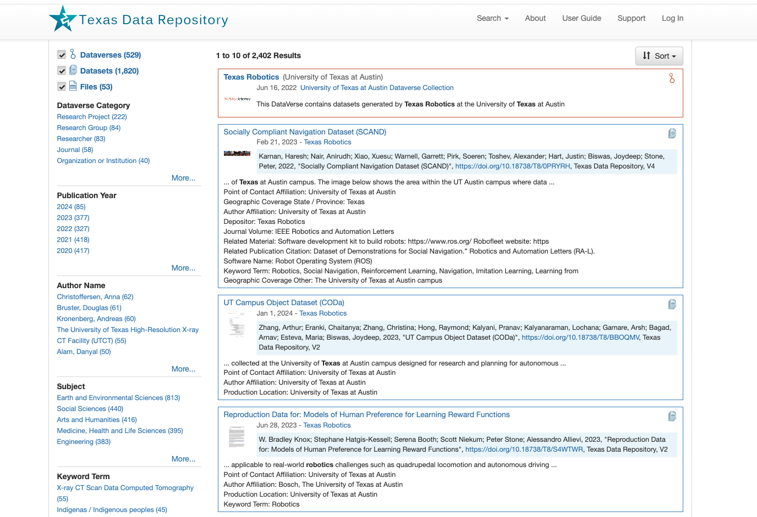
Ongoing Work
Data dictionary consensus:
Consolidation of terms.
How do we describe… a robot?
Knowledge system:
Infrastructure.
Find convergence.
AI ready metadata to improve description and understanding of H-R systems.

