Slide 1
FAIR, Modular and Reproducible ML Workflows for Domain Scientists: An Imageomics Case Study
Meghan Balk • Hilmar Lapp • John Bradley
and the Imageomics Team

Slide 2
Scope

Slide 3
FAIR and Reproducible Workflows: Aims & Benefits
Repeatability, reproducibility, and reuse of workflows
Automatically recreate the results end-to-end
Document precisely how, in an standard declarative and executable format
Empower domain scientists to modify
Reuse of ML workflows, including as the core of domain science workflows
Interoperability across compute environments
HPC cluster, SC facility, Jetstream VMs, AWS, …
FAIR-R workflows promote FAIR and modular workflow components
Reusability and interoperability of workflow components
Findable and accessible components:
Container or package registries
FAIR model, FAIR code, FAIR data & metadata
Findable & accessible through open repositories

Slide 4
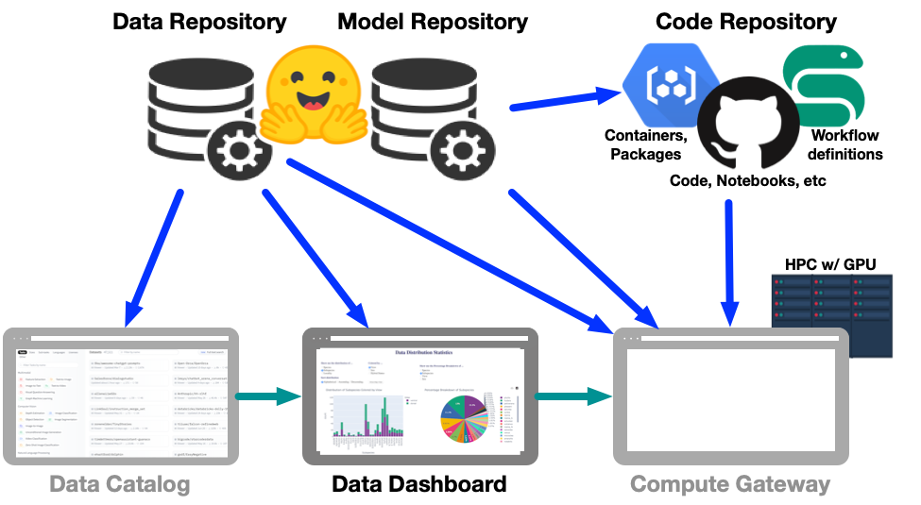
Metadata standards for FAIR and Reproducible Workflows And Their Components Enable Ecosystems

Slide 5
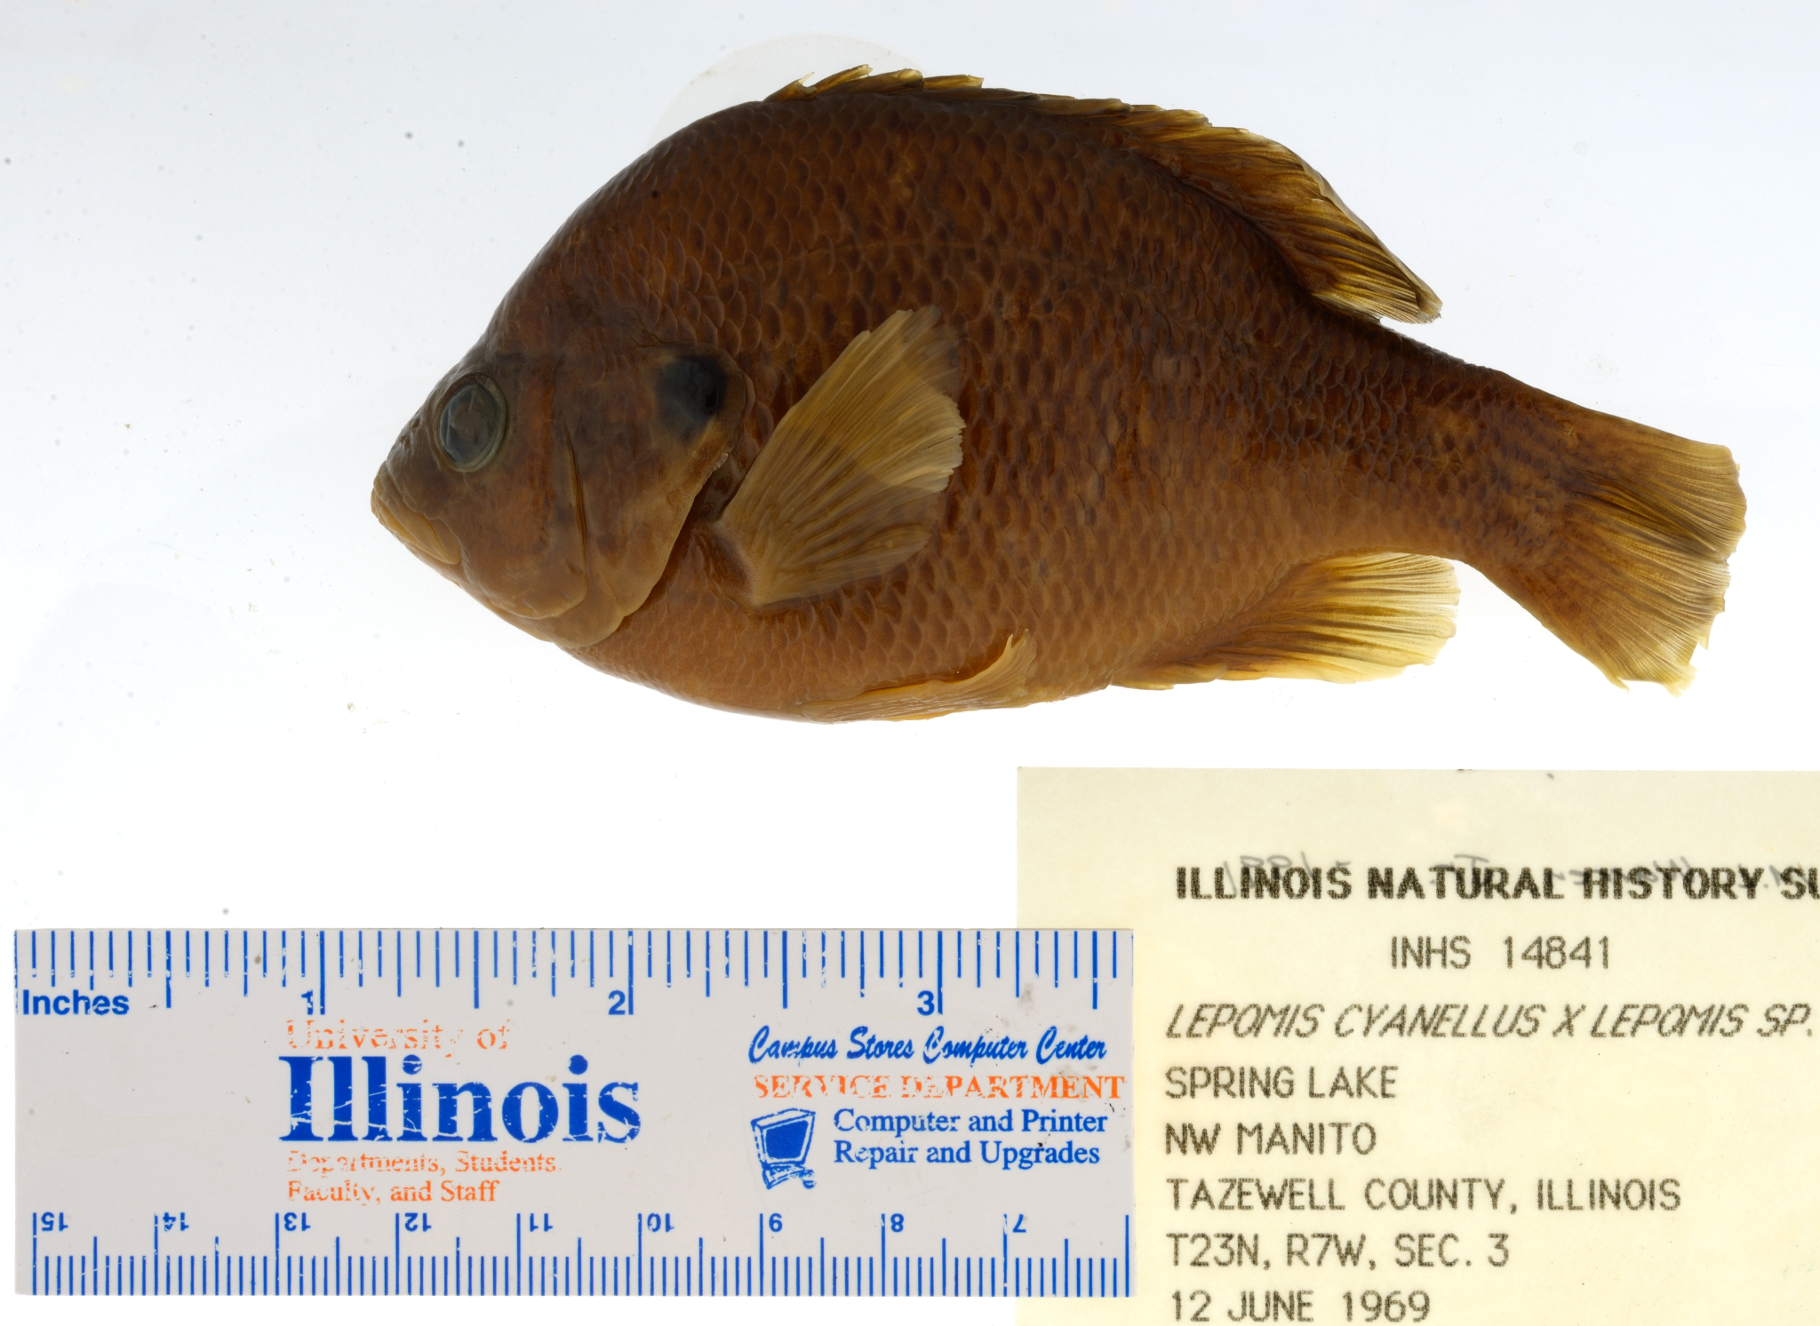
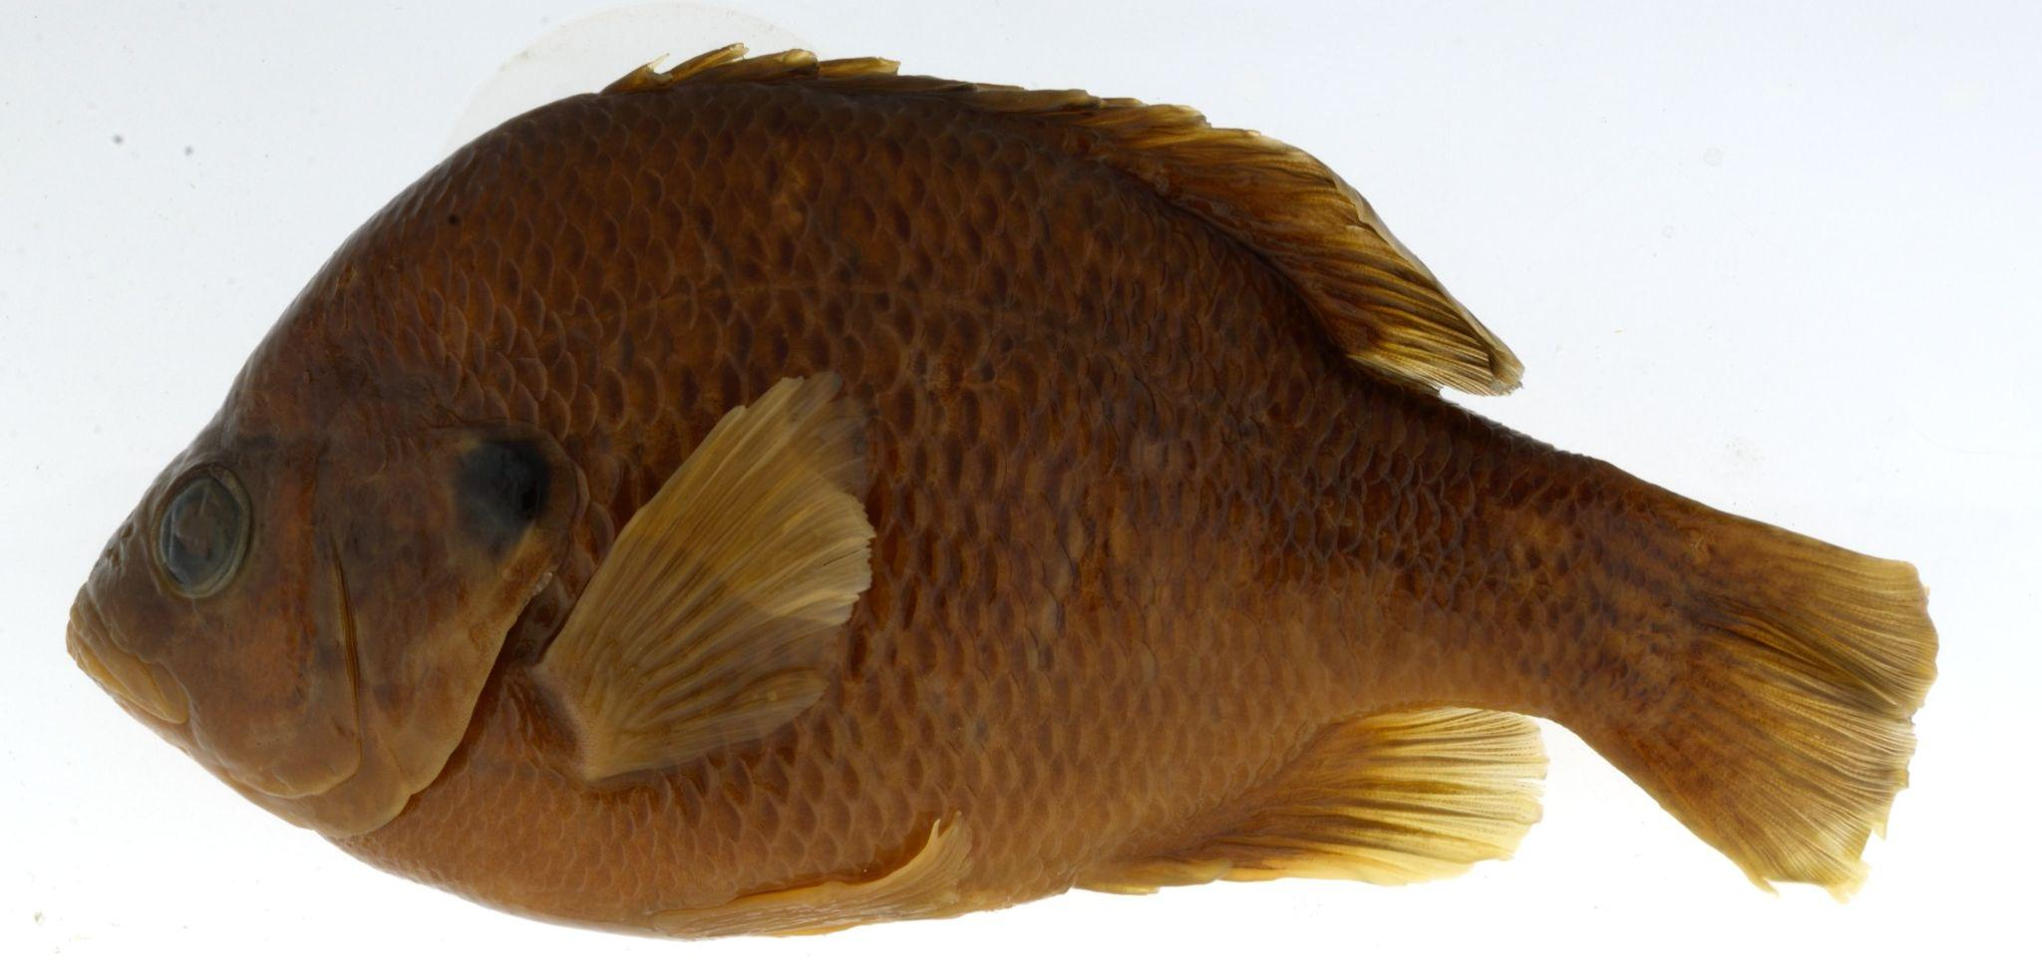
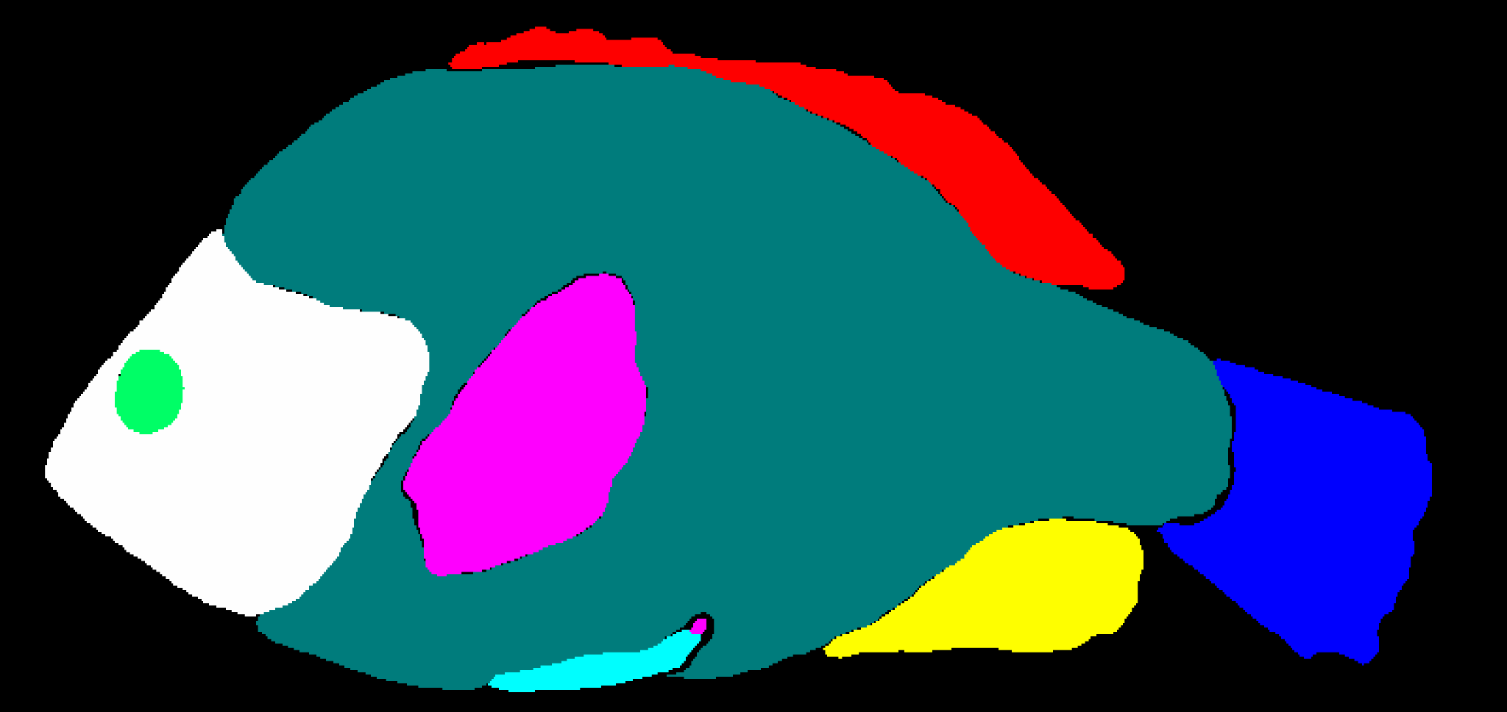
Domain Researcher Workflow: Conceptual
Input Files
Download Metadata
Filter Images
Get Images, image ML (object detection, object crop, segmentation, quantification of segments), output data
Analyze Data
Output Files
.csv
Notes:
Here is an generic workflow for using image data with machine learning. Generally, we find that researchers want to select images, download images, process images, and analyze the outputs. The things they want to store are the inputs and outputs, but maybe not the intermediate parts. They want to select the images themselves, and we recommend writing a script so that it is reproducible, and they want to create custom code to analyze the results. The first processing step of a machine learning workflow on images usually starts with some sort of object detection and processing to create a cropped image, followed by another machine learning process, like segmentation, classification, or landmarking.
The input files are stored on the OSU data commons. We have three currently: Image metadata (OPEN: https://datacommons.tdai.osu.edu/dataset.xhtml?persistentId=doi:10.5072/FK2/QOHJGD), Image Quality Metadata (OPEN: https://datacommons.tdai.osu.edu/dataset.xhtml?persistentId=doi:10.5072/FK2/ZIFDTJ), both of which were originally downloaded from here (OPEN: https://bgnn.tulane.edu/hdrweb/hdr/imagemetadata/); and Burress et al. 2017, which we’re using to help trim the dataset down to a study sample set (OPEN: https://datacommons.tdai.osu.edu/dataset.xhtml?persistentId=doi:10.5072/FK2/KLN3CS).
We have not yet saved the outputs, but will before publication.

Slide 6
Get Images
Process Image
Machine Learning
Create Mask
Generate Metadata
Crop Image
Download Images
Reformat Metadata
Segment Image
folder:
Mask
folder:
Images
folder:
Cropped
folder:
Segment
folder:
Metadata
_mask.png
_cropped.jpg
_segment.json
fishID.jpg
_metadata.json
BGNN_Core_Workflow
Notes:
We split these up into two workflows:
The core workflow [CLICK], which contains the components and rules that are more general than the case study. For example, generally someone wanting to use the minnow image dataset will want to download images, they may want to use the drexel code to generate metadata, may want to modify it by creating a new version of the drexel_metadata_formatter, and may want to crop the image, and may want to use the segmentation model. What a new project will want to do themselves is select the images to download and analyze the outputs.
The minnow trait repo calls the general workflow as well as the researcher’s own scripts. The fish use case, where we limited to minnows, is used to illustrate this workflow.

Slide 7
Minnow_Trait_Segmentation
Download Metadata
Filter Images
Get Images
Process Image
Machine Learning
Analyze Data
Create Mask
Generate Metadata
Crop Image
Download Metadata
Filter data
Download Images
Reformat Metadata
Segment Image
Analyze Segmentation
folder:
Mask
folder:
Files
folder:
Files
folder:
Images
folder:
Cropped
folder:
Segment
folder:
Results
folder:
Metadata
_mask.png
.csv
.csv
_cropped.jpg
tables, figures
fishID.jpg
_segment.json
_metadata.json
BGNN_Core_Workflow
Notes:
We split these up into two workflows:
The core workflow [CLICK], which contains the components and rules that are more general than the case study. For example, generally someone wanting to use the minnow image dataset will want to download images, they may want to use the drexel code to generate metadata, may want to modify it by creating a new version of the drexel_metadata_formatter, and may want to crop the image, and may want to use the segmentation model. What a new project will want to do themselves is select the images to download and analyze the outputs.
The minnow trait repo calls the general workflow as well as the researcher’s own scripts. The fish use case, where we limited to minnows, is used to illustrate this workflow.

Slide 8
FAIR, modular and fully reproducible workflow product
Containerization to isolate software environments
Workflow manager (Snakemake) for declarative rules and end-to-end workflow automation. Automation portable between HPC environments.
Executable and modifiable by biology domain scientist
All digital components are FAIR

Slide 9
Why Snakemake?
Readable and modifiable by domain scientists; specification language is a syntactical extension of Python
Supports both software containers and conda environments for dependency definition, reproducible installation, and isolation
Promotes workflow modularization: workflows can themselves be components
Execution is scalable from single to multi-core, HPC cluster, etc
Highly configurable
Extensible via plugin system

Slide 10
Role of Metadata & Ontologies

Slide 11
FAIR workflows should have FAIR components
Principle | Levels | Data and Metadata |  | Software |  | ML Models
 |  | Wilkinson et al. 2016 | Our Application | Barker et al. 2022 | Our Application | Our Application
Findable | 1 | Data and metadata are assigned a globally unique identifier | All metadata and data are available with the archives, which have a globally unique identifier (Table 1) | Assigned a globally unique identifier | All software have a globally unique identifier for their archive (Table 1) | ML models are given a unique identifier and are versioned (Table 1)
 | 1.1 |  |  | Components of software representing levels of granularity are assigned distinct identifiers | Every release is given a new DOI by the archive | Revision included in DOI citation
 | 1.2 |  |  | Different versions of the software are assigned distinct identifiers | Each version is given a unique identifier using Semantic Versioning | Identifiable by commit hash from version control

Slide 12
Principle | Levels | Data and Metadata |  | Software |  | ML Models
 |  | Wilkinson et al. 2016 | Our Application | Barker et al. 2022 | Our Application | Our Application
F I N D A B L E | 2 | Data are described by rich metadata | All data items have associated metadata with the archive and in their repository | Described by rich metadata | All software have associated metadata in the archive and in their repository | All models have associated metadata in the repository in the form of rich model cards
 | 3 | Metadata clearly and explicitly include the identifier of data or software they describe |  |  |  | Metadata includes provenance for training and base models
 | 4 | Data and metadata are registered in a searchable resource | All image metadata are hosted by Fish-AIR, which is searchable, and they are in an archive; all image data are hosted by Fish-AIR, which is searchable, and retrievable from their metadata files | Metadata are FAIR, searchable, and indexable | Software container images are in the GitHub container registry | Models are in Hugging Face repository, which is searchable by various model attributes

Slide 13
Principle | Levels | Data and Metadata |  | Software |  | ML Models
 |  | Wilkinson et al. 2016 | Our Application | Barker et al. 2022 | Our Application | Our Application
A C C E S S I B L E | 1 | Data and metadata are retrievable by identifier using a standardized communications protocol | We bring in metadata and data from the archive using its unique identifier and import using WM and config file | Retrievable by identifier using a standardized communications protocol | Code from GitHub and container images are recruited using unique identifiers and container version by the workflow definition | Models and their weights are retrievable by a unique identifier by the workflow definition
 | 1.1 | Protocol is open, free, universally implementable | Fish-AIR (repository) and Zenodo (archive) use HTTP(S) GET |  |  | Protocol is HTTPS or Git version control
 | 1.2 | Protocol allows for authentication and authorisation, when necessary
 | 2 | Metadata are accessible, even when data or software are no longer available | We have created a download to retrieve data and software

Slide 14
Prin- ciple | Levels | Data and Metadata |  | Software |  | ML Models
 |  | Wilkinson et al. 2016 | Our Application | Barker et al. 2022 | Our Application | Our Application
I N T E R O P E R A B L E | 1 | Data and metadata use a formal, accessible, shared language for knowledge representation | Metadata in a csv file that is readable; image data are retrieved from a URL | Reads, writes, and exchanges data in a way that meets domain-relevant community standards | We read in and use the software through a WM that is available to the community and used in biological research | Models are in PyTorch format
 | 2 | Data and metadata use vocabularies that follow FAIR principles | Vocabularies for metadata determined by the community (for the fish image metadata) or are from Dublin Core (DC), Darwin Core (DwC), and Audiovisual Core (AC) and other biodiversity standards
 | 3 | Data and metadata includes qualified references to other data and metadata | Metadata references the image data by URL; some metadata vocabularies from DwC | Includes qualified references to other objects | Software dependencies enumerated in requirement definitions (i.e., for python, R, external repositories, model weights, and all container images).

Slide 15
Principle | Levels | Data and Metadata |  | Software |  | ML Models
 |  | Wilkinson et al. 2016 | Our Application | Barker et al. 2022 | Our Application | Our Application
R E U S A B L E | 1 | Data and metadata are richly described with a plurality of accurate and relevant attributes | Fish-AIR has image metadata and vocabulary documentation | Richly described with a plurality of accurate and relevant attributes | Software metadata includes authors/attribution, licensing, release version and data, mention other dependencies where necessary, and rich, informal descriptions (e.g., README files) | Rich metadata descriptions in the form of model cards, includes authors/attributions, licensing, and versioning in the form of commit hashes
 | 1.1 | Data and metadata are released with a clear and accessible data usage license | All components, repositories, and archives have a license | Released with a clear and accessible data usage license | All software, repositories, and archives have a license | All models have a license

Slide 16
Principle | Levels | Data and Metadata |  | Software |  | ML Models
 |  | Wilkinson et al. 2016 | Our Application | Barker et al. 2022 | Our Application | Our Application
R E U S A B L E | 1.2 | Data and metadata are associated with detailed provenance | All image metadata include information of the hosting and data-governing institution | Associated with detailed provenance | All repositories, container images, and archived snapshots include information about authors and versioning; all GitHub repositories have CITATION.cff files | Metadata describes the software and data used to train the models to produce the weights
 | 1.3 | Data and metadata meets domain-relevant standards | Image metadata format and vocabulary use domain-relevant standards (i.e., CSV, XML, DwC); image data use standard formats | Meets domain-relevant standards | Container images are dockerized and reusable by Singularity in HPC environments; YAML files define code dependencies | Model cards are a Hugging Face standard, and PyTorch is a ML standard

Slide 17
Takeaways:
Metadata, and therefore metadata vocabularies and ontologies are foundational to achieving FAIR products
In contrast to data and software, the foundations for FAIR ML models are only just emerging:
FAIR checklist
Metadata standards and vocabularies
Format standards promoting interoperability
Model commons
FAIR and Reproducible ML workflows are another step behind

Slide 18
Challenges & Opportunities

Slide 19
Some suggestions for a FAIRR ML workflow checklist
Workflow definition
Under version control and in an open repository
Uses releases following semantic versioning for naming.
Workflow components (tools, component workflows, etc) are FAIR:
Under version control in an open repository;
Associated with a globally unique identifier, and identified by version, ideally using releases following semantic versioning for naming
Installable automatically by the workflow execution engine (published container image, or conda environment dependencies formally defined)
Associated with metadata for provenance, citation etc.
Data inputs are FAIR:
Published under a common open content license (or at least one that permits free reuse for research)
Available through fully automatable download, i.e., requiring no authentication or authorization steps that cannot be fully automated
Associated with a globally unique identifier, and identified by version;
Available in an interoperable and reusable standard format;
Associated with provenance, citation, and other metadata using standard vocabularies and format.
ML Models are FAIR:
Under version control in an open repository such as HF;
Identified by the workflow by version, ideally using releases following semantic versioning;
Available under an open license;
Available in a standard interoperable format (e.g., PyTorch)
Associated with metadata, ideally in the form of Model Cards, and including provenance, citation, etc

Slide 20
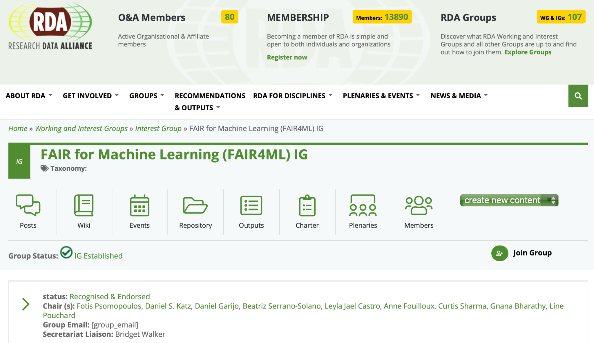
Connect with national and international community efforts

Slide 21
Acknowledgements
Biology-Guided Neural Networks Teams
Drexel: Jane Greenberg, Joel Pepper, David Breen, Kevin Karnani
VT: Anuj Karpatne, M. Maruf
Tulane: Hank Bart, Yasin Bakis, Bahadir Altintas, Xiaojun Wang, Dom Jebbia
NEON: Paula Mabee, Chris Florian, Thibault Tabarin
Balk et al, A FAIR and modular image-based workflow for knowledge discovery in the emerging field of imageomics. Methods in Ecology and Evolution, in press.
National Science Foundation

