Slide 1
Metadata for Reproducible Big Data Analytics in the Cloud
Jianwu Wang
Big Data Analytics Lab, UMBC (bdal.umbc.edu)
iHARP: NSF HDR Institute for Harnessing Data and Model Revolution in the Polar Regions (iharp.umbc.edu)
AI-Ready Data Workshop: Navigating the Dynamic Frontier of Metadata and Ontologies (April 15-16, 2024)
Notes:
15 minutes in total.

Slide 2
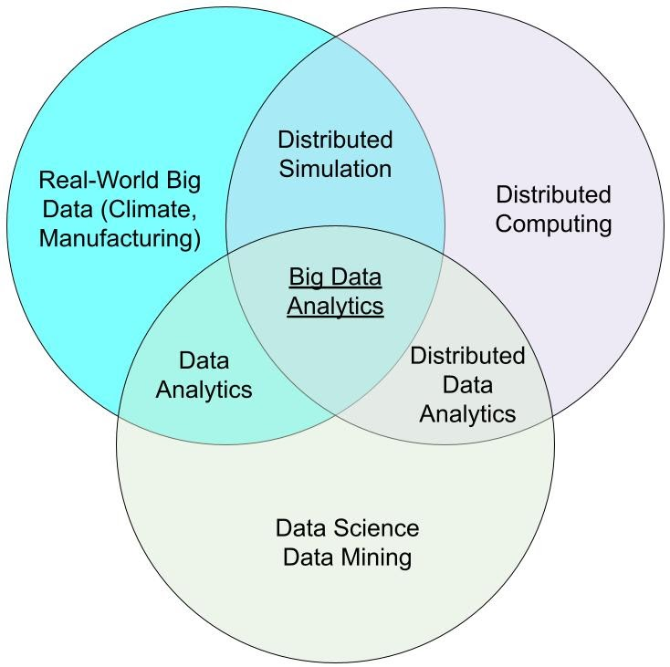
About Me and My Lab (Big Data Analytics Lab)
Center on big data analytics with three connected and supporting areas
Distributed computing: key enabling computing infrastructure for big data
Data science: core research topic to learn patterns from big data
Real-world big data: research frontier to identify new research challenges and evaluate research contribution and impacts
Holistic and end-to-end research
Identify new and important research challenges
Propose integrative solutions
Evaluate from many aspects: efficiency, effectiveness, helps to domain scientists, etc.
Notes:
Venn:

Slide 3
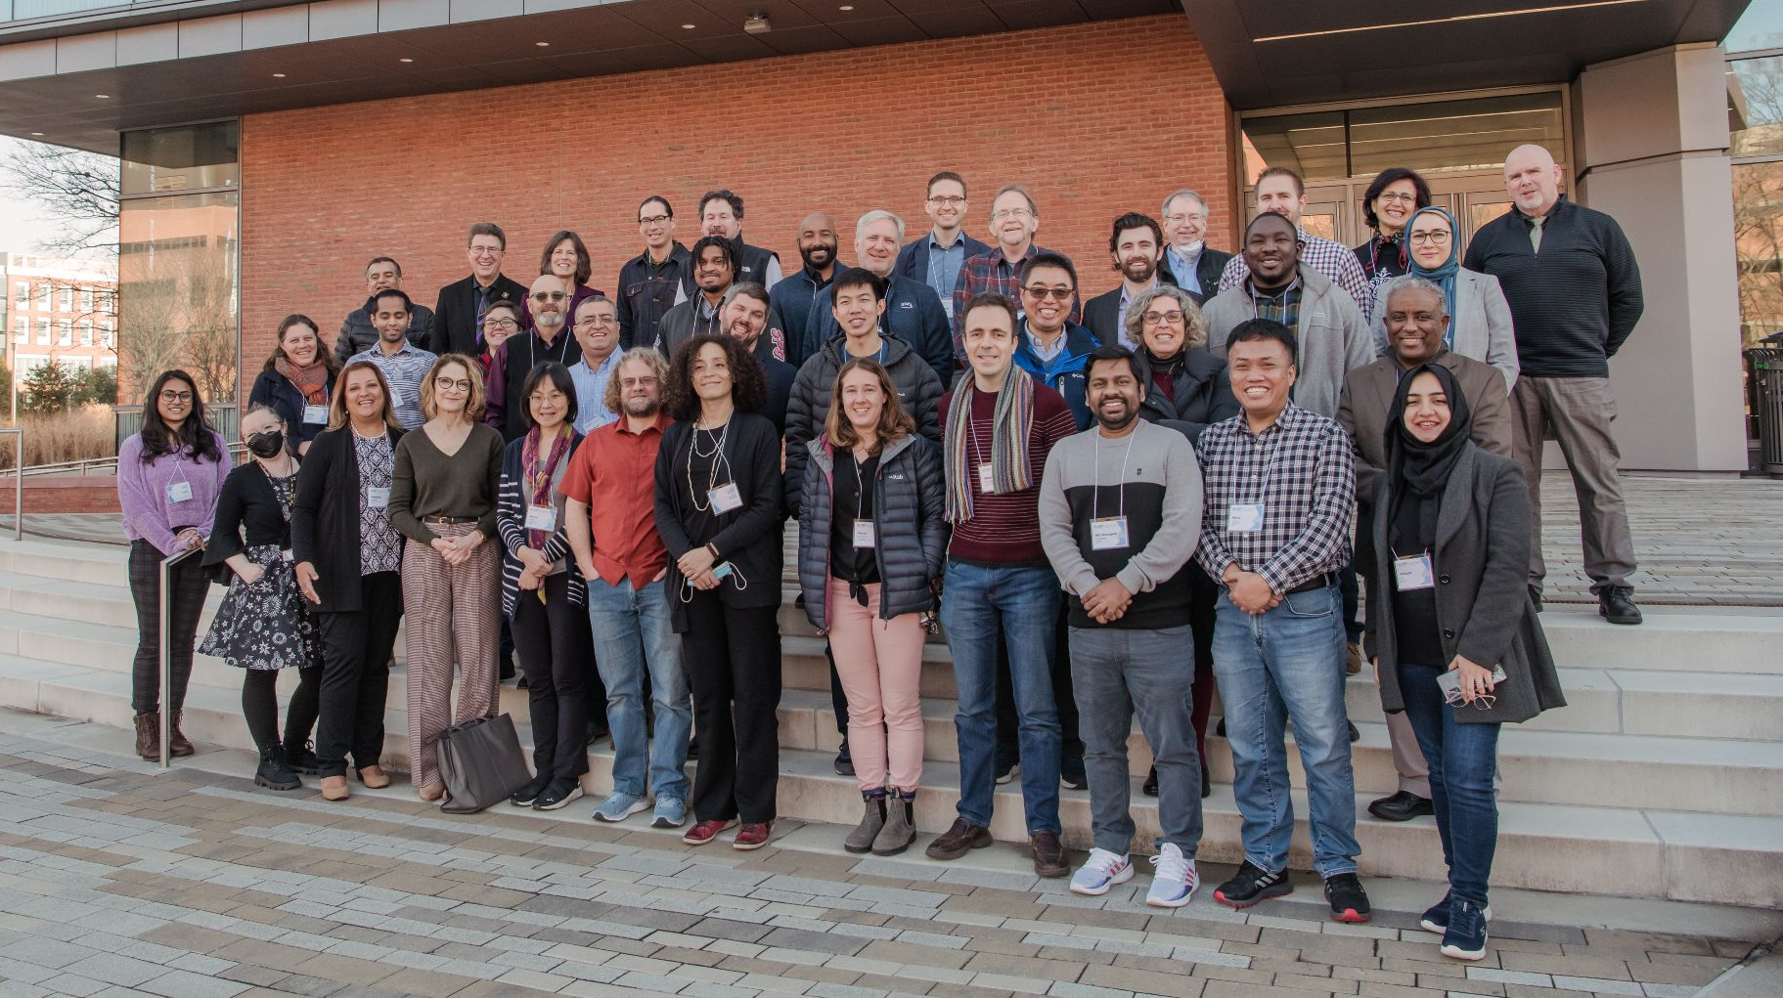
https://iharp.umbc.edu/
Vision | iHARP advances our understanding of the response of polar regions to climate change and its global impacts by deeply integrating data science and polar science to spur physics-informed, data-driven discoveries.
Mission | iHARP conducts data intensive research, education, outreach, and cyberinfrastructure development that will transform understanding of the effects of climate change in polar regions. This institute brings together stakeholders and leading scholars in data science and polar science to reduce uncertainties in projecting Greenland and Antarctica’s future mass balance, associated sea-level rise, and impacts on global communities.
Photo of iHARP Members, Collaborators and Partners taken at the January 2023 All Hands Meeting. Photo by Marlayna Demond ’11 for UMBC
Current opportunities (https://iharp.umbc.edu/op/): 1) Call for Synergy Incentives Program (SIP) Proposals, 2) Call for iHARP Polar Informatics Graduate and Visiting Research Fellows
9 Collaborating Universities
20+ Partners in Government, Academia
and Industry
25+ Senior Researchers
20+ Student Researchers and growing (High School, Undergraduate, Graduate, PhD)
30+ Individual Collaborators
11+ Projects
4 Focus Areas
1 Overarching theme of Education & Outreach

Slide 4
Introduction: Reproducibility
Definition: a capability that obtains consistent results using the same computational steps, methods, and code
By reproducing an existing experiment, we can have more confidence in the research.
We can also explore how the experiment behaviors with different configurations like input datasets, execution arguments and environments

Slide 5
Challenges: Reproducibility
It is still difficult to achieve end-to-end automated big data analytics execution and reproduction in the cloud. The end-to-end automation should support
scale-up and scale-out of distributed hardware & software environment provisioning
data and configuration storage for each execution
resource termination after execution
execution history query
The services provided by each service provider such as AWS and Azure are proprietary, an application developed for one cloud cannot run in another cloud.

Slide 6
Background - Cloud-based reproducibility
Cloud has become a popular environment to run AI applications and other data analytics.
E.g., NASA is moving all its Earth data to the cloud for easier data access and processing.
Three aspects could vary during reproduction of an existing application:
Different application configuration (dataset, application argument, etc.) to know how the application performs with different datasets or arguments.
Different cloud provider hardware environment (virtual machine type and number, etc.) within the same cloud provider to test scale-up and scale-out.
Different cloud providers to avoid vendor lock-in problem.

Slide 7
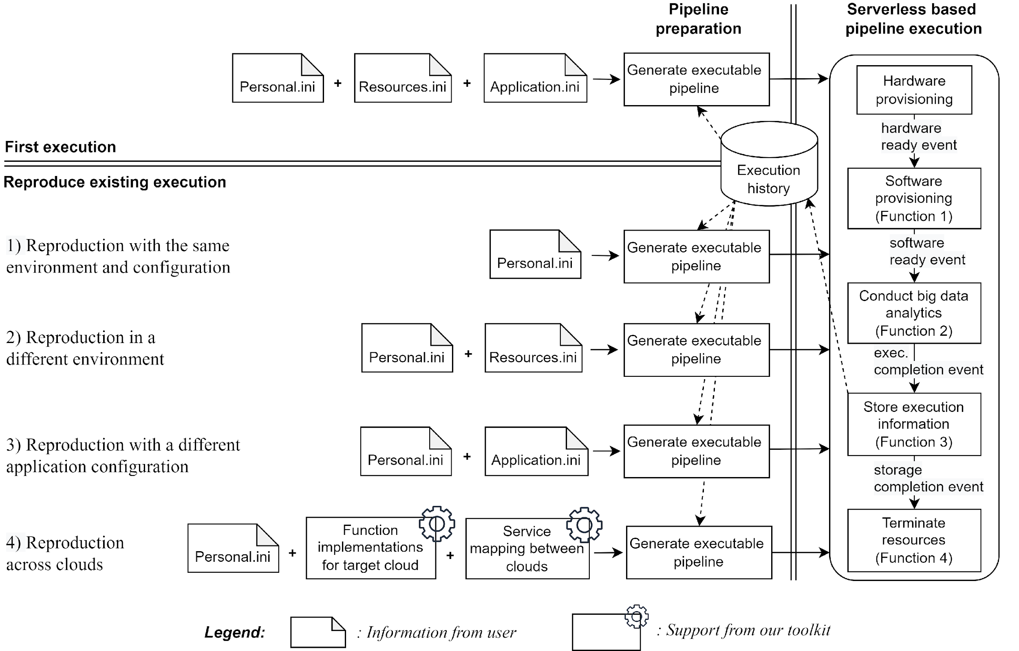
Reproducible and Portable Big Data Analytics in the Cloud (RPAC) Toolkit
RPAC enables users to easily re-run previous experiments with the same or different setups.
First execution of an application
Reproduction of the existing execution by querying historical configurations

Slide 8
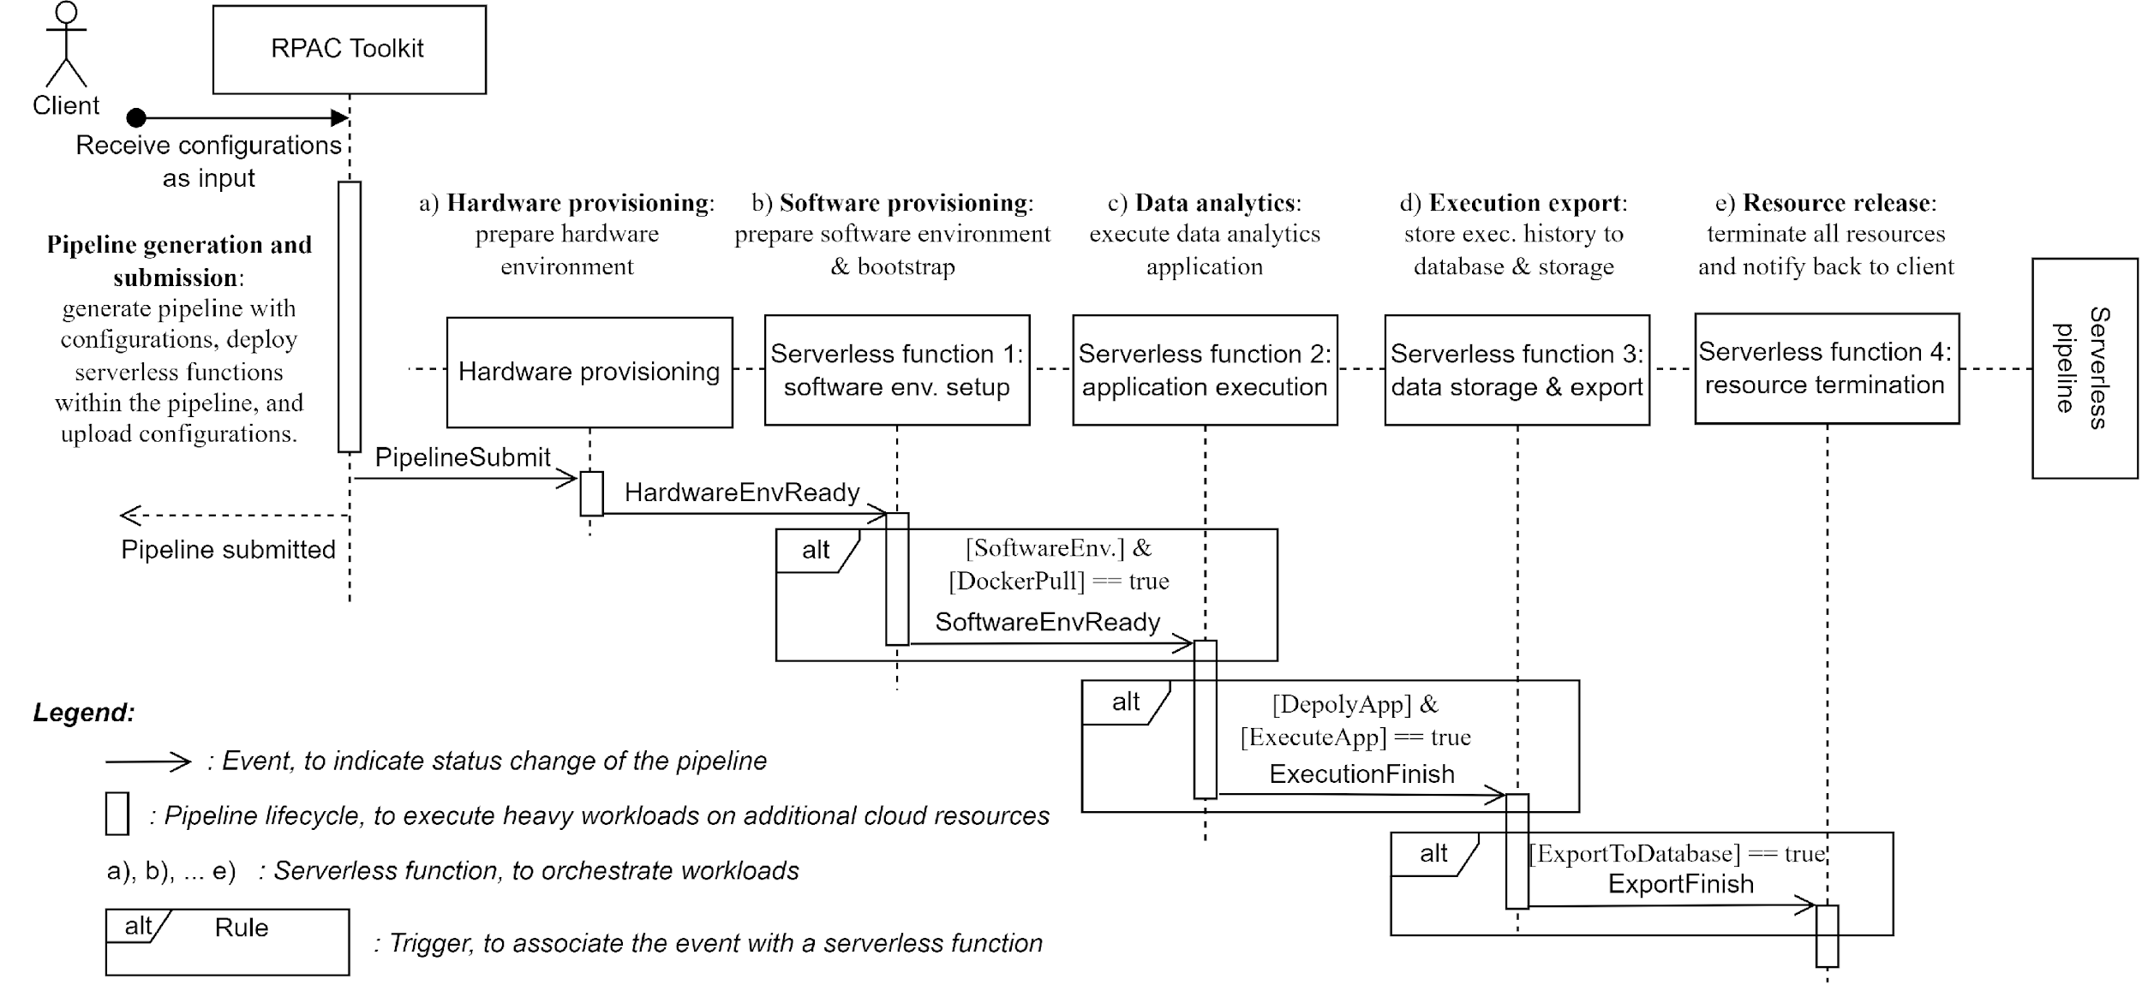
Serverless and Docker-based Execution Automation
Serverless computing offers templates to describe cloud resources required by the application
Each component in the application pipeline is implemented as a serverless function and triggered by the events it listens to

Slide 9
Metadata for Cloud based Reproducibility
To avoid learning specific specifications and templates for specific clouds, we extract minimal information a user has to provide for application execution or reproduction.
resources.ini stores hardware and software resources information: virtual machine type, virtual instance number, docker image and big data engine;
application.ini records the program URI of the application, program arguments, and input dataset URIs of the program;
personal.ini contains the cloud credential information: SSH key location and cloud credential info.

Slide 10
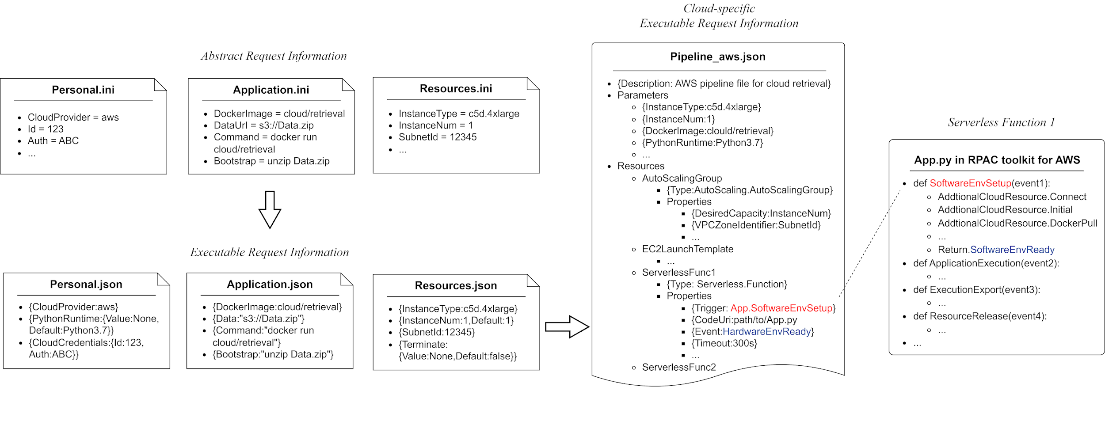
Mapping from Abstract Requirement to Executable Cloud Specific Serverless Pipeline and Functions
The abstract request information is first transferred to the executable request information while missing parameters can be filled with their default values. All parameters in the executable request information are also sorted out based on the cloud-specific schema.
Notes:
The abstract request information is first transferred to the executable request information while missing parameters can be filled with their default values. All parameters in the executable request information are also sorted out based on the cloud-specific schema.

Slide 11
Extensibility
Our toolkit can be easily extended to additional clouds because most services from different cloud providers can be mapped to each other.

Slide 12
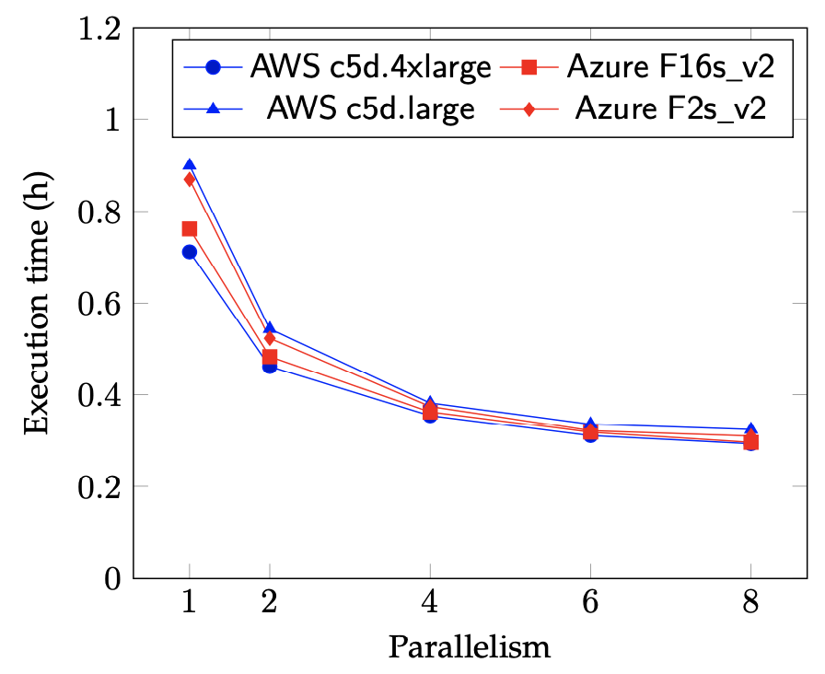
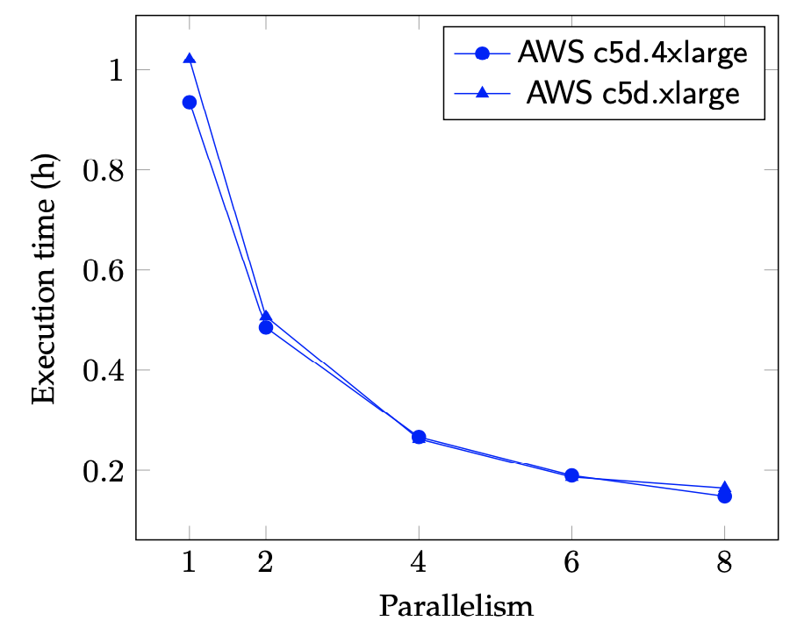
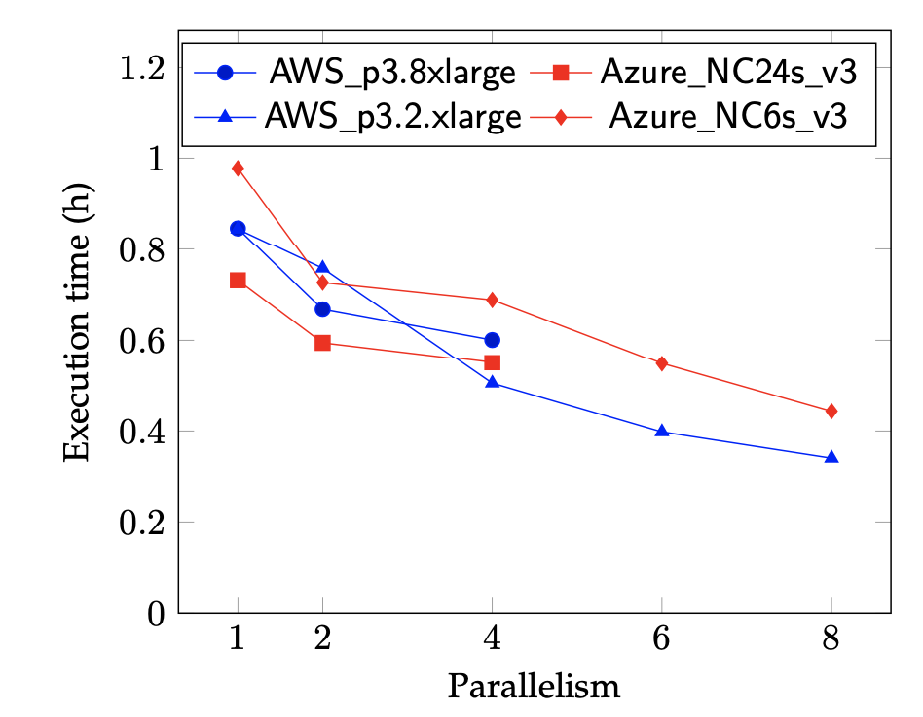
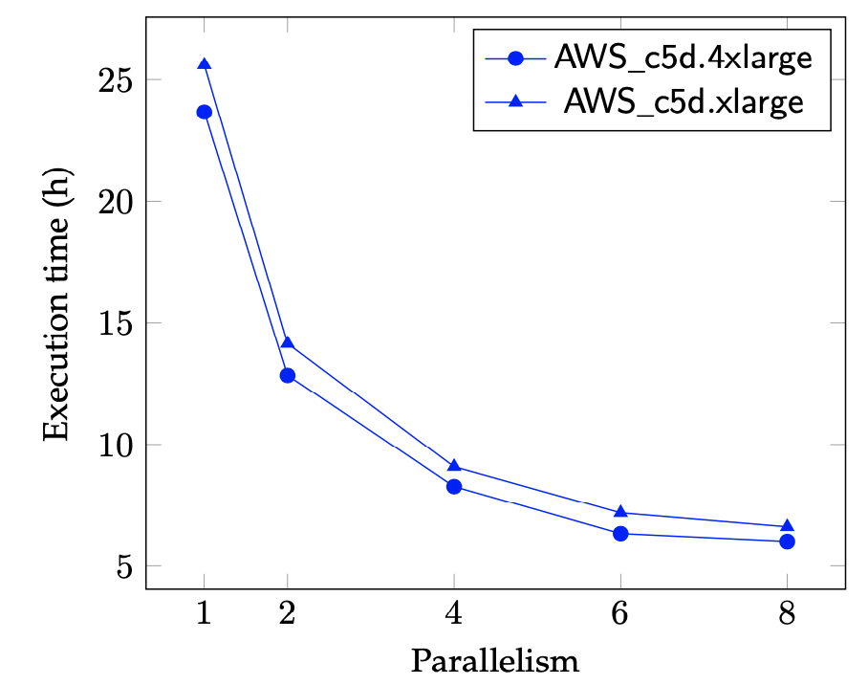
Experiments
We did CPU and GPU based scalability experiments for reproducibility support for both AWS and Azure.
Cloud retrieval
Causality discovery
Domain adaptation
Data collocation
A)
B)
Experiments include both scale-up (circle and square mark) and scale-out (triangle and diamond mark) cases
D)
C)

Slide 13
Limitations
The work focuses on computation environment of AI readiness
Machine learning pipeline is treated as a black box
Opportunities
Complete metadata for all three aspects of AI readiness (data, AI model, and computation environment).
One DOI for all vs three interoperable DOIs
Some community guidance/standards on metadata for cloud-based reproducibility?
An example: W3C Provenance Data Model Standard (https://www.w3.org/TR/prov-dm/)

Slide 14
Acknowledgements
Funding from NASA and NSF
Developing Passive Satellite Cloud Remote Sensing Algorithms Using Collocated Observations, Numerical Simulation and Deep Learning, NASA
CAREER: Big Data Climate Causality Analytics, NSF
NSF Harnessing Data Revolution (HDR) Institute: Harnessing Data and Model Revolution in the Polar Regions (iHARP), NSF
Paper info: Xin Wang, Pei Guo, Xingyan Li, Aryya Gangopadhyay, Carl E. Busart, Jade Freeman and Jianwu Wang. Reproducible and Portable Big Data Analytics in the Cloud. IEEE Transactions on Cloud Computing, vol. 11, no. 3, pages 2966-2982, 1 July-Sept. 2023. DOI:10.1109/TCC.2023.3245081. https://github.com/big-data-lab-umbc/Reproducible_and_portable_app_in_cloud
My contact info: Jianwu@umbc.edu

