Slide 1
Innovating the Standards Process with YAMZ: Yet Another Metadata Zoo and AI Implications
Isabel Moreira de Oliveira and Scott McClellan
OAC-2118201
Notes:
First introduce structure: Context of

Slide 2
Collaborative Vocabulary and Civil Engineering
Civil engineering relies upon communicating among a variety of fields such as architecture and construction to accomplish goals
Terminological differences among stakeholders can impede consensus or introduce ambiguity into projects
Terminology forms an important part of the standards-making process but often typifies dominant or majoritarian approaches to a subject
Standards often do not reflect neologisms or non-normative usages of terms which may also inform practical considerations

Slide 3
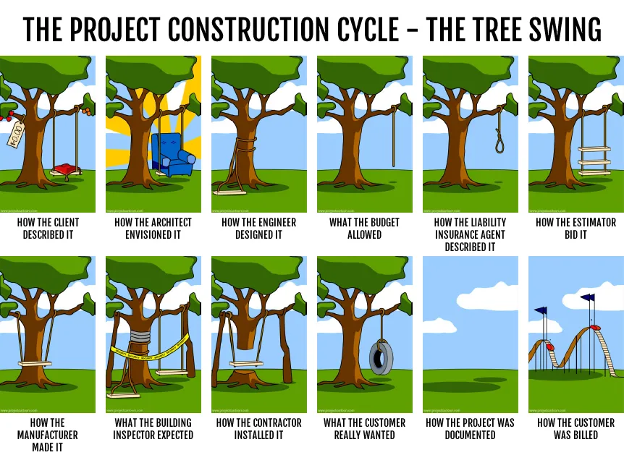
Communication in the AEC industry
AEC
Architecture, Engineering and Construction
https://medium.com/@yewandesulaiman/the-product-manager-her-product-and-her-customer-7927399dc36a

Slide 4
Collaborative Vocabulary and Civil Engineering
Civil engineering relies upon communicating among a variety of fields such as architecture and construction to accomplish goals
Terminological differences among stakeholders can impede consensus or introduce ambiguity into projects
Terminology forms an important part of the standards-making process but often represents dominant or majoritarian approaches to a subject
Standards often do not reflect neologisms or non-normative usages of terms which may also inform practical considerations

Slide 5
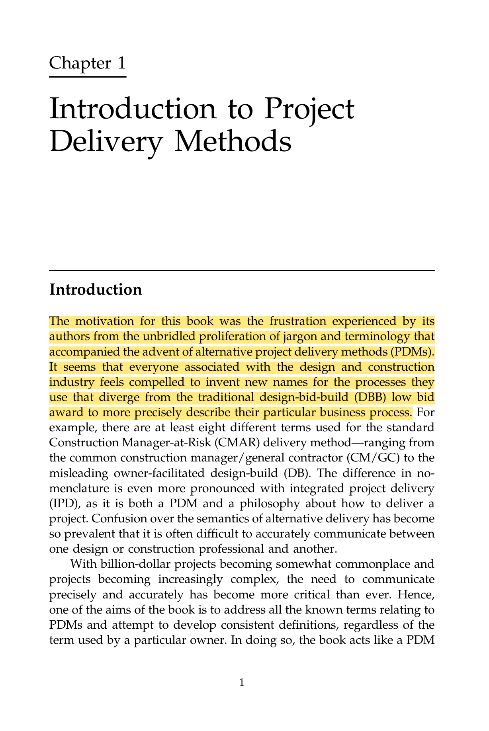
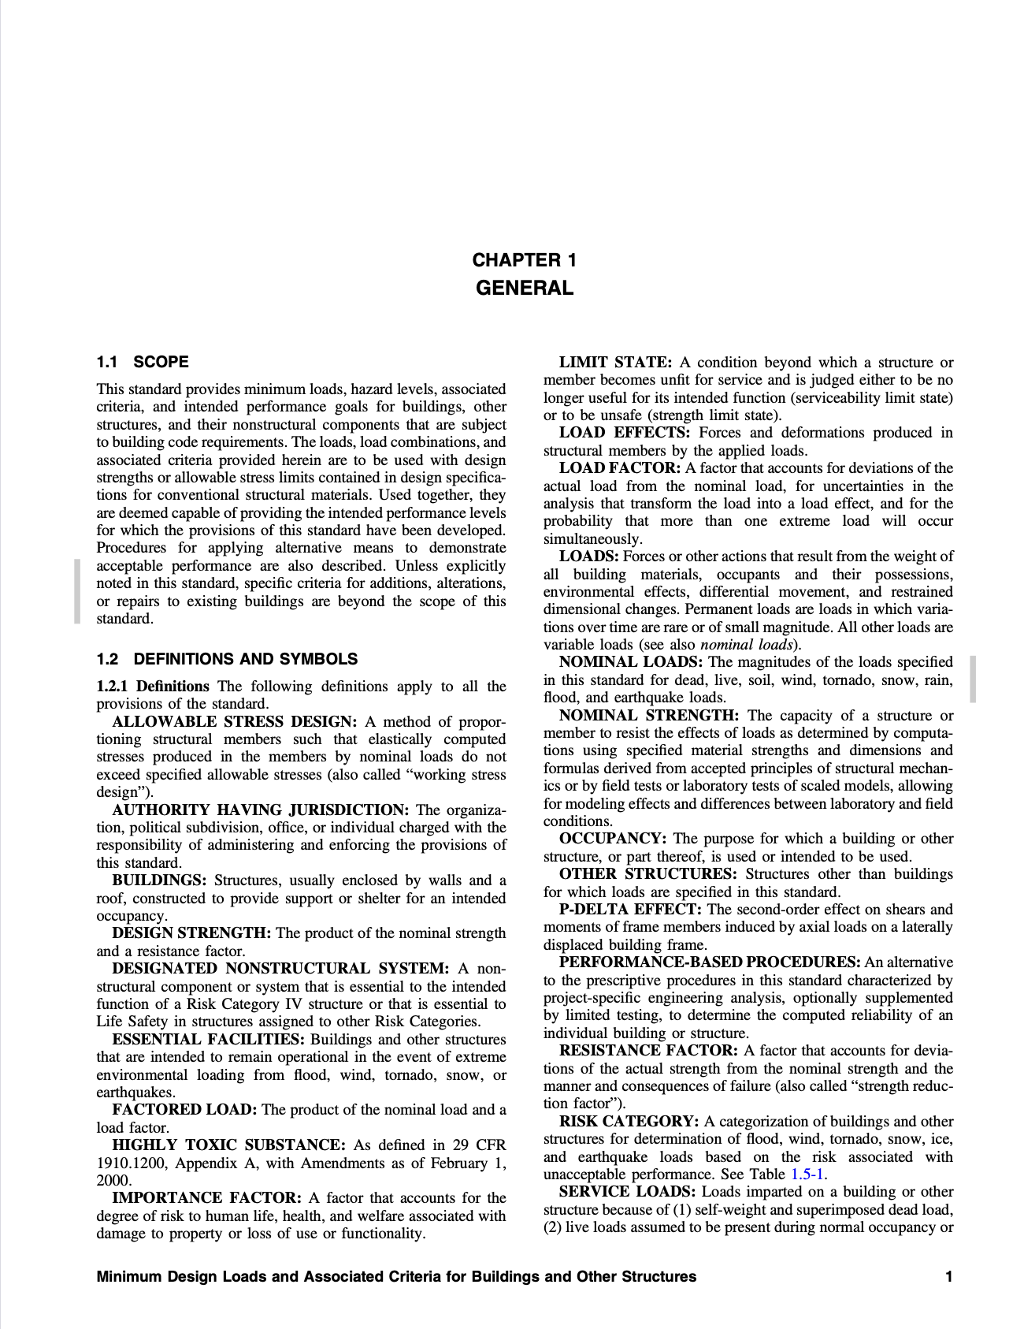
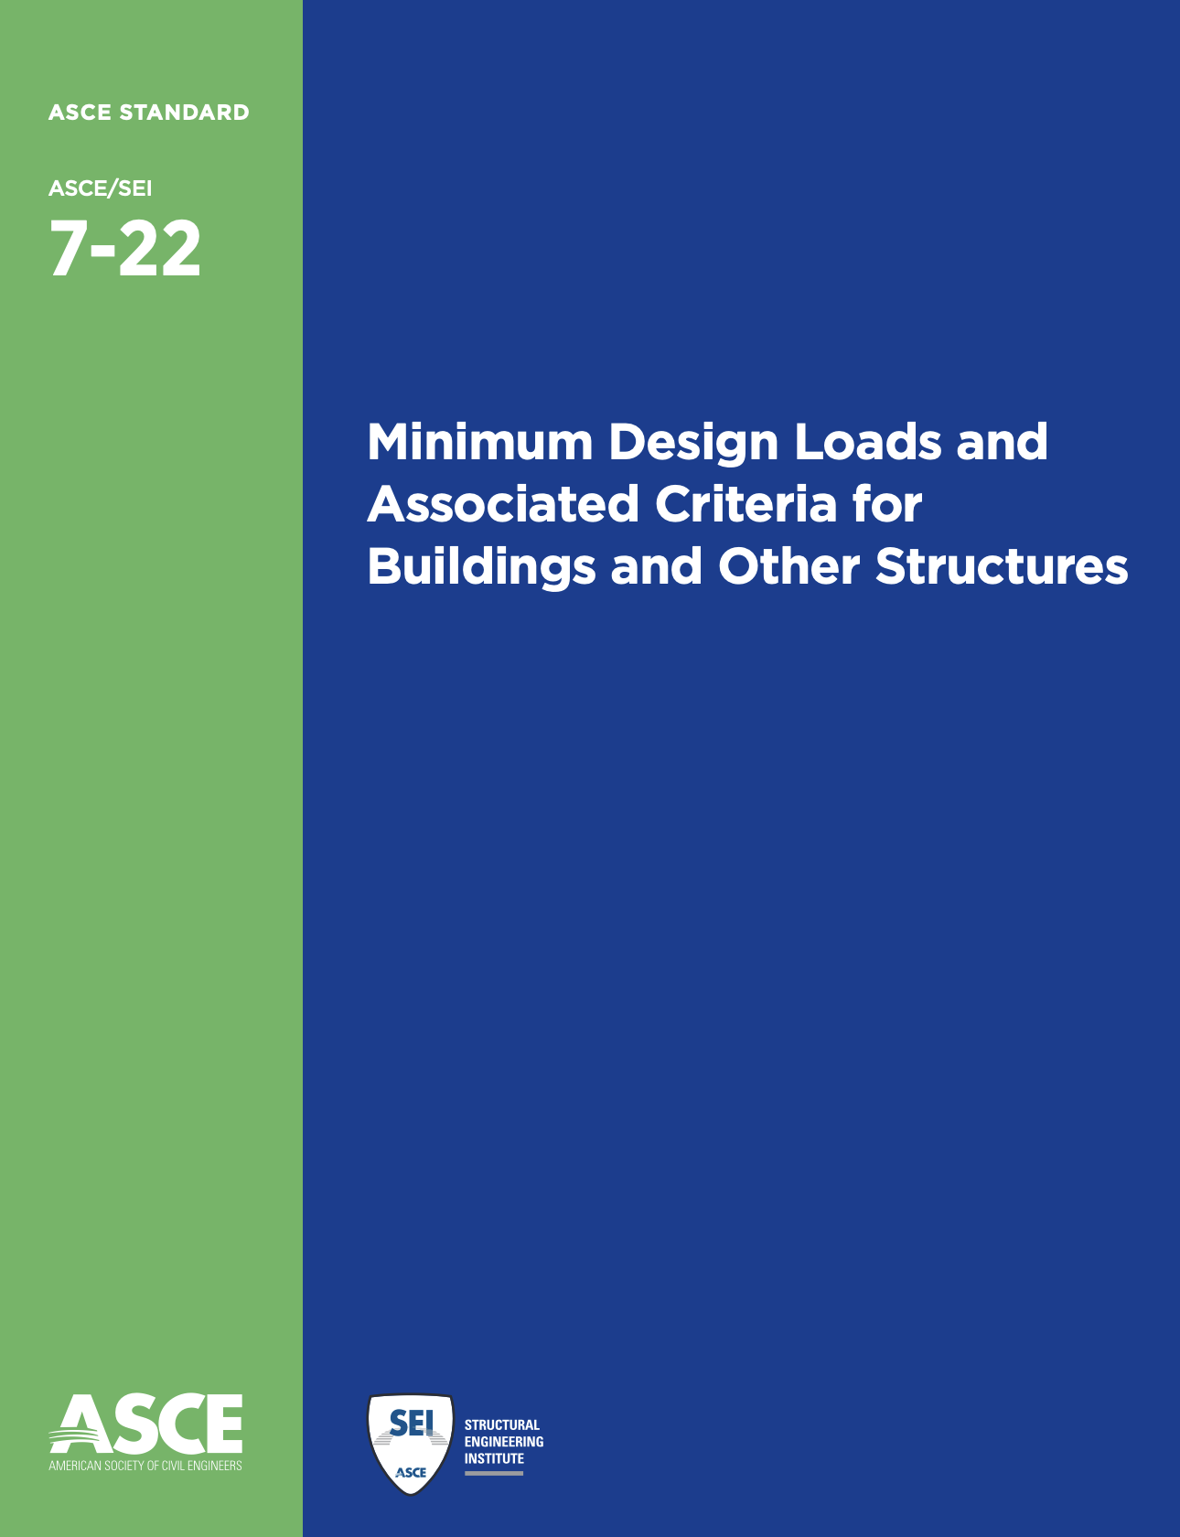
Standards vs. primers in AEC
Strict
Flexible
Notes:
The moments prior to the primers and design guide developments are the ones where vocabulary is being decided upon and decisions are made to include or exclude terms from glossaries

Slide 6
Collaborative Vocabulary and Civil Engineering
Civil engineering relies upon communicating among a variety of fields such as architecture and construction to accomplish goals
Terminological differences among stakeholders can impede consensus or introduce ambiguity into projects
Terminology forms an important part of the standards-making process but often typifies dominant or majoritarian approaches to a subject
Standards often do not reflect neologisms or non-normative usages of terms which may also inform practical considerations

Slide 7
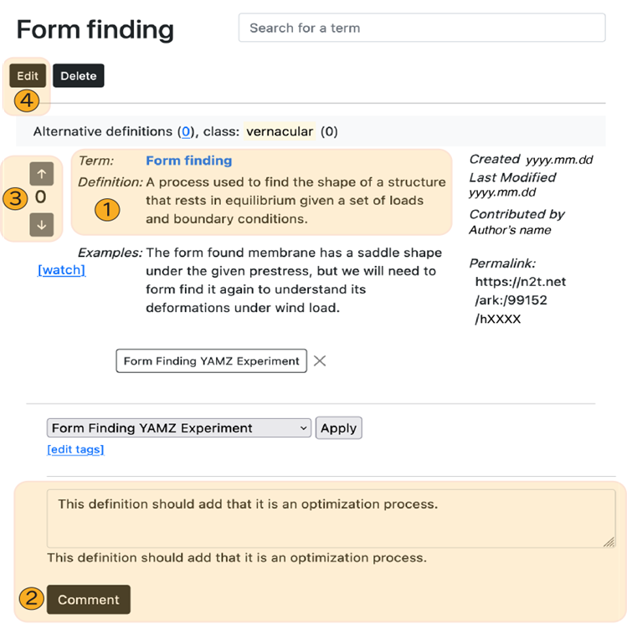
Yet Another Metadata Zoo (YAMZ)
Collaborative vocabulary platform that allows users to define terms and add examples
Each entry receives a persistent identifier (PID) in the form of an archival key (ARK)
Users can comment and vote on terms, similar to Stackoverflow
Voting allows communities to organically decide on best definitions
PIDs provide users unique, dereferenceable links to their terms
Site: https://www.yamz.net
Repository: https://github.com/metadata-research/yamz
I.M. de Oliveira and S. McClellan et al., 2023 (Under Review)

Slide 8
Challenges in Semantics and AI-Ready Data
Emergent vocabularies may not be sufficiently stable to assist classification
Artificial intelligence applications rely upon human-in-the-loop to provide understanding or meaning to the insights and results they produce
Precision and nuance in terminology assists such insights but only insofar as they allow community members to communicate
YAMZ allows for organic development of terminology which may overcome such problems as:
Neologism
Unstable terminology
Polysemy
YAMZ provides a path for easing transdisciplinary connections broadening vocabulary accessibility

Slide 9
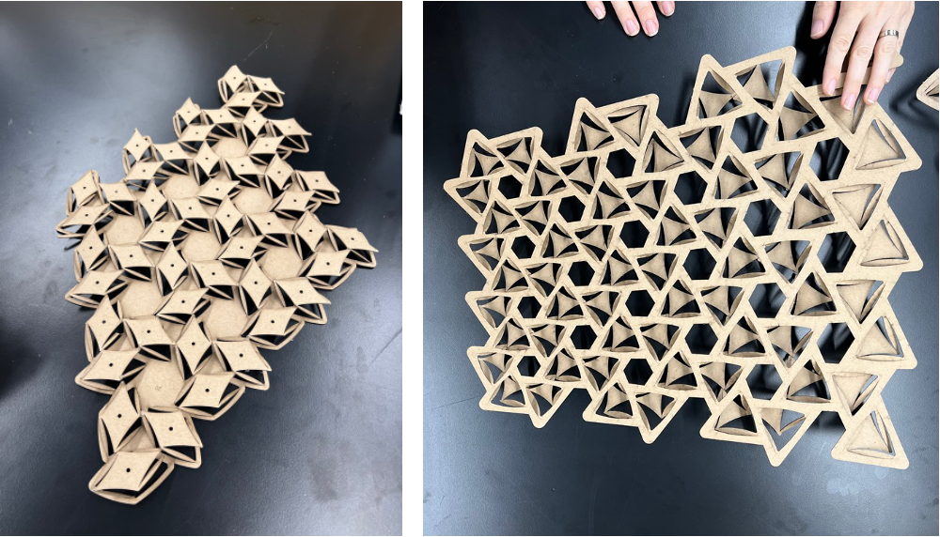
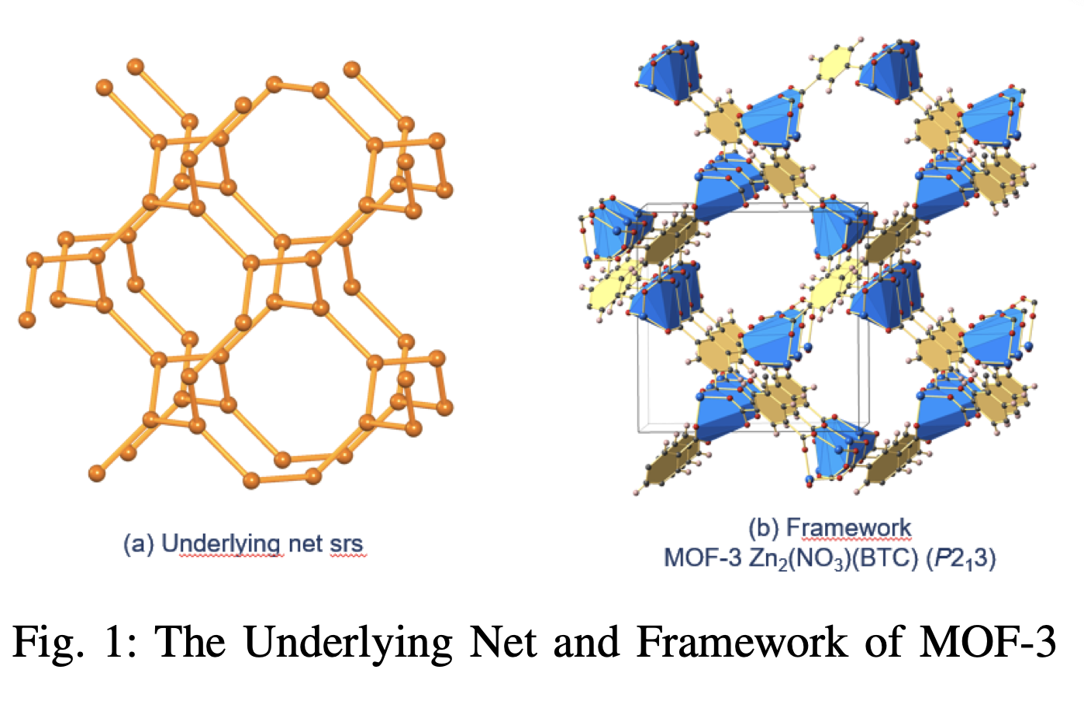
Challenges in the Standards Space
YAMZ can allow for better description of inputs and outputs of AI algorithms
Transitioning from definitions to describing outputs decreases the gap between different disciplines, e.g.: kirigami, MOFs, etc.
Y. An et al. 2022
E. Baker, 2023

Slide 10
Challenges in the Standards Space
How can YAMZ specifically allow for better description of inputs and outputs of AI algorithms?
Transitioning from definitions to describing outputs decreases the gap between different disciplines, e.g.: kirigami, MOFs, metamaterials, etc.
Leveraging similarities across definitions to develop robust communal vocabularies which assist machine learning techniques
How might YAMZ assist in aligning area-specific metadata/terminology with established industry standards? E.g. form finding

Slide 11
Acknowledgments
We would like to acknowledge John Kunze, the developer of YAMZ, and Chris Rauch, who has helped maintain and develop the application.
We would like to acknowledge funding from NSF OAC # 2118201.
References
Yuan, A., Greenberg, J., Zhao, X., Hu, X., McCLellan, S., Kalinowski, A., Uribe-Romo, F. J., Langlois, K., Furst, J., Gómez-Gualdrón, D. A., Fajardo-Rojas, F., & Ardila, K. (2022). Building Open Knowledge Graph for Metal-Organic Frameworks (MOF-KG): Challenges and Case Studies. arXiv (Cornell University). https://doi.org/10.48550/arxiv.2207.04502
de Oliveira, I. M., Sosa, E. M., Baker, E., & Adriaenssens, S. (2023). Experimental and numerical investigation of a rotational kirigami system. Thin-Walled Structures, 192, 111123. https://doi.org/10.1016/j.tws.2023.111123
de Oliveira, I. M. and McClellan, S., Rauch, C., Adriaenssens, S., & Greenberg, J. (2023). An exploratory analysis of YAMZ: Building terminological consensus in civil engineering. (Under Review)

Slide 12
https://yamz.net/term/ark/h8073
https://yamz.net/term/ark/h8074

