Slide 1
AI-Ready Data: Navigating the Dynamic Frontier of Metadata and Ontologies Standards Development, Adoption, and Implementation: Realities and Fictions
Metadata Research Center, Drexel University * April 16, 2024
Nettie Lagace | nlagace@niso.org

Slide 2
What is and what does it do?
Creates, publishes and maintains standards and best practices
Fosters adoption of existing standards
Educates the community on technology-related issues
Incubates thought leadership activities to advance technology
Supports communication between libraries, publishers, and vendors
Notes:
And our core mission is STANDARDS
Non-profit industry trade association accredited by ANSI with 230+ members – libraries, library orgs, publishers, publisher orgs, vendors, suppliers, intermediaries, others
Mission of developing and maintaining technical standards related to information, documentation, discovery and distribution of published materials and media
Represent US to ANSI
Volunteer-driven organization with 500+ contributing participants spread out across the world

Slide 3
Standards for Community Practice
Standards can be used to:
- Make sure things work together
- Ensure things are done the same way
- Help people understand what/how to do something
- Understand what consumers/users are getting
- Build trust among suppliers and customers and users

Slide 4
Some metadata-related NISO publications
ANSI/NISO Z39.4-2021 Criteria for Indexes
ANSI/NISO Z39.14-1997 (R2015) Guidelines for Abstracts
ANSI/NISO Z39.19-2005 (R2010) Guidelines for the Construction, Format, and Management of Monolingual Controlled Vocabularies
ANSI/NISO Z39.85-2012 The Dublin Core Metadata Element Set
ANSI/NISO Z39.87-2006 (R2017) Data Dictionary - Technical Metadata for Digital Still Images
ANSI/NISO Z39.96-2021, JATS: Journal Article Tag Suite, version 1.3
ANSI/NISO Z39.104-2022, CRediT, Contributor Roles Taxonomy
ANSI/NISO Z39.106-2023, Standard Terminology for Peer Review
NISO TR-06-2017, Issues in Vocabulary Management
Understanding Metadata: What is Metadata, and What is it For?: A Primer
Photo by Alvaro Pinot on Unsplash

Slide 5
NISO receives a proposal
Maintain & Update
NISO Member Approval
Publish final version Market/Educate
Working Group formed
Respond & Modify
Standards Development Process
Scope & determine deliverables
Public review
Gather input
Produce draft output
Notes:
Our development process follows a general cycle … though each project has different emphases and timelines, due to their differing scopes and participants

Slide 6
ANSI standards
Openness, lack of dominance, balance = everyone affected has a voice
Notifications, consideration of views and objections
Consensus votes and appeals
ANSI patent policy, commercial terms and conditions
Publication and maintenance
Credible & have Integrity

Slide 7
Challenges
Volunteer-driven
Diverse perspectives, diverse array of values
Scope … different things to different people
Timeframe
”Slow” process … vs scenery change
Adoption – can be expensive to change
Maintenance > whose baby is it
Notes:
Standards development principles:
Transparency & Openness
Broad consensus
Balance / Lack of Dominance
Notification of Standards Development
Coordination & Harmonization
Consideration of views
Appeals
Written Procedures Govern

Slide 8
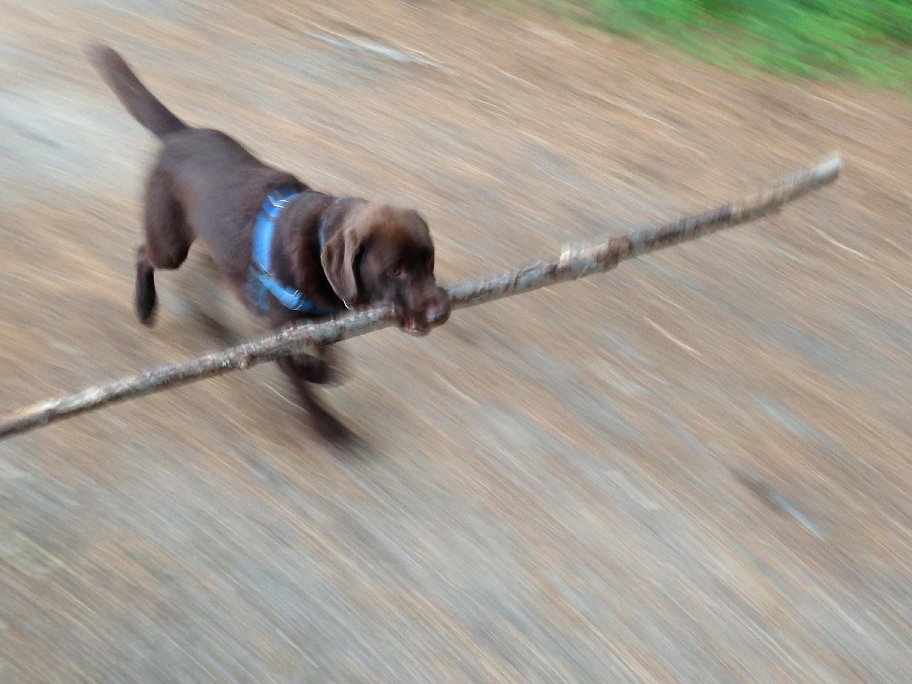
Standards do the Heavy Lifting! @abugseye | nlagace@niso.org

