Slide 1
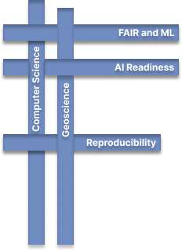
AI Ready Data Workshop
FARR: FAIR in ML, AI Readiness, & AI Reproducibility Research Coordination Network
Drexel University
April 2024
This work is supported through the NSF award #2226453.

Slide 2
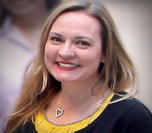
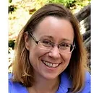
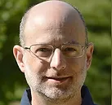
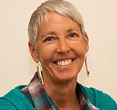
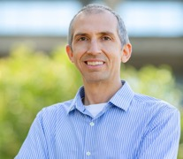
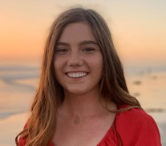
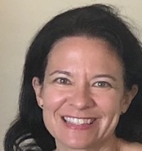
FARR Team
PI, Christine Kirkpatrick
Co-PI, Karen Stocks
Co-PI, Yuhan (Douglas) Rao
Co-PI, Daniel S. Katz
Project Director, Lynne Schreiber
Sr. Personnel,
Kevin Coakley
Project Manager, Julie Christopher
Communications,
Kim Mann Bruch

Slide 3
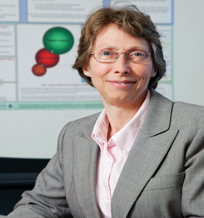
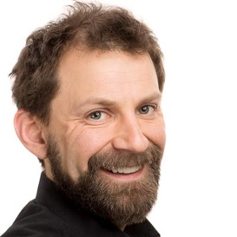
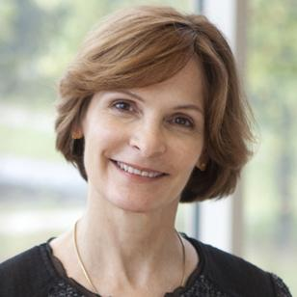
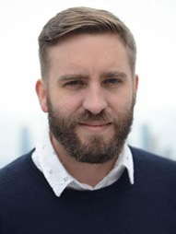
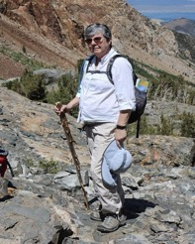
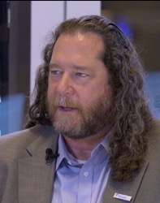
FARR Advisory Board
Melissa Cragin (Rice)
Odd Erik Gundersen (NTNU)
Beth Plale (Indiana)
Ryan Abernathey (Columbia)
Cathy Constable (Scripps, UC San Diego)
John Towns (NCSA, Illinois)

Slide 4
FARR Goals & Activities
Goals:
Building communities to
promote better practices for AI
harness community efforts
improve efficiency and reproducibility
stimulate and enhance new research
Activities:
Presentations, workshops, webinars, listening sessions
Assessing community needs
Community roadmap, gaps, research priorities
Incorporating community practices into outreach materials and tools
fostering new collaborations (proposals)

Slide 5
Opportunities for Projects & Community
Input on community needs, gaps, and roadmap
FARR network meetings and early career travel scholarships
Connect with FARR via
ESIP’s Data readiness and ML clusters
Research Data Alliance (RDA) FAIR4ML interest group (monthly and plenaries)
FARR hosted webinars
Sign up for our newsletter
Suggest use cases and let us promote your project’s use of AI and FARR-related practices
Let us feature you in a science story
For more info, contact us at community@farr-rcn.org
To join our mailing list, visit http://farr-rcn.org

Slide 6
FARR Stakeholders and Partners
Communities:
Computer Science
Geosciences
‘Research Data’ Community
Contributors:
Individual researchers
Institutions/organizations
Cyberinfrastructure (CI) providers
Repositories/facilities
Networks of facilities
Major Partners:
ESIP’s Council of Data Facilities cluster (co-Chaired by FARR)
ESIP’s Data readiness cluster
MLCommons (Science and DMLR)
RDA FAIR4ML Interest Group
CODATA
GO FAIR
Collaborators:
NAIRR (includes SDSC, NCSA)

Slide 7
FARR Partners
Notes:
CDF: Jerad Bales, Amber E. Budden (DataONE), Suzanne Carbotte (R2R), Jerry A. Carter (IRIS), Robert Chen, Simon Gording (Neotoma), Corinna Gries, Nick Jarboe (FIESTA), Chris Jenkins (dbSEABED), Danie Kinkade, Christine Laney (NEON), Chris Lenhardt (Renci), Paula Mabee (NEON), Lindsay Powers (U.S. Geological Survey), Maša Prodanović, Mohan Ramamurthy (UNIDATA), Greg Tucker, Susan Winter (CASCI)

Slide 8
AI Readiness
Primary Stakeholders | Larger Issues Explored
Geoscientists, Computer Scientists | Assessing data FAIRness as it relates to AI readiness and data-centric AI, community practices for using ML to improve AI readiness
Geo data facilities, users of data repos | Role of data facilities in AI readiness, reusability of data, enabling transdisciplinary science
Accomplishments
promoting AI readiness resources
Using FAIR to foster AI-readiness in Data Facilities
Checklist to Examine AI-readiness
Council of Data Facilities administration
6 mini research opportunities selected for advancing AI readiness in Earth sciences
Target communities: AGU, RDA, ESIP, CODATA/GO FAIR, MLCommons
Near-Term Activities Planned
Additional opportunities available for advancing AI readiness in Earth sciences (encourage ECR), Honoraria ($2500) for up to ~10 people
Paper underway
‘Where do I start?’
-Geoscientist at AGU ‘22
Progress

Slide 9
AI Reproducibility
Primary Stakeholders | Larger Issues Explored
Computer Scientists, domain scientists | Awareness of variability and irreproducibility in ML, need to contribute ML outputs for aggregated research
Accomplishments
Climate Informatics 2023 Reproducibility challenge
First effort in climate informatics domain
Three published computational notebooks via Environmental Data Science Book
Reproducibility webinar series began August 2023: https://www.farr-rcn.org/resources
Several presentations in partner organizations
Target communities: ACM REP, MLCommons, AGU, RDA, ESIP
Near-Term Activities Planned
Implementing lessons learned from the CI reproducibility challenge
Climate Informatics 2024 (April 2024, London) reproducibility review workflow
Exploring issues of reproducibility on emerging foundation models in geosciences (w/ MLCommons Science Working Group)
Graduate student in AI Reproducibility (papers, presentations, proposals)

Slide 10
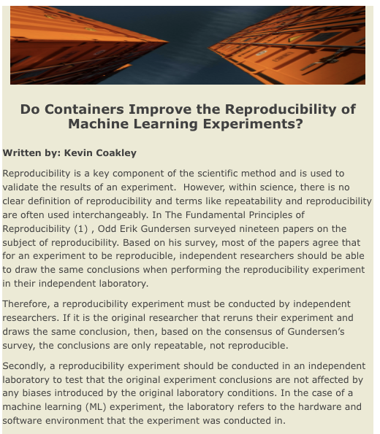
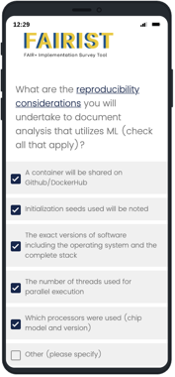
Making AI Reproducibility Accessible

Slide 11
FAIR in ML
Primary Stakeholders | Larger Issues Explored
Researchers, CI providers | Using ML to improve ML, making data reusable and more FAIR, FAIR’s relationship to AI readiness
Main accomplishments
RDA FAIR4ML interest group started late 2022
Intended to build consensus and community of practice around FAIR for ML
Created two task forces: FAIR in the ML lifecycle & metadata for FAIR ML
Held monthly virtual meetings, 2 hybrid meetings at RDA plenaries in Spring & Fall 2023
Paper - FAIR for ML Benchmarking - discussion of metadata/ontologies
Target communities: RDA, GO FAIR/CODATA, MLCommons
Near-Term Activities Planned
FAIR4ML: virtual monthly meetings to continue, virtual meeting at RDA plenary in Spring 2024 and hybrid at plenary in Fall 2024, task forces to continue work
1-2 new papers
Refactoring for Gen-AI and LLM world
Progress

Slide 12
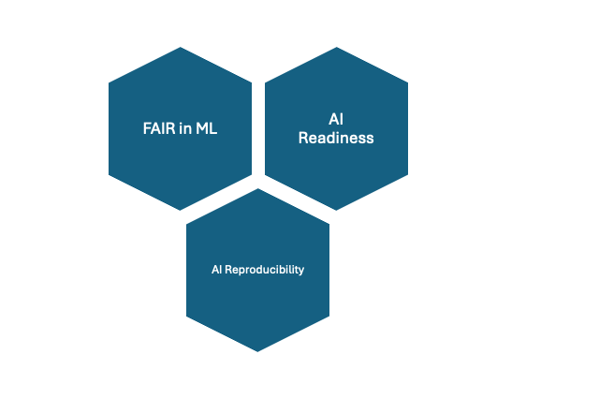
FARR Connection to Metadata / Ontologies
FAIR in ML
Using ML to improve ML through application of the FAIR Principles
ML utilizing existing ontologies and controlled vocabularies to create analysis-ready computer science data
AI Readiness
What semantics-related practices add or increase the ability to use data in AI processes?
To what extent does Gen-AI/LLMs make all data machine actionable?
What is the lowest effort needed with metadata to support AI accuracy?
AI Reproducibility
Metadata and controlled vocabularies for use in AI repro checklists
Other ways semantics can aid AI reproducibility

Slide 13
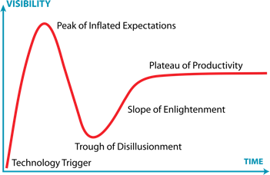
Opportunities & Chopportunities™
Keeping up with the Joneses, the Metas, the Googles, the NVIDIAs: Industry leading DL resources; how to bridge multisector divide → Sharing industry’s semantic resources
Readiness for AI Readiness: Learning from the AI readiness repository interviews: many repositories need an on-ramp to begin considering AI readiness → Bake in advice re: metadata
Rapidly changing landscape: Refactoring work for Gen-AI & LLMs
Ahead of our time: While FAIR for data may be reaching "slope of enlightenment", FAIR for ML models is still at or before "technology trigger"
Source: https://en.wikipedia.org/wiki/Gartner_hype_cycle#/media/File:Gartner_Hype_Cycle.svg

Slide 14
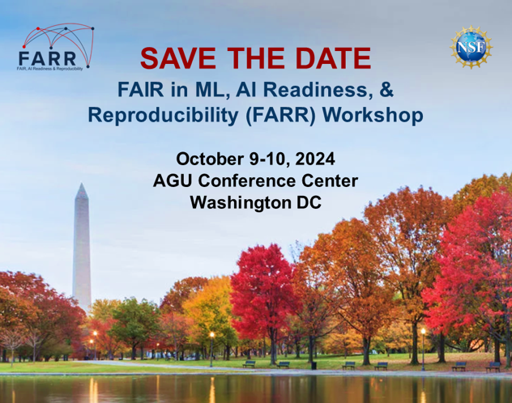
FARR Workshop: October 9-10, 2024 in DC
Call for abstracts
Spurring new or deepened collaborations
Sharing best practices and lessons learned
Exploring research gaps and priorities
Continuing Fully AI Ready ideation from ‘10 Years of FAIR’
Interested? https://tinyurl.com/FARRinDC

