Slide 1
Showcase: Using FishAIR Within Data Production Pipeline
Xiaojun Wang, Bahadır Altıntaş, Dom Jebbia, Yasin Bakış, Henry Bart

Slide 2
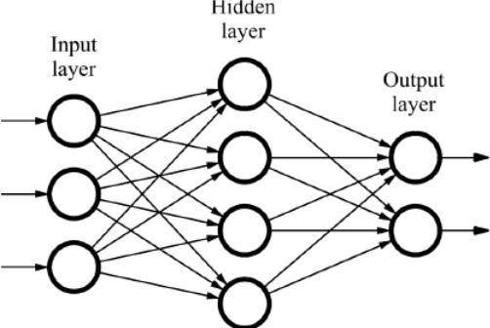
Our Journey
Biology Guided Neural Networks
（BGNN）
Imageomics
Extracting more traits like animal behaviors from multimedia (images and videos) by using machine learning analysis
Extracting Phenotypic traits from specimen images by using neural networks with biological guidance
FishAIR
An AI-Ready fish image dataset with integrated Image Quality Management System

Slide 3
We are providing…
Type | Source | Number
Digitized Collection from Museums | GLIN, iDigBio, GBIF, FishBase, Morphbank | ~1 Million
Harvested Fish Images | TUBRI | ~400K
Landmarking Pipeline Images (Bounding Box,Segmentation,Landmarks ) | Virginia Tech, TUBRI | ~110K
Images
Type | Source
Image Metadata (Multimedia, Quality, Extended Information, Batch) | TUBRI
Fish midlines metadata (upcoming)
Automated quality metadata (upcoming) | Drexel University Metadata Research Center
Fish outlines metadata (upcoming)
Metadata

Slide 4
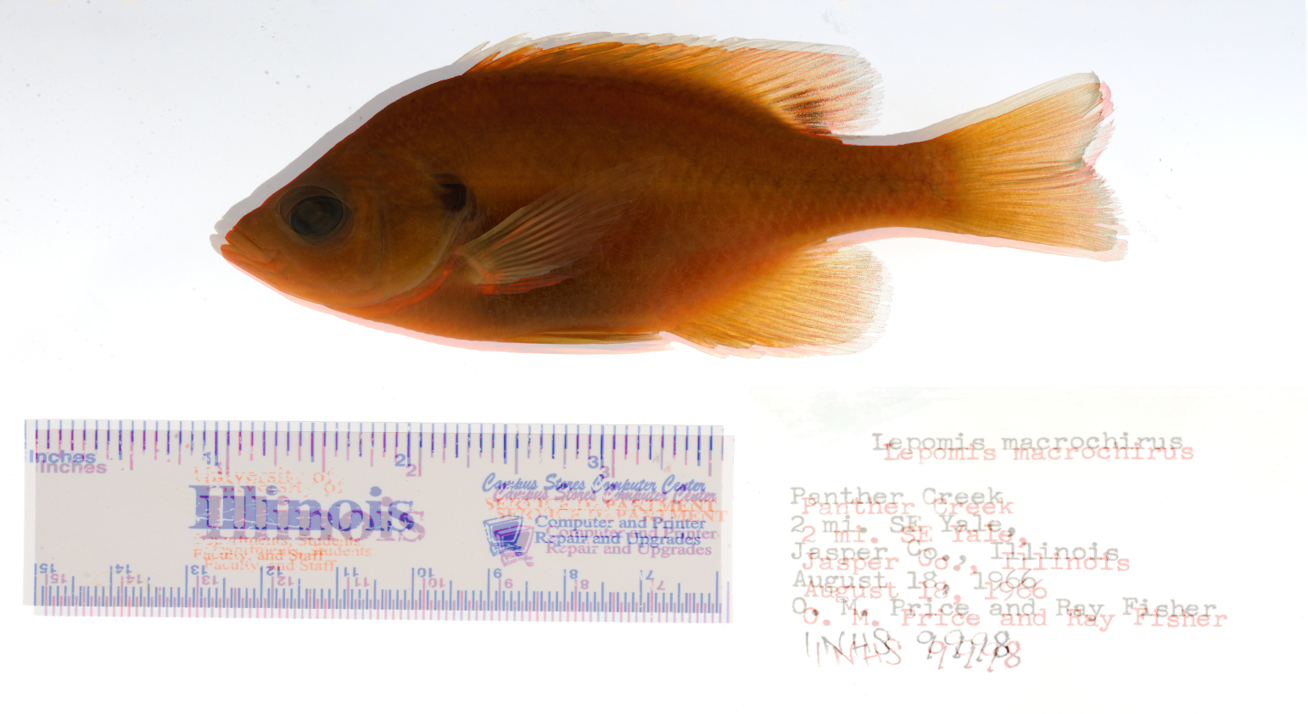
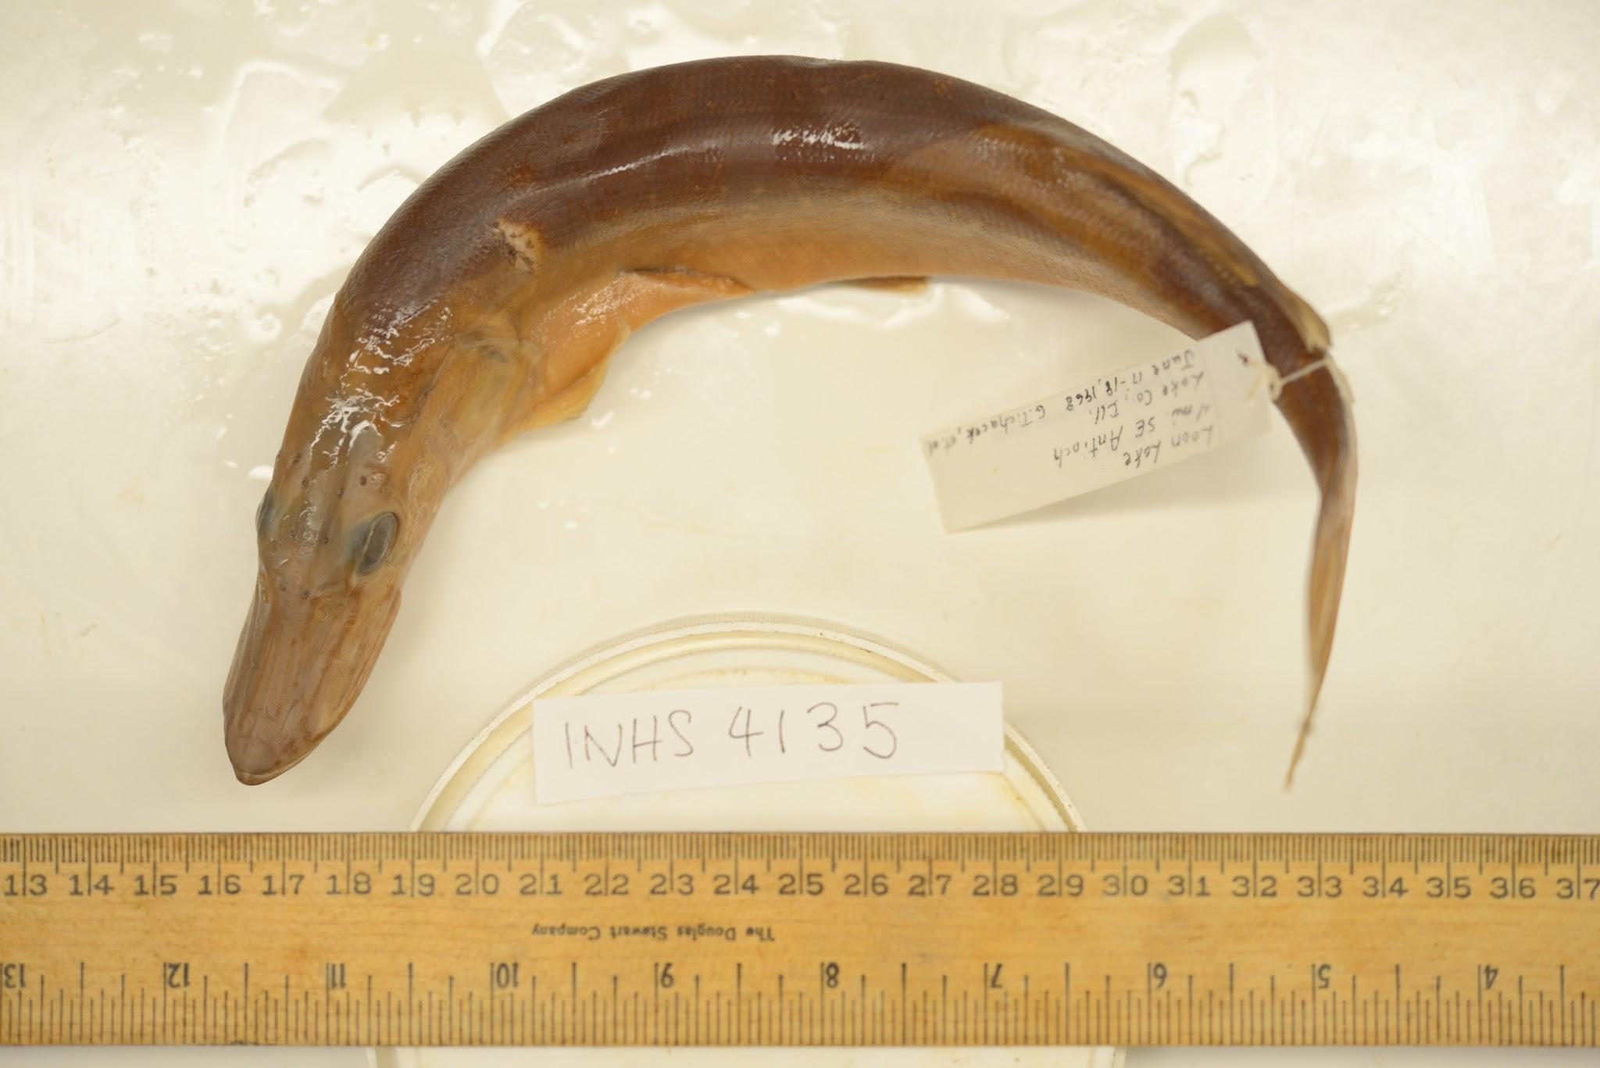
Challenges - Issues of Datasets
Lack of further image information
Non-standard and chaotic naming
Inflexible data structure
Non-terminology
No provenance
Different IDs
Color Shifted
Chaotic file names
No
License
No
PIDs
non-FAIR
CSV only
Viewpoint Variance

Slide 5
FishAIR - Enhancing FAIR & AIR
BEFORE
AFTER
Imageomics & FishAIR
ARK ID
System
Diverse fish datasets
RDF Data model
Quality Metadata
API Services
Terminology
FishAIR
Metadata Volume
AI-Ready
FAIR

Slide 6
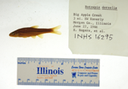
Solutions - Archival Resource Key
batch
Unique ARK IDs
Easy identification & search
Data provenance
Tracking for data lineage
https://fishair.org/ark:/89609/bat[batchARKID]
ARK
metadata
multimedia
https:/fishair.org//ark:/89609/[multimedia_ARKID]
data archive
https://fishair.org/ark:/89609/dts[data_archive_ARKID]

Slide 7
Solutions - Provenance

Slide 8
Solutions - RDF and AIR Terminology
Image Quality Metadata
Occurrence
Automated
Trait
Metadata
RDF model
Ensure adaptable data structure
AIR terminology
Consistent data description
Phylogenetic
Trees
Multimedia
Upcoming metadata
Integrating more (meta)data
ARK ID
……
Taxon
Descriptions
Extended
Image
Metadata
Batch
AIR Terminology: https://fishair.org/vocabulary.html

Slide 9
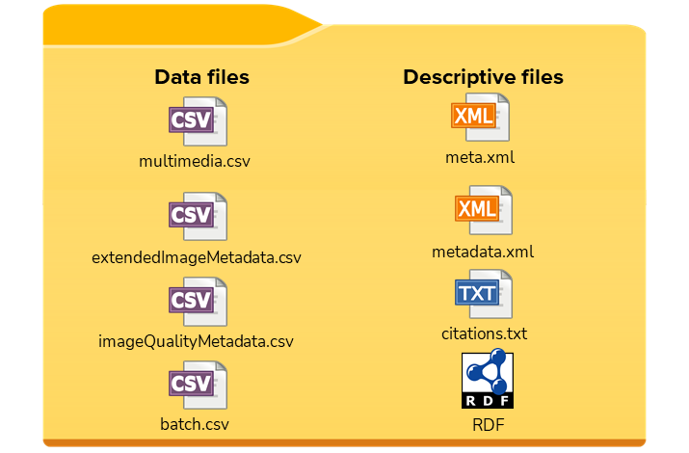
Solutions - FishAIR API and Archive
FishAIR API
Data Archive
FishAIR_[ARKID_for_Derived_Datasets].zip

Slide 10
FishAIR Functioning within Your Pipeline
Museum Images
Object Detection/
Bounding Box
Create new Batch
Provenance
Landmarking Pipeline
Segmentation
Assign ARKIDs, ParentARKIDs
Create Package
+
Extract Metadata
Landmarking

Slide 11
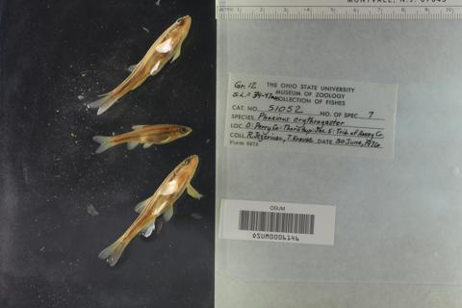
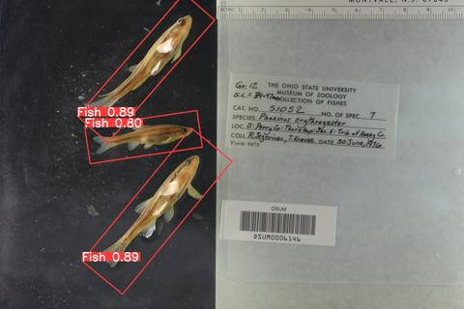
FishAIR data download-process-upload workflow
Download images using multimedia.csv file
Download metadata with API
Process downloaded images
Create a new batch on FishAir
www.fishair.org
Upload new images
and metadata to FishAIR

Slide 12
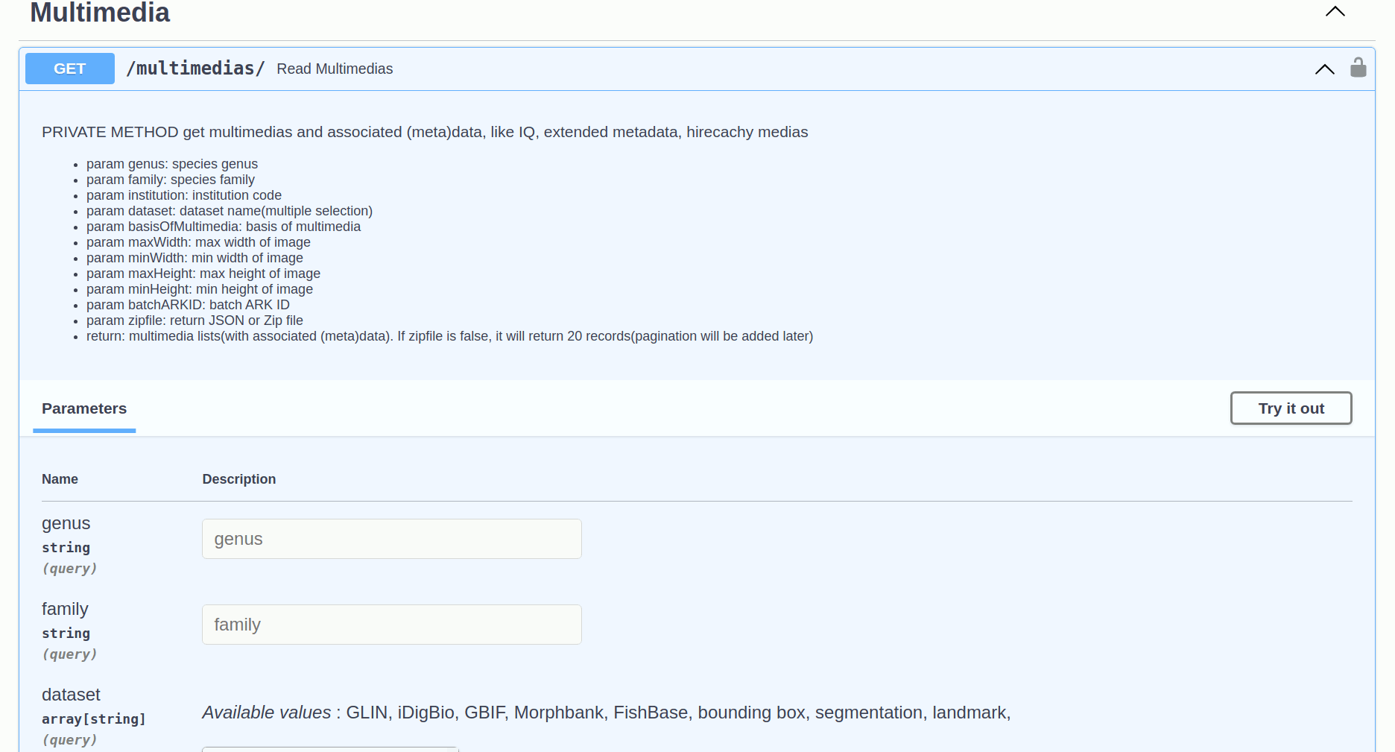
www.fishair.org
Download metadata with API

Slide 13
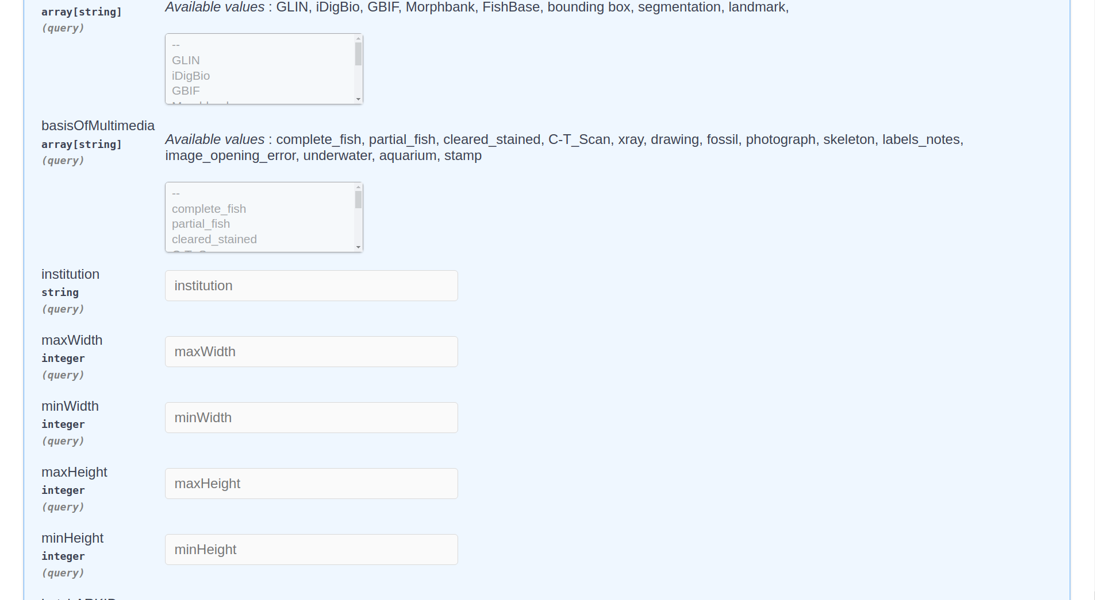
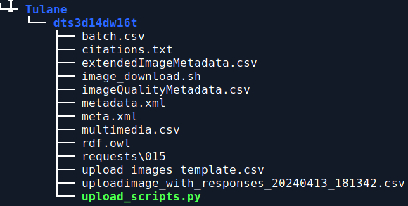
Download metadata with API
Archive file contents

Slide 14
Download images using multimedia.csv file
Usage: ./image_download.sh -s FILTERINGFIELD -v KEYWORD -g GROUPINGFIELD
Parameters:
-h Shows this help
-s name of the FILTERINGFIELD
-v keyword for your filtering
-g grouping parameter. Can be grouped by GROUPINGFIELD
Example: ./image_download.sh -s "genus" -v "Esox" -g scientificName
Example: ./image_download.sh -s "genus" -v "Esox"
or to download all: ./image_download.sh

Slide 15
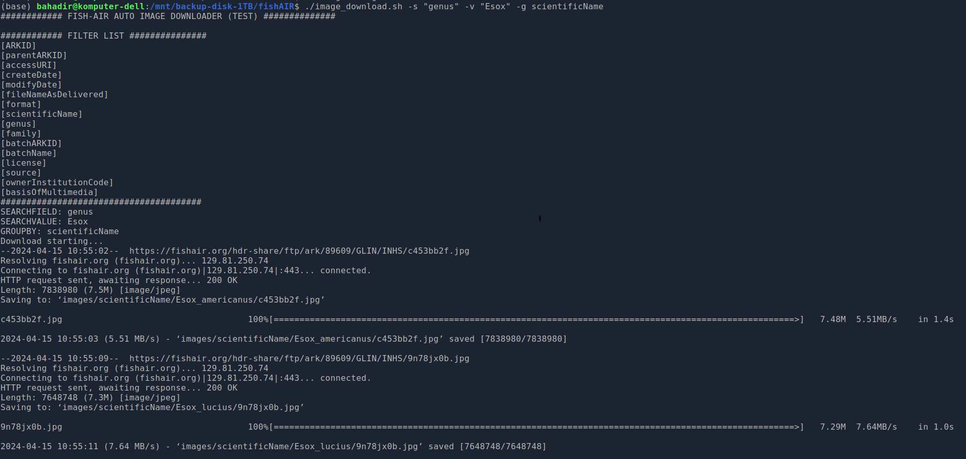
Download images using multimedia.csv file
Download folder tree

Slide 16
Process downloaded images
Object Detection + Cropping Bounding box images
Object detection
Cropped bounding box images
9m94nf1b_bbox_1.jpg
9m94nf1b_bbox_2.jpg
9m94nf1b_bbox_3.jpg

Slide 17
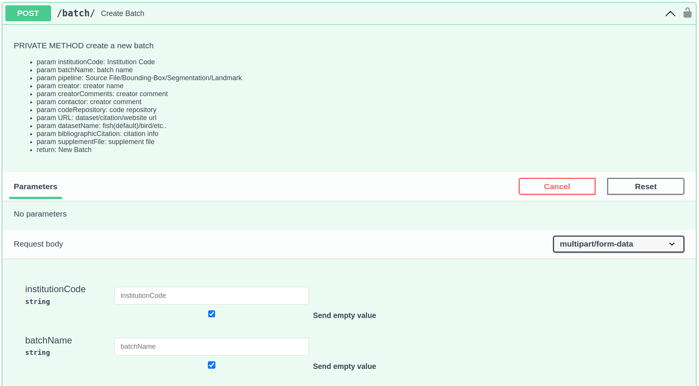
Create a new batch on FishAir
Batch can be created from
API interface or using upload_scripts.py

Slide 18
Upload new images and metadata to FishAIR
Preparing “upload_image.csv” file
$ python upload_scripts.py [Image List.csv] [your API-KEY]

Slide 19
What’s Next
Dataset and Vocabulary Version Control
Automated Image Metadata
Image Quality Metadata
Species Profile
AI Fitness Score
Multimedia Objects
Datasets/Batches
Taxonomic Groups
Feature Extraction
Improving scripts’ functionalities for AI/machine learning purposes

Slide 20
Thank you
Q&A

Slide 21
Batches
Landmark Pipeline
FishAIR
Data Cleaning/
Filtering/Labeling
iDigbio,GLIN…
Digitized Collection
Bounding Box
Bounding Box
Segmentation
Download
Upload
Segmentation
Landmarking pipeline
Landmarking
Image sets and associated metadata
Landmark Image Sets B
Landmark Image Sets A

Slide 22
Challenges - BGNN
Lack of AI readiness metadata in data sources hinders the full representation of image quality and information
Image
Data Sources
File Format
URI
Type
(Field notes, C-T Scan, etc.)
Quality Measures
GLIN
Color Shifted
iDigBio
Morphbank
GBIF
Viewpoint Variance

