Slide 1
Data, metadata,
and re-curation
Ryan Scherle

Slide 2
An open data publishing platform & community committed to the open availability and routine re-use of all research data

Slide 3
Conceived by researchers in 2007 as home for a wide-ranging scope of data
Backed by journals in 2011 with the Joint Data Archiving Policy
Curated data and metadata
Original goal: preserve the data, with minimal burden to researchers

Slide 4
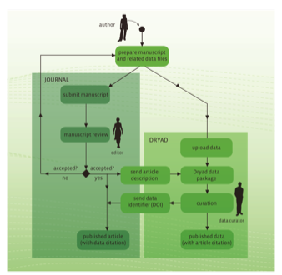
Original metadata augmented by full-text articles
Notes:
- Dryad’s original goal was to accept and preserve the data....because so much was being lost
- Now that we have made data preservation more standard,, we are slowly improving the quality of both data and metadata
- But we cannot add to the burden of the researchers!

Slide 5
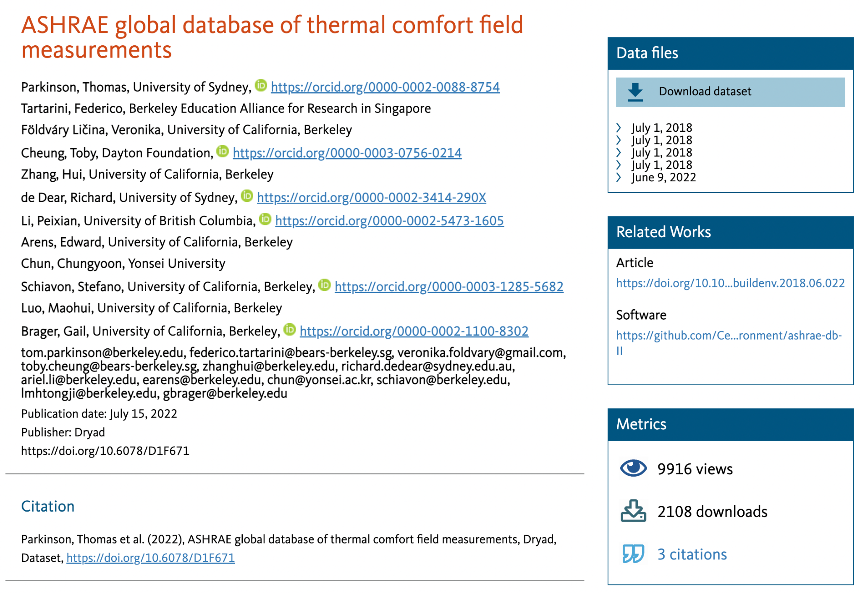
The Dryad data publication
Our process connects data and related objects to the global research infrastructure, enabling discovery and reuse
Connecting related works

Slide 6
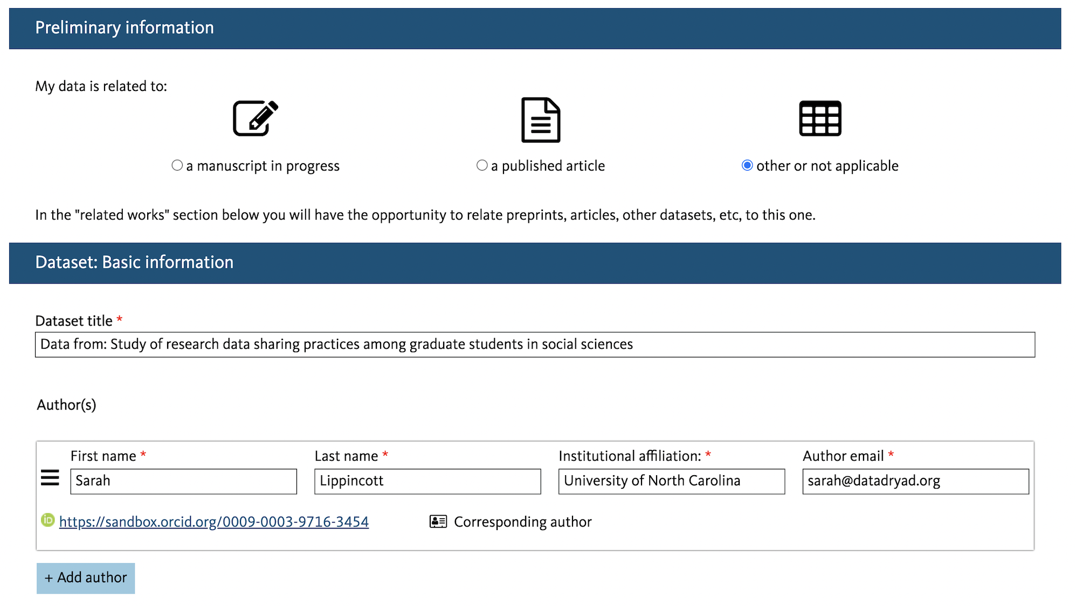
Journal info
Title
Author(s)
Notes:
Journal name: If associated with a manuscript, fields for journal name and manuscript number are required.
We ask you to let us know if the data is related to a manuscript in process, or to a published article or or not. If it's related to a published article, we can often grab some metadata from the doi. So you drop the doi into this field and click import article metadata, and we'll be able to usually pull in a kind of a placeholder title for the data pull in the author names and affiliations, which is a big time saver, potentially. When you have a lot of of co-authors and can help to avoid any sort of data entry mistakes.
Title: The title should be a succinct summary of both the data and study subject or focus. A good title typically contains 8 to 10 words that adequately describe the content of the dataset.
Author(s): Name, email address, institutional affiliation of main researcher(s) involved in producing the data.
Affiliations are drawn from the Research Organization Registry (ROR)
If you provide your co-authors' email addresses, when the dataset is published they will receive a message giving them the option to add their ORCID to the Dryad record
You can add as many authors as you like. You'll automatically be listed as the corresponding author, if you're the one who logs into Dryad.
If you are the depositor, but you are not the first author you can. You can reorder the list of authors. But whoever deposits will always be the corresponding author who will receive communications from our curation team.

Slide 7
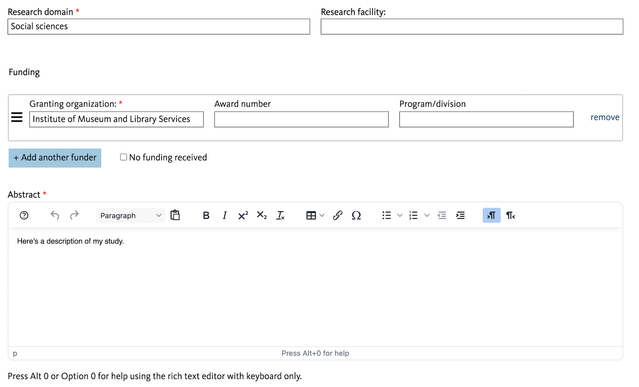
Research domain
Funding
Abstract
Notes:
Research domain: Primary research domain. Domains are drawn from the OECD Fields of Science and Technology classification.
Research facility: Where the research was conducted, if different from your current affiliation (e.g., a field station).
Funding Information: Name of the funding organization that supported the creation of the resource, including applicable grant number(s). Each grant and associated award number should be input separately. Options in the drop-down menu are populated by the Research Organization Registry.
Abstract: Brief summary of the dataset’s structure and concepts including information regarding values, contents of the dataset, reuse potential and any legal or ethical considerations. If this dataset is associated with an article, abstract language can be similar, but it should focus on the information relevant to the data itself, rather than to the study.

Slide 8
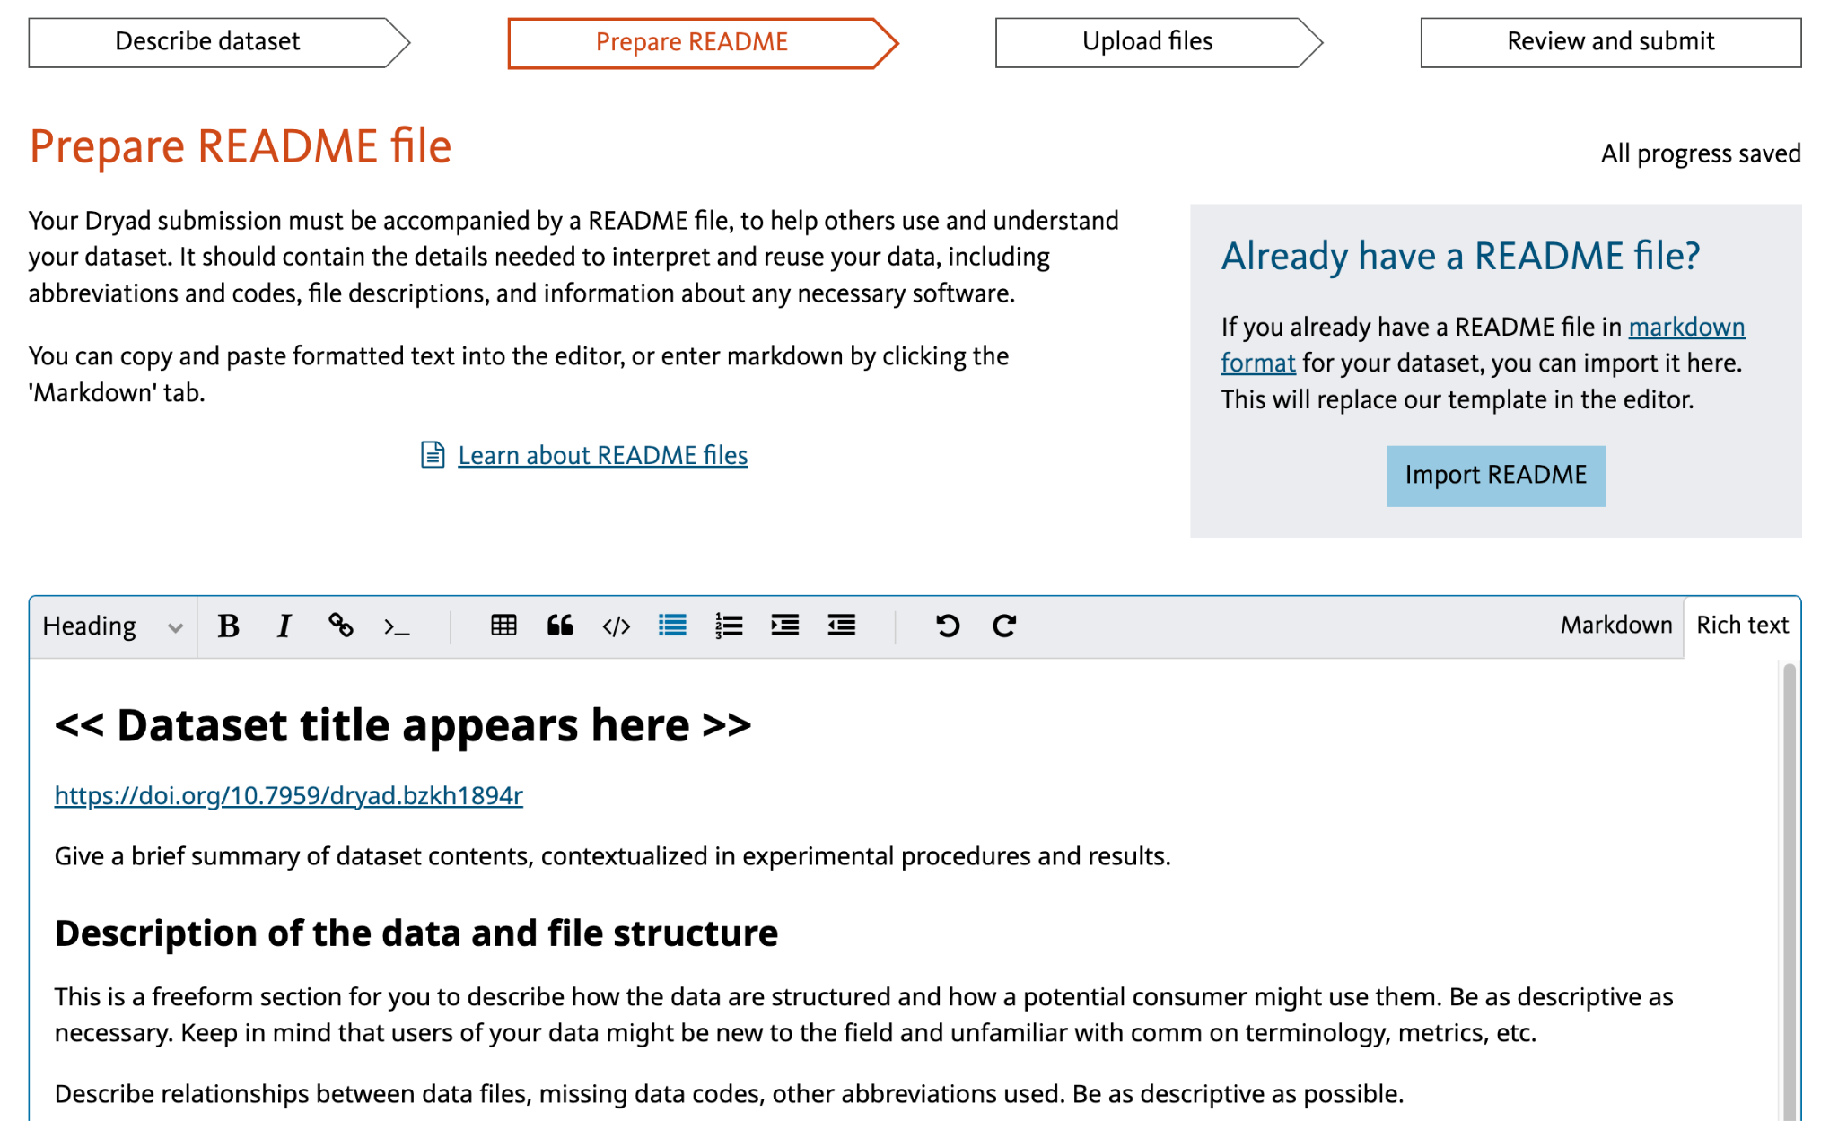

Slide 9
Example: Choose open file formats
Use non-proprietary, open file formats to enable easy access, better preservation, and interoperability
If you do include proprietary files, consider also providing the data in an open format
Plain text formats are preferred (.csv)
Notes:
To maximize accessibility, reusability and preservability, share data in non-proprietary open formats when possible (see preferred formats). This ensures your data will be accessible by most people. Review files for errors. Common errors include missing data, misnamed files, mislabeled variables, incorrectly formatted values, and corrupted file archives. It may be helpful to run data validation tools before sharing. For example, if you are working with tabular datasets, a service like goodTables can identify missing data and data type formatting problems. Files compression may be necessary to reduce large file sizes or directories of files. Files can be bundled together in compressed file archives (.zip, .7z, .tar.gz). If you have a large directory of files, and there is a logical way to split it into subdirectories and compress those, we encourage you to do so. We recommend not exceeding 10GB each.

Slide 10
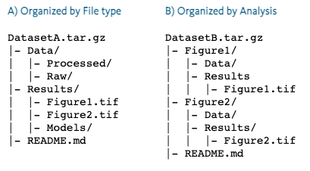
Example: Organize files logically
Check files for errors or omissions
Name files descriptively and consistently
Remove unnecessary files
Create a clear and logical file structure
Bundle organized files into compressed file archives
Keep individual files or archives less than 10GB in size
Verify file archives open and are not corrupted

Slide 11
Example: Prepare a comprehensive README file
Write clearly for a broad audience
Describe processing pipeline and analysis steps
Define all variables, abbreviations, missing data codes, and units and allowable values
Dates and locations of data collection (use standardized date formats)
Describe file structure and contents
Describe code, scripts, or software used to process, visualize, analyze, and compress the data
Notes:
Write clearly for a broad audience
Provide a clear, comprehensive, and concise description of all components of your dataset in a README document. This will help others interpret and re-analyze your data.
Use accepted vocabularies for your discipline
Describe processing pipeline and analysis steps
Summary of experimental efforts underlying this dataset
Define all variables, abbreviations, missing data codes, and units and allowable values
Definitions of all variables, abbreviations, missing data codes, empty cells, and units
Dates and locations of data collection (use standardized date formats)
Provide description of file structure and contents
As David mentioned in the previous slide
Describe code, scripts, or software used to process, visualize, analyze, and compress the data
Links to other publicly accessible locations of the data
Other sources, if any, that the data was derived from
Any other details that may influence reuse or replication efforts
https://datadryad.org/stash/best_practices#describe
We provide a README template in Markdown format to guide you through the creation of your README documentation.
If your dataset includes compressed archives, please upload your README externally as a stand-alone file in the 'Data' category so that users can view its contents before downloading the full dataset.

Slide 13
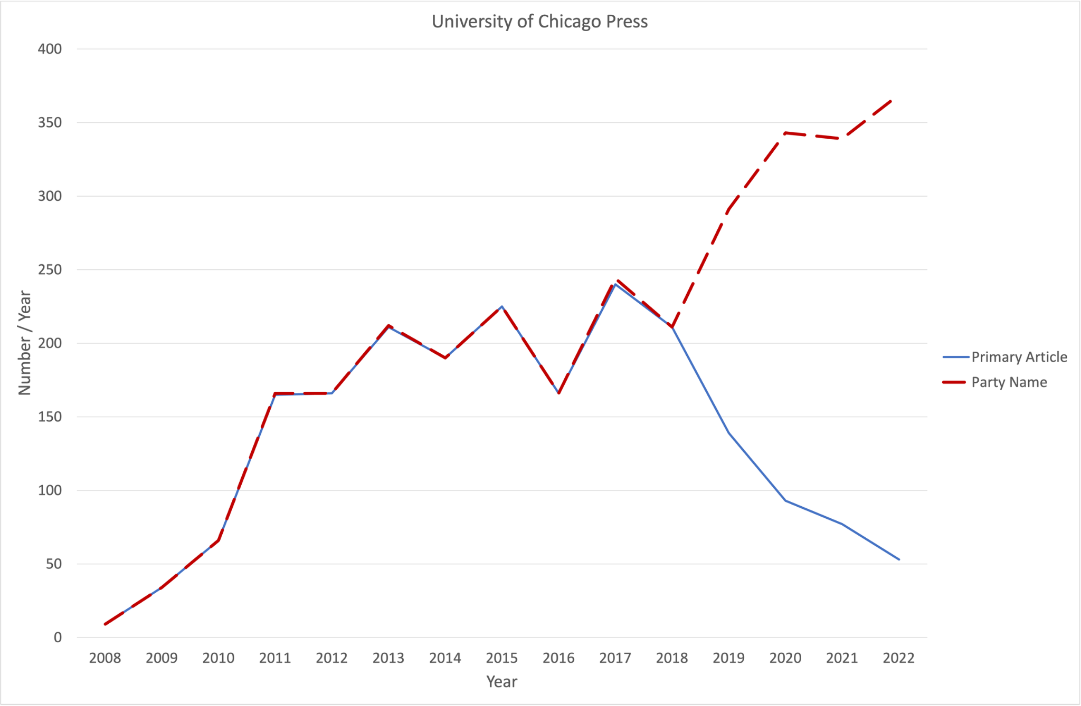

Slide 14
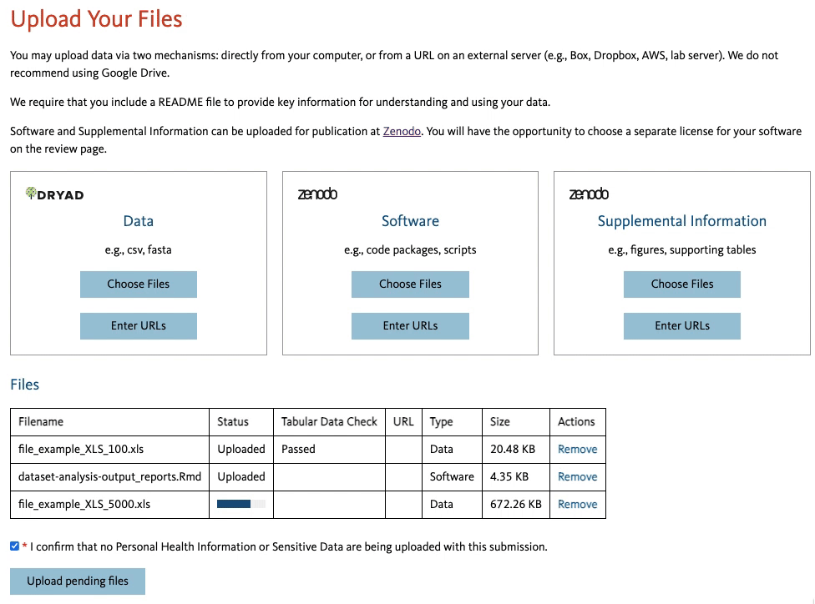
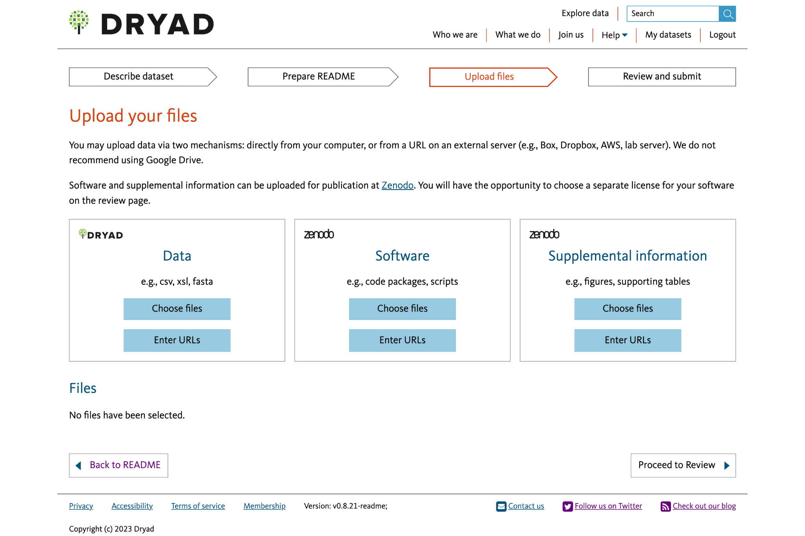
Notes:
We accept data uploads up to 300 GB. Through the browser you can upload directly from from your desktop for for smaller data files for larger data sets. We recommend that you provide us with a URL from an external server like box or dropbox, or a lab server that you maintain. We just need a publicly accessible yeah, URL, where we can go and harvest the data. and we'll do that in the background while you complete the submission process rather than you. Waiting on this page for data to upload.
We also, at this stage allow you to upload files separately to Zenodo, another open access repository. It provides a home for all sorts of content. And we have a partnership with them to accept software and supplemental information that's related to Dryad datasets. We do accept code at Dryad. If you have, small scripts that are really integral to the data package, we encourage you to upload those with alongside your data directly to Dryad. The advantage of uploading to Zenodo is that you can choose a software specific license and you'll get a separate DOI for the software, which can be useful for distinguishing and citing separate research outputs.
If you upload tabular data, which is the most common type of data we see at Dryad, we run it through an automated system check that looks for common errors that we see in in tabular data. It'll. It'll let you know what theirs are that if if it finds errors. It'll let you know what they are, and it'll provide some suggested steps for remediation.

Slide 15
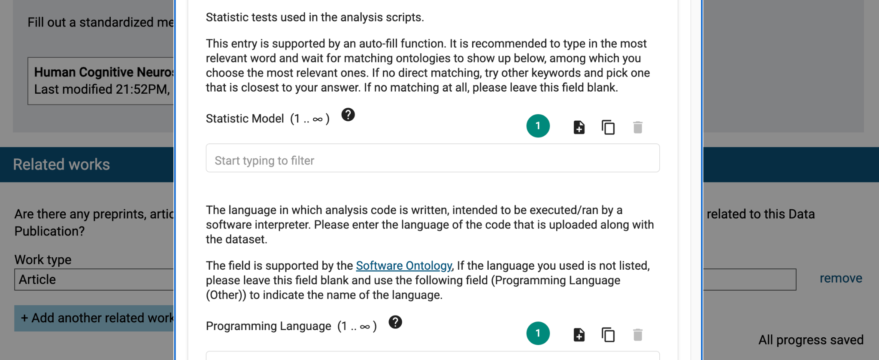

Slide 17
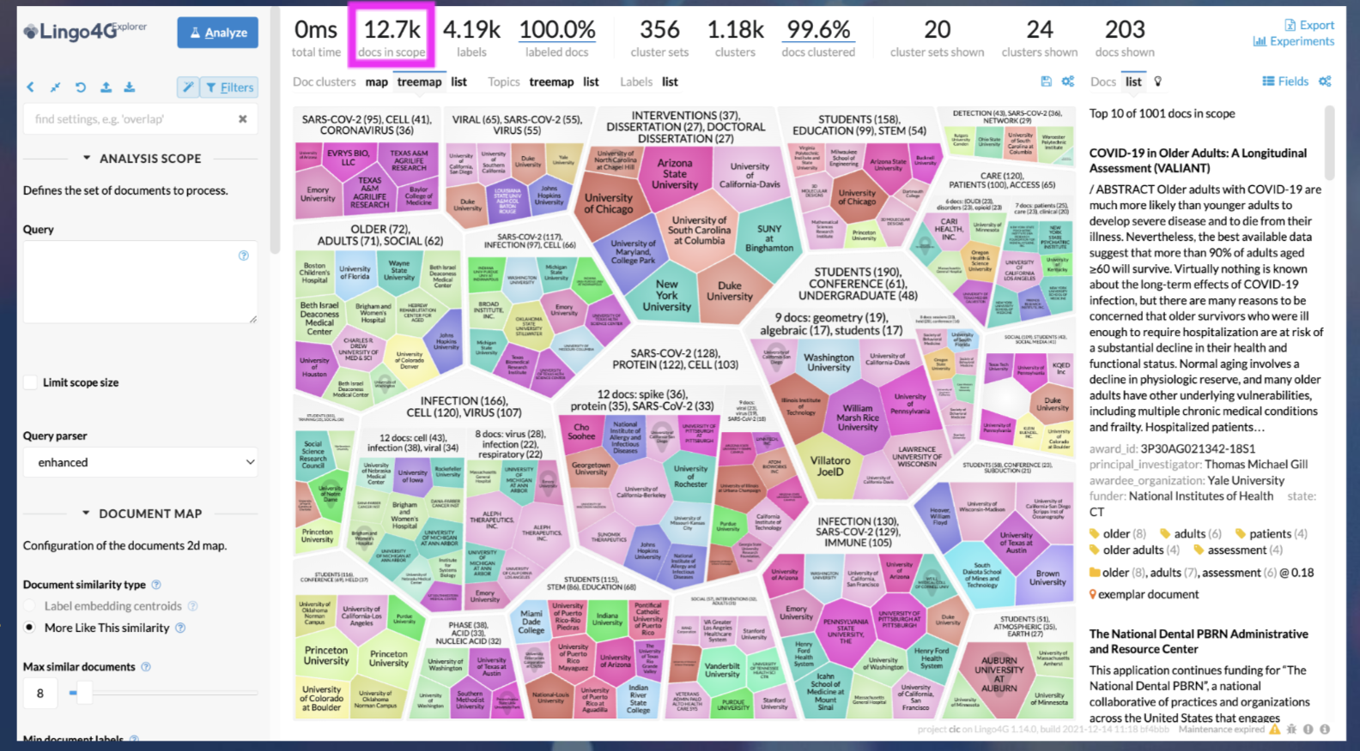

Slide 18
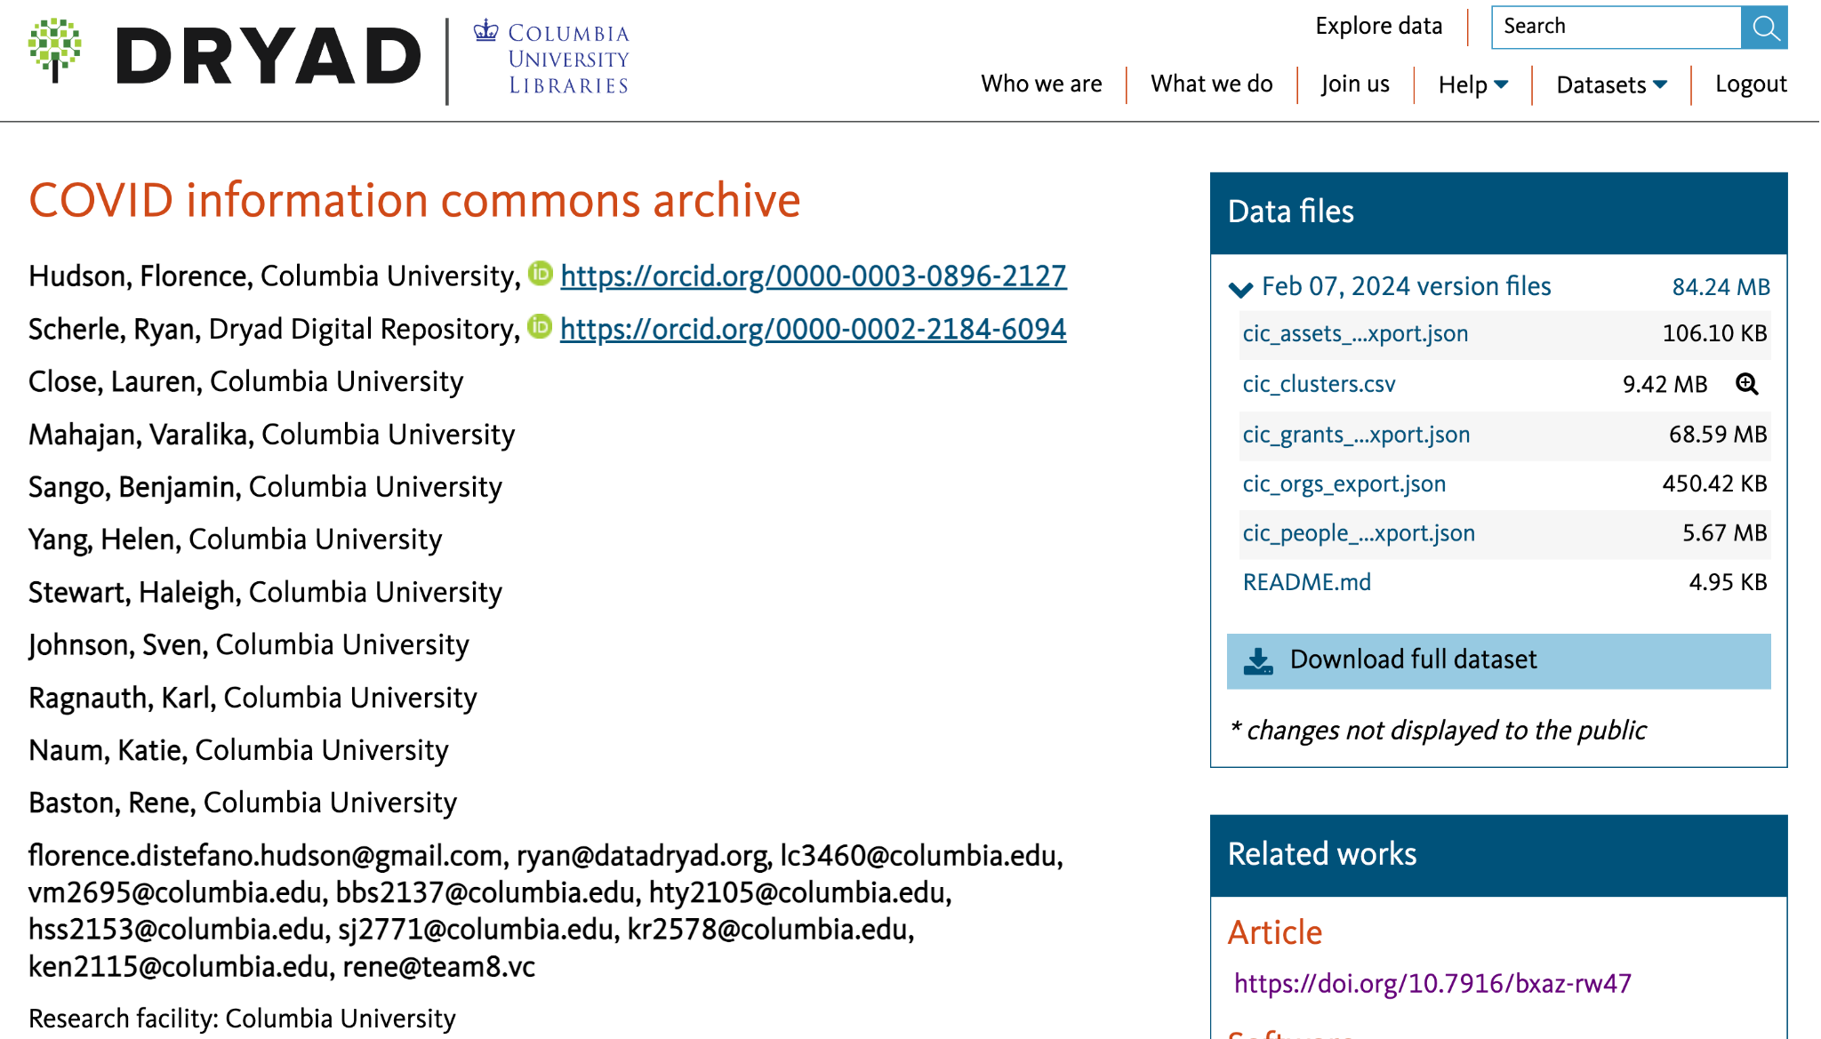
Notes:
Importing structured metadata from funders, repositories, etc.
Human-generated content is curated before approving
Each type of metadata is available as a separate download
Enhancing search system to work with clustered contents
Continuous re-curation as more content and connections become available

Slide 19
Opportunities
Extraction of data description and metadata from research papers
Automated creation of metadata according to specific schema
Completeness & accuracy checks
Improved searching tools
Enabling extracts from large data
Better ties to ontologies
Notes:
https://crln.acrl.org/index.php/crlnews/article/view/26068/33984

