Slide 1
DataFed: Making Science Repeatable with ML Pipelines
Joshua S. Brown, Ph.D.
Oak Ridge National Laboratory
04/16/2024

Slide 2
Outline
Introduction
What is DataFed?
ML Pipelines and Metadata
Dr. Bishop and Franky, a story of a ML Pipeline featuring DataFed
Questions
Appendix - DataFed Features
Notes:
https://www.kaggle.com/datasets/uciml/red-wine-quality-cortez-et-al-2009
Wine Dataset provided by Kaggle

Slide 3
Introduction

Slide 4
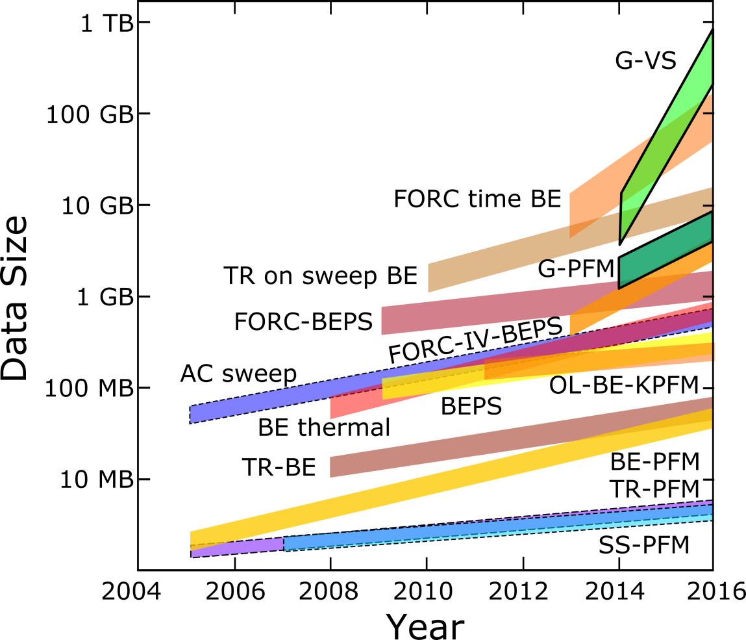
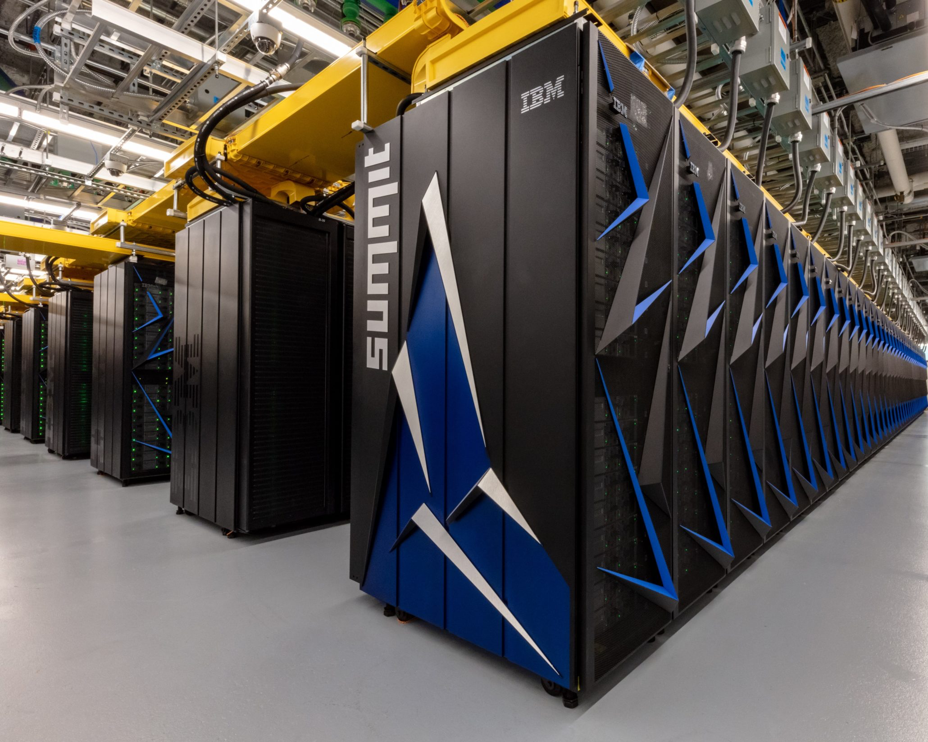
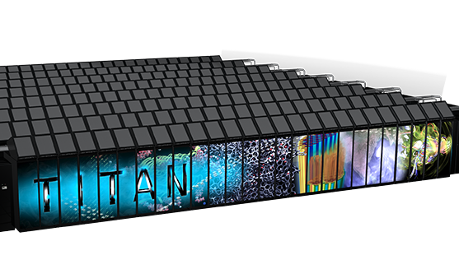
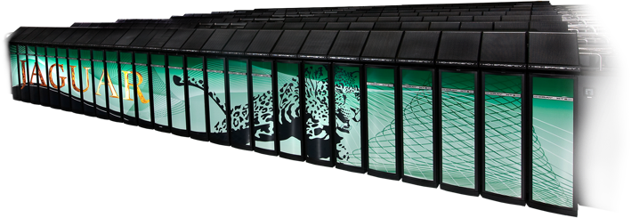
Increasing Data Volume
Ever faster, larger simulation (data)
1.6 EF
Microscopy Data
200 PF
27 PF
2 PF
2010
2013
2018
2022
Kalinin et al., ACS Nano, 9068-9086, 2015

Slide 5
What is DataFed?

Slide 6
DataFed is a Metadata Management Service for Big Data

Slide 7
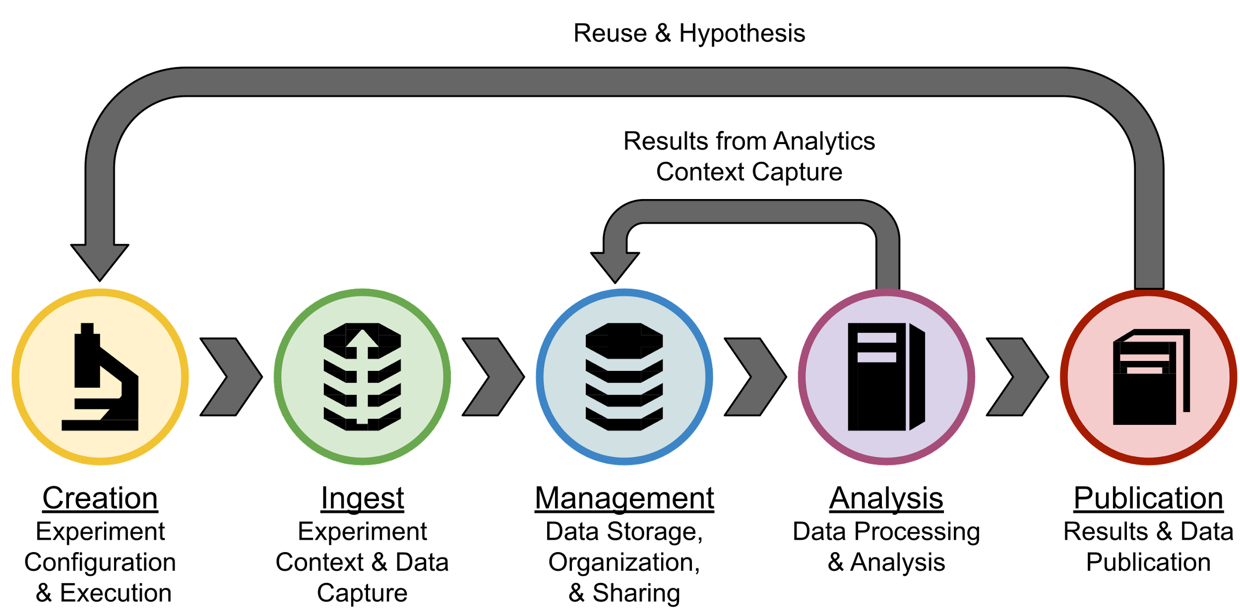
Lifecycle of Scientific Datasets

Slide 8
Laborious Wrangling of Unstructured (Meta)data
Relevant metadata rarely available / indexed / searchable
Not all metadata may be available
Naming and structure varies by user and time
Most often embedded in file names
Instrument
Modality
Date
User
Material
Cypher_1\Senli\BE_KPFM\STO\2011_08_10_BE\
NC_STO_AC1V_73kHz_bw25kHz_5um_DC2V_offset_0V_Tap1302kHz_64BE_0009
Operation Mode
Scan size
Data Acquisition
Other Experiment
Parameters
(captured in parameters file)

Slide 9
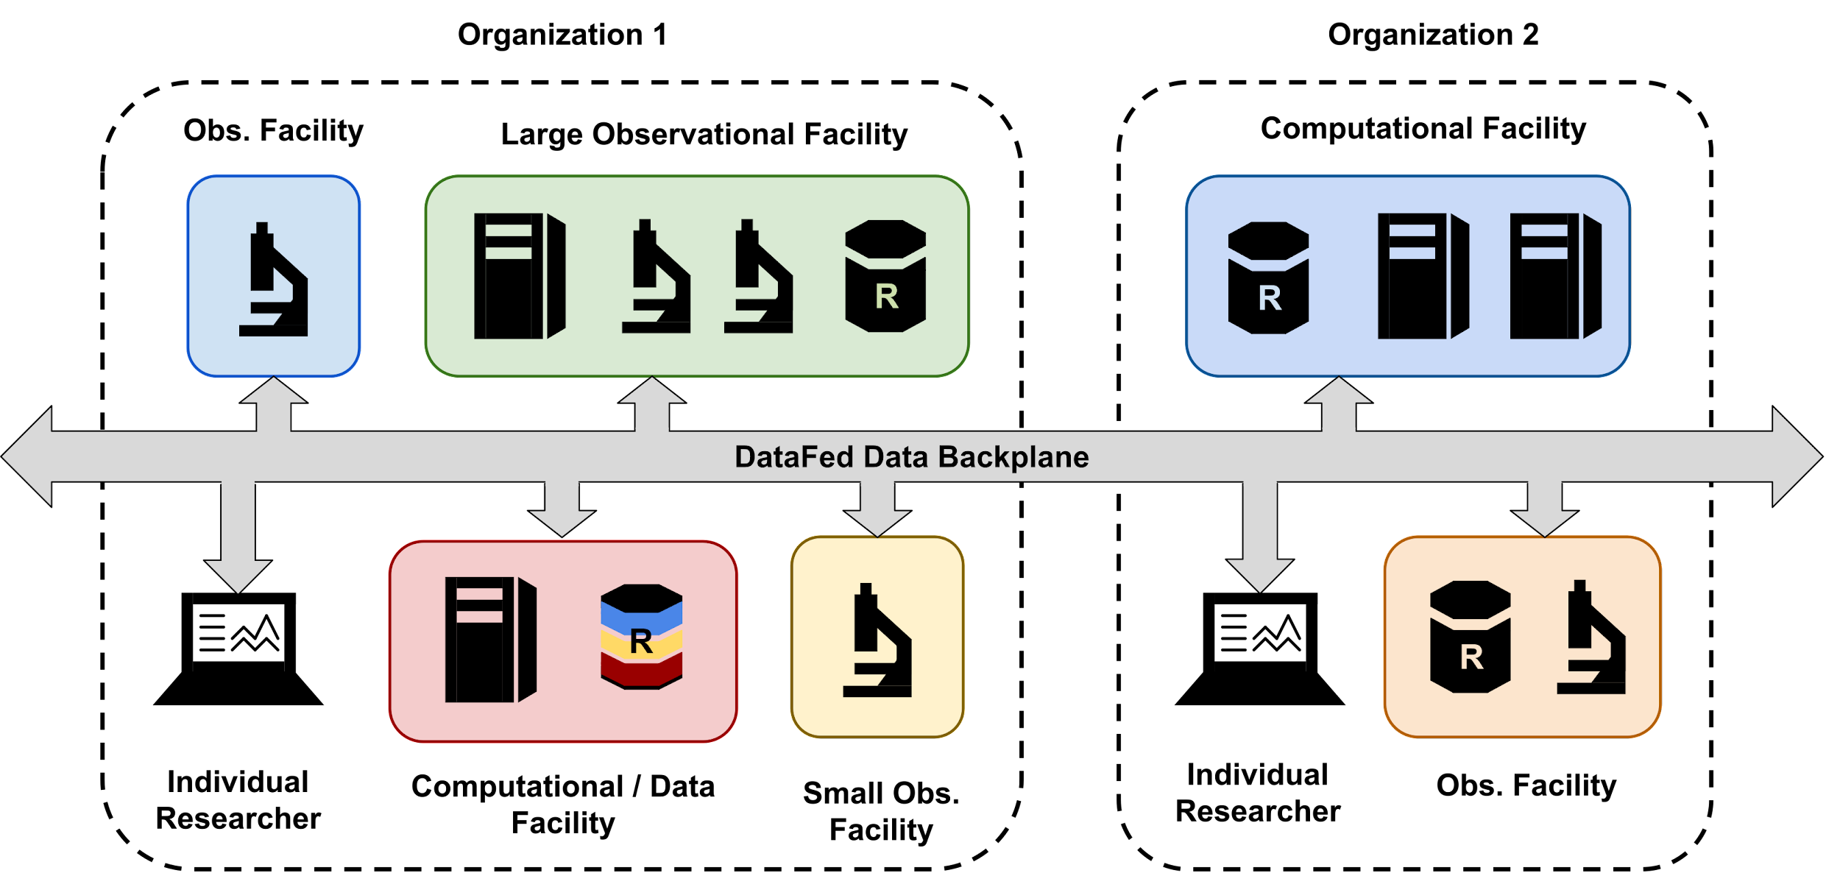
Unified Management of Data across Facilities

Slide 10
DataFed Records & Collections
Collection
Metadata
Location of raw data
Record with Raw Data

Slide 11
ML Pipelines and Metadata

Slide 12
ML Pipelines & Metadata
Training
Confusion
Matrix
Sanitized Data
Initial Features
Raw Data
Data
Wrangling
Data
Splitting
Model
Feature Engineering
A
B
C
D
Test
Inferences
Feature
Metrics
Testing

Slide 13
Examples of Metadata in ML
Technique – supervised, unsupervised, reinforcement learning
Algorithm – Linear Regression, Logistic Regression, Decision Trees, Random forest …
Framework - XGBoost, Keras, TensorFlow…
Loss Function – MSE, Accuracy, F1 score…
Algorithm Hyper Parameters
Max-depth
Learning-rate
Epochs

Slide 14
Dr. Bishop and Franky, a story of a ML Pipeline featuring DataFed

Slide 15
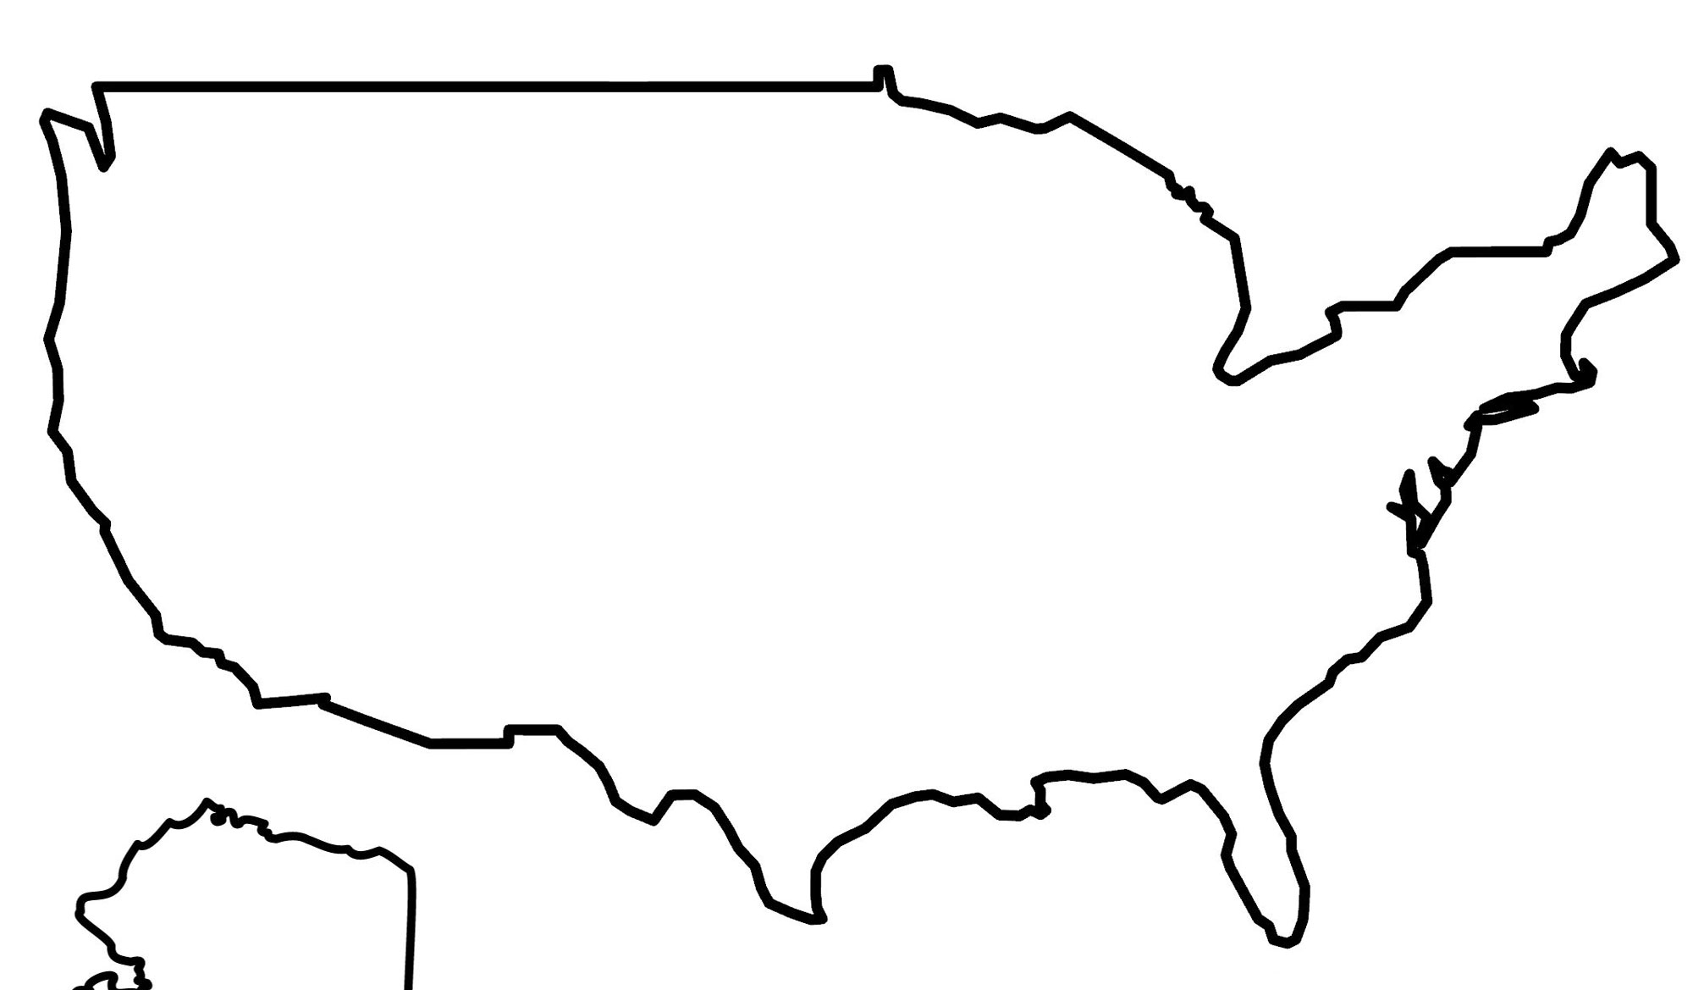
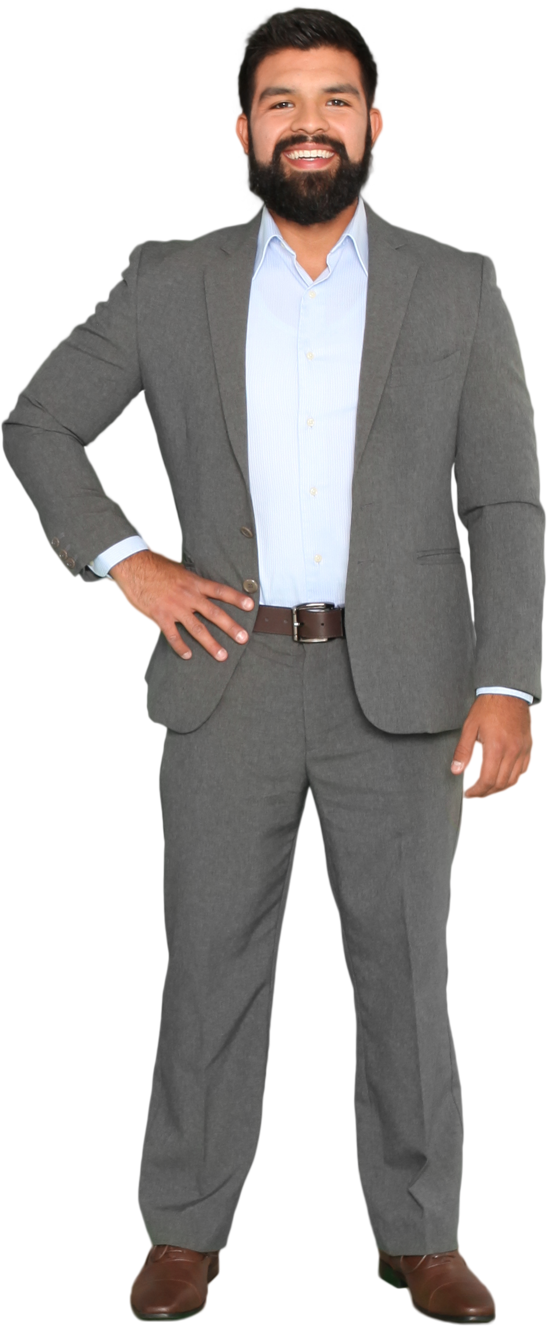
Dr. Bishop and Franky
University of
Champaign
Fine Wines Inc.
https://gisgeography.com/wp-content/uploads/2020/04/USA-Country-Outline.jpg
Notes:
Dr. Bishop works is a researcher at the University of Champaign, he is collaborating with Fine Wines Incorporated, they are on a mission to train an algorithm to predict the quality of their wines so they can accurately price them.
Dr. Bishop is very busy writing multiple grants so he has a graduate student named Franky that will be doing the work for him.
Dr. Bishop has worked to develop models before and know that it is easy to loose track of what parameters and datasets were used to train his model. Often times he has had to go back and tune a model or alter the dataset to come up with the best solution. He has heard of DataFed which he realizes he can use to help keep track of his files and the metadata around. Them.

Slide 16
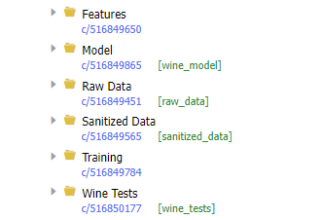
A ML Story featuring DataFed
Notes:
Dr. Bishop follows an initial set of steps to get started.
He creates an account in Globus
2. He then has his Fine Wines incorporated create a DataFed Managed Repository
4. He logs into the web UI at datafed.ornl.gov
3. He then creates a logical set of “Collections” to organize his ML data.

Slide 17
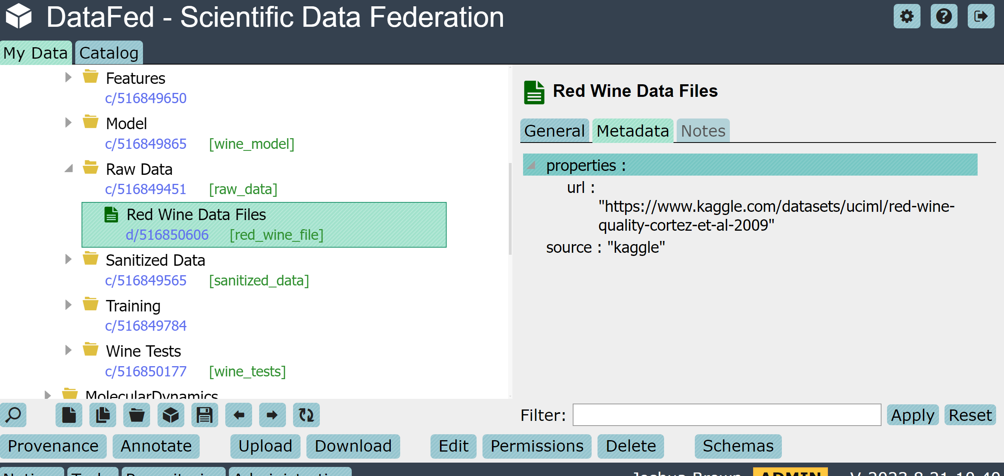
Raw data located on a machine with Globus
DataFed Server
Notes:
Dr. Bishop proceeds to upload his raw data to the DataFed Managed repository. He can do this directly using the uploads button in web UI and selecting a Globus Endpoint where his raw data is located, which in this case is on his laptop.
Dr. Bishop is glad he can do this because now he doesn’t have to store the metadata i.e. such as where the raw data came from, in a separate file, in DataFed the raw data and metadata are treated as a single entity.
Dr Bishop knows each ML model has many hyperparameters. With DataFed he can be sure the raw data and the metadata are always stored together.

Slide 18
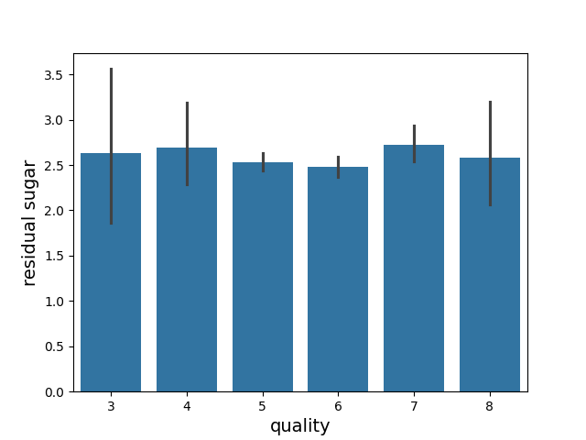
The Student
Residual sugar and wine quality do not appear to be strongly correlated.
Notes:
Because Dr. Bishop is very busy writing grant proposals, he has his eager student Jeffrey sanitize and upload the data for him.
As part of their feature engineering process they discover that the residual sugar less than 2% positively correlated with the wine quality and decide to remove the residual sugar as a feature of the data set.

Slide 19
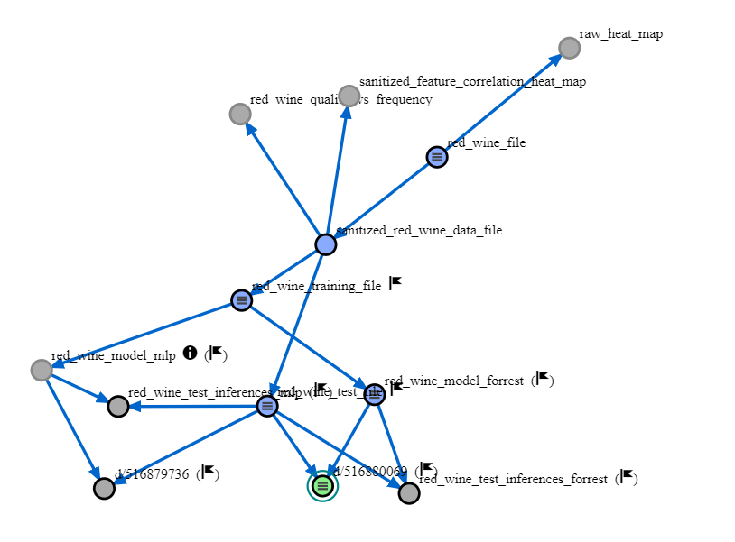
Provenance Tracking and Errors of Derived works

Slide 20
Error propagation and Lineage continued
Franky

Slide 21
Adding Controls with Schemas
{
"properties": "features_removed": {
"oneOf": [
{
"enum": [
"fixed acidity",
"volatile acidity",
"citric acid",
"chlorides",
"free sulfur dioxide",
"residual sugar",
"total sulfur dioxide",
"density",
"pH",
"sulphates",
"alcohol“
],
"type": "string“
},
{
"type": "null“
}
]
}
}
Notes:
In addition, Dr Bishop wants to look at the effects of removing different features from the training model to help optimize the training process. He creates a schema to help ensure that Franky records the metadata in a standardized fashion.

Slide 22
Notes:
Any time Franky fails to use a standardized formats he sees a wrench appear next to the record as well as a notification.

Slide 23
Questions
?

Slide 24
Acknowledgements
This research used resources of the Oak Ridge Leadership Computing Facility (OLCF) and of the Compute and Data Environment for Science (CADES) at the Oak Ridge National Laboratory, which is supported by the Office of Science of the U.S. Department of Energy under Contract No. DE-AC05- 00OR22725.

Slide 25
Appendix - DataFed Features

Slide 26
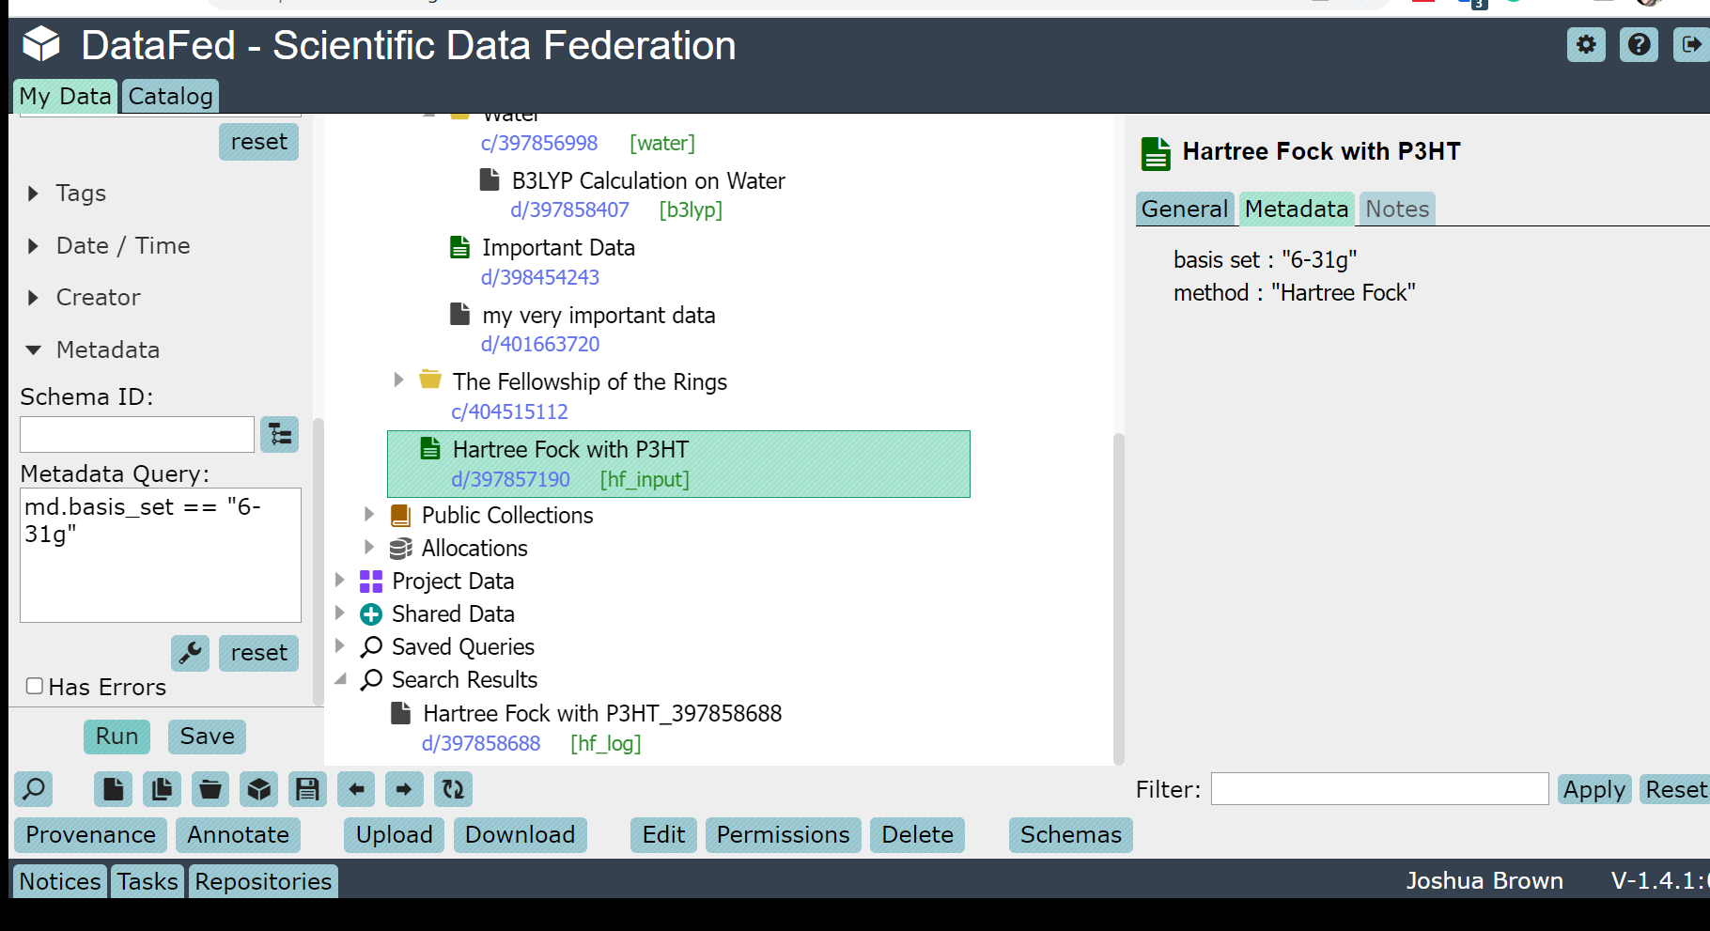
Search

Slide 27
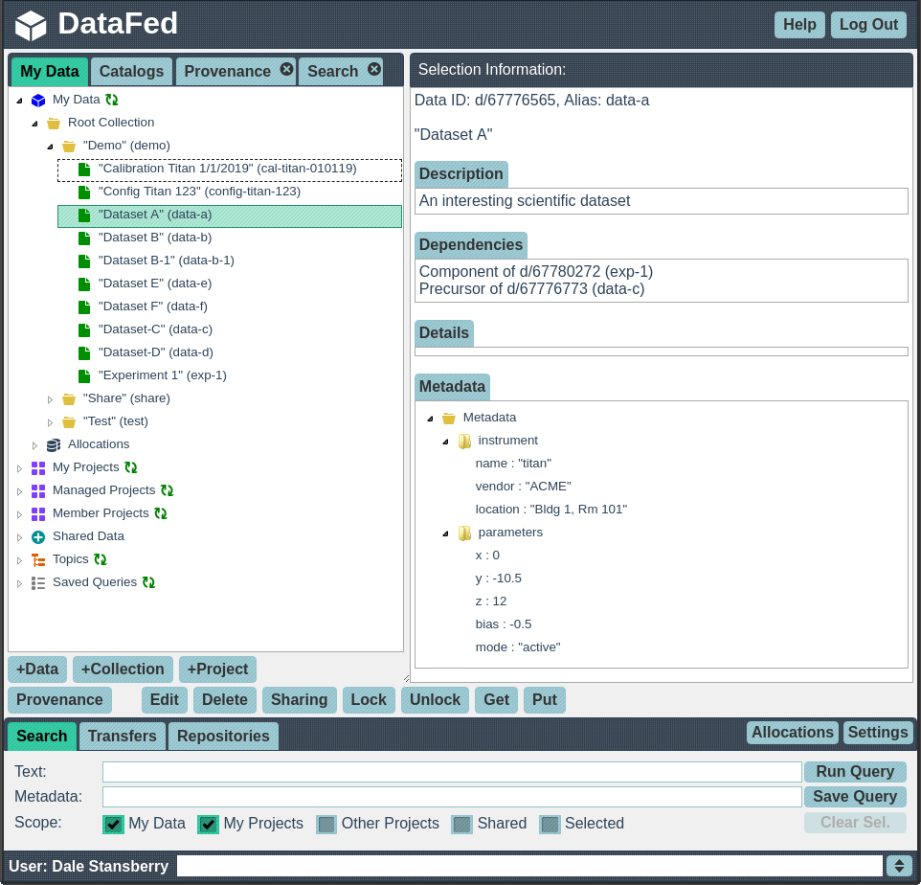
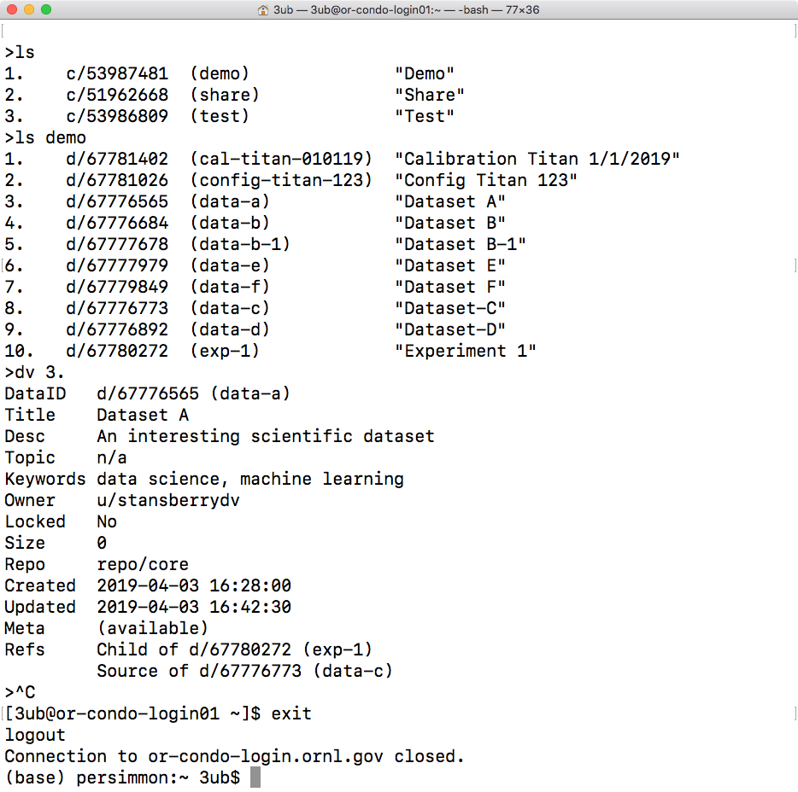
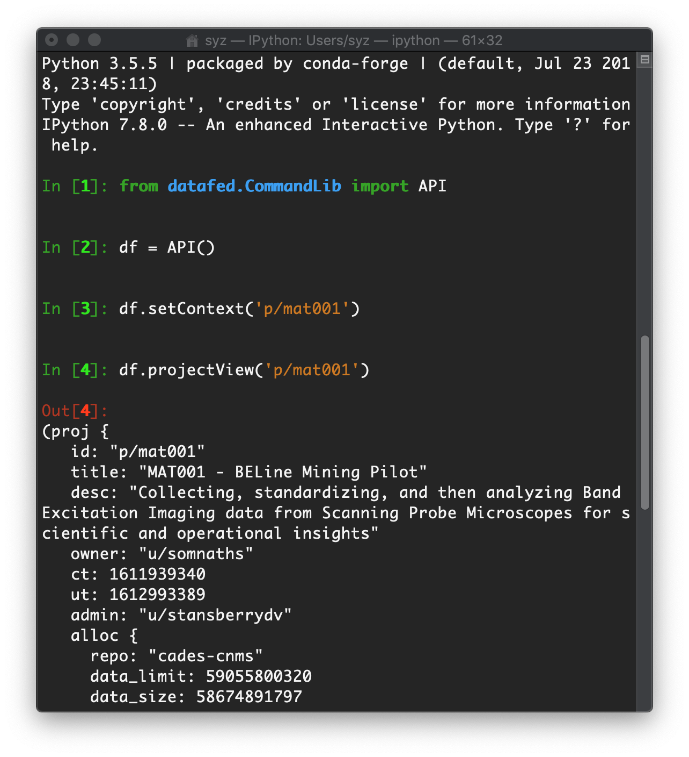
Multiple Interfaces - Web Portal and APIs
Modern web application
Command-line & Python interfaces
Interactive & non-interactive scripting (e.g. - HPC environments)

Slide 28
Fine-Grained Access Control
Per user or group, and default
Per record, or collection
Inherited from parent collection(s)
Differing permissions for records and collections

Slide 29
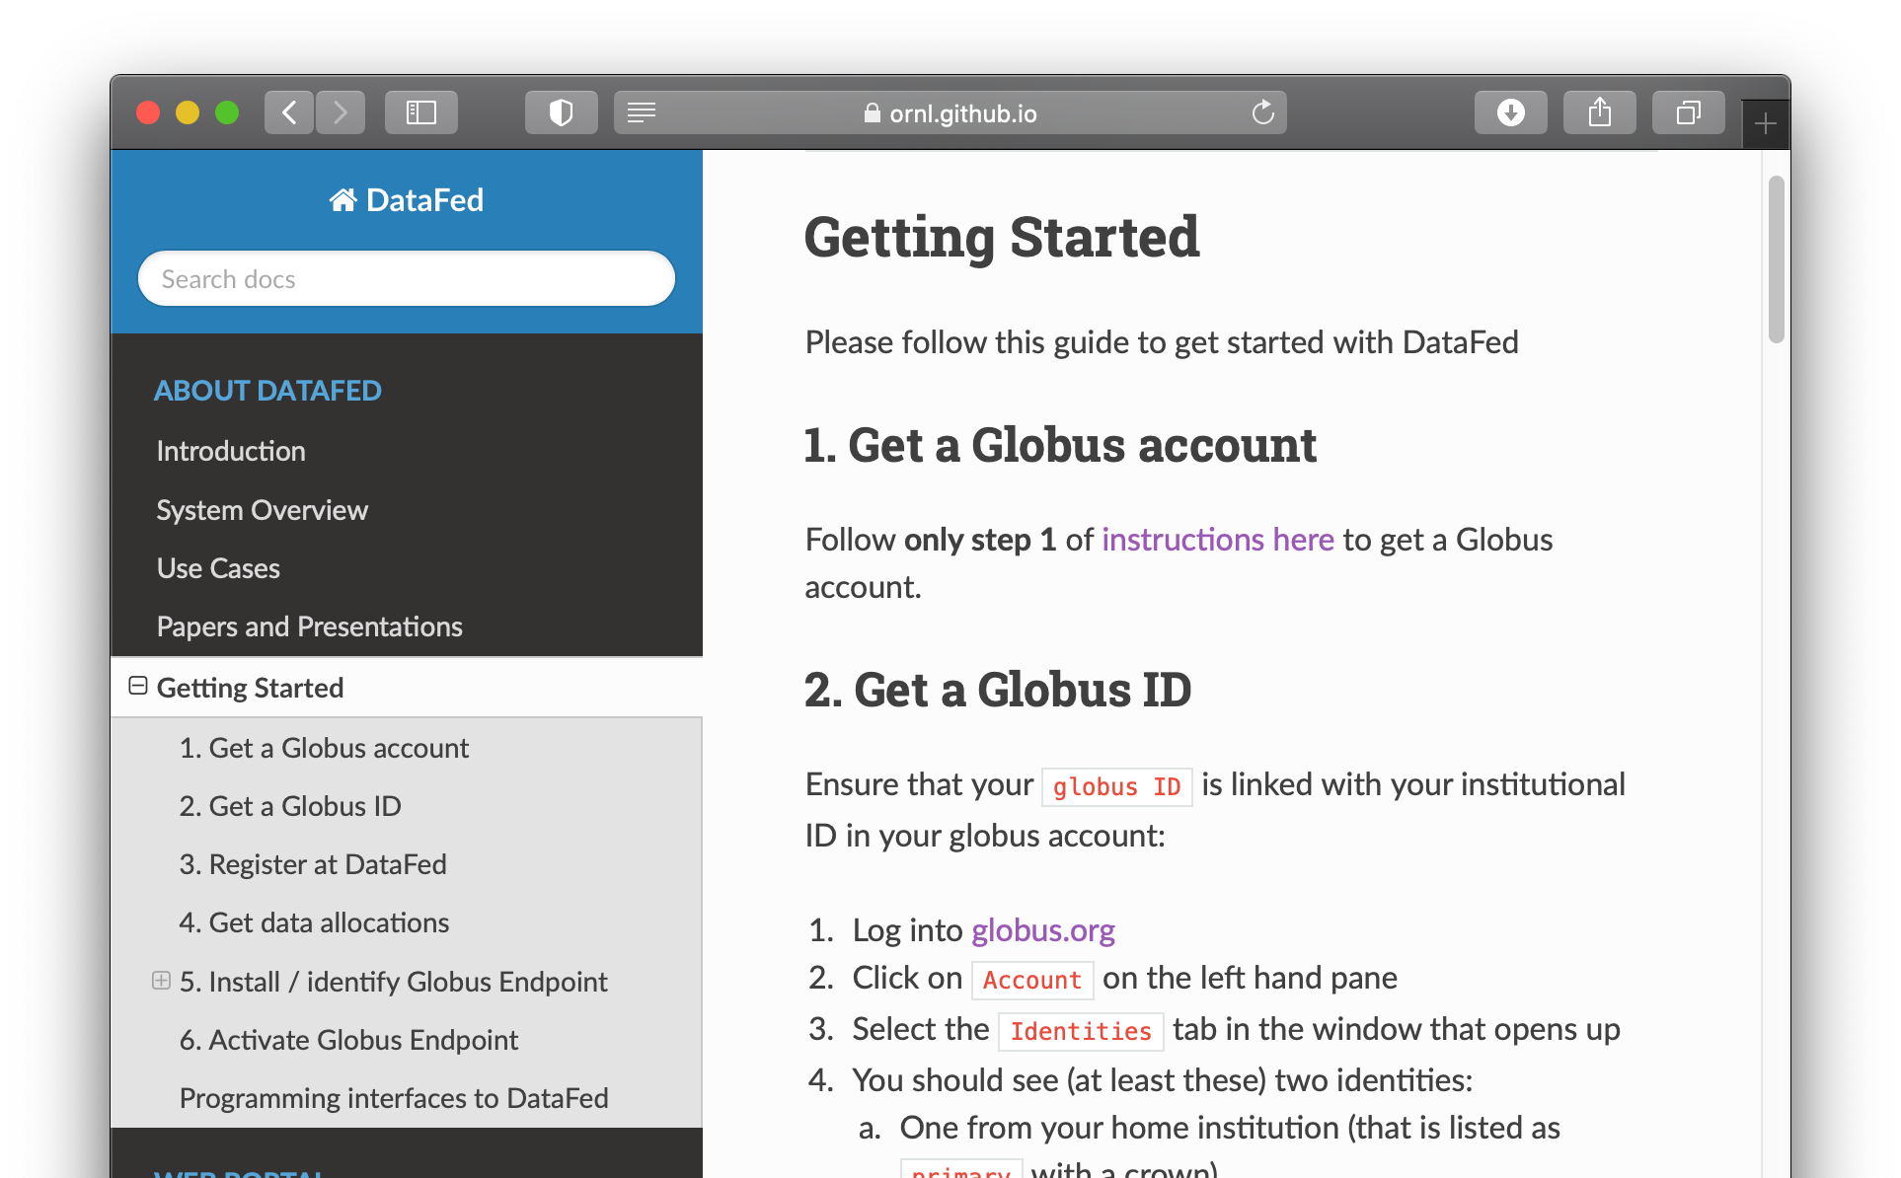
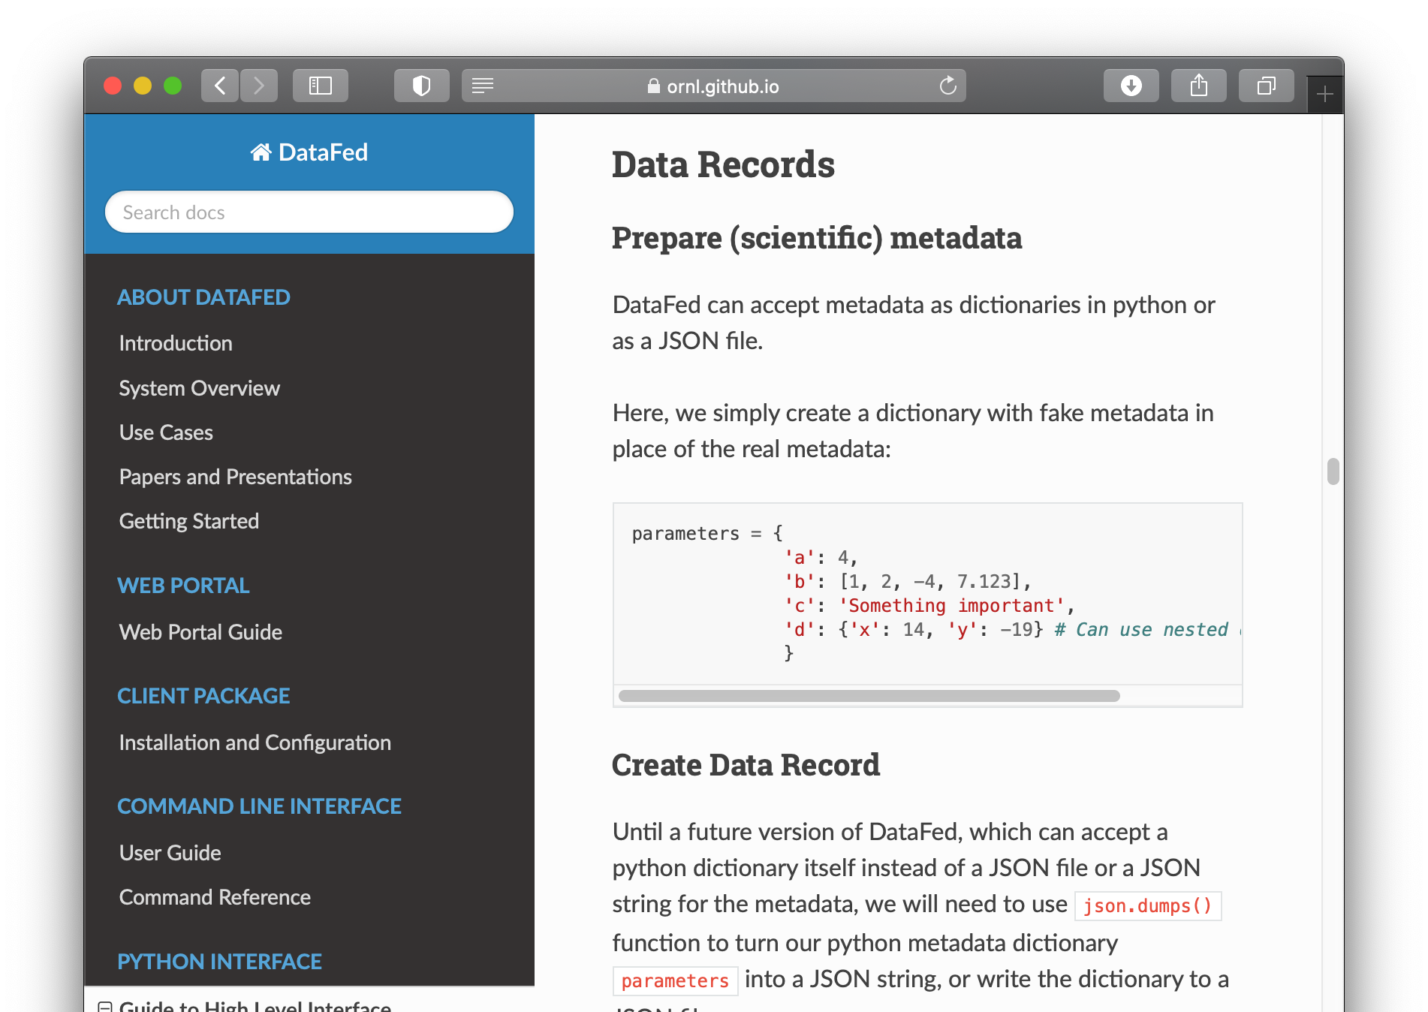
Documentation and User Guides
https://ornl.github.io/DataFed/

