Slide 1
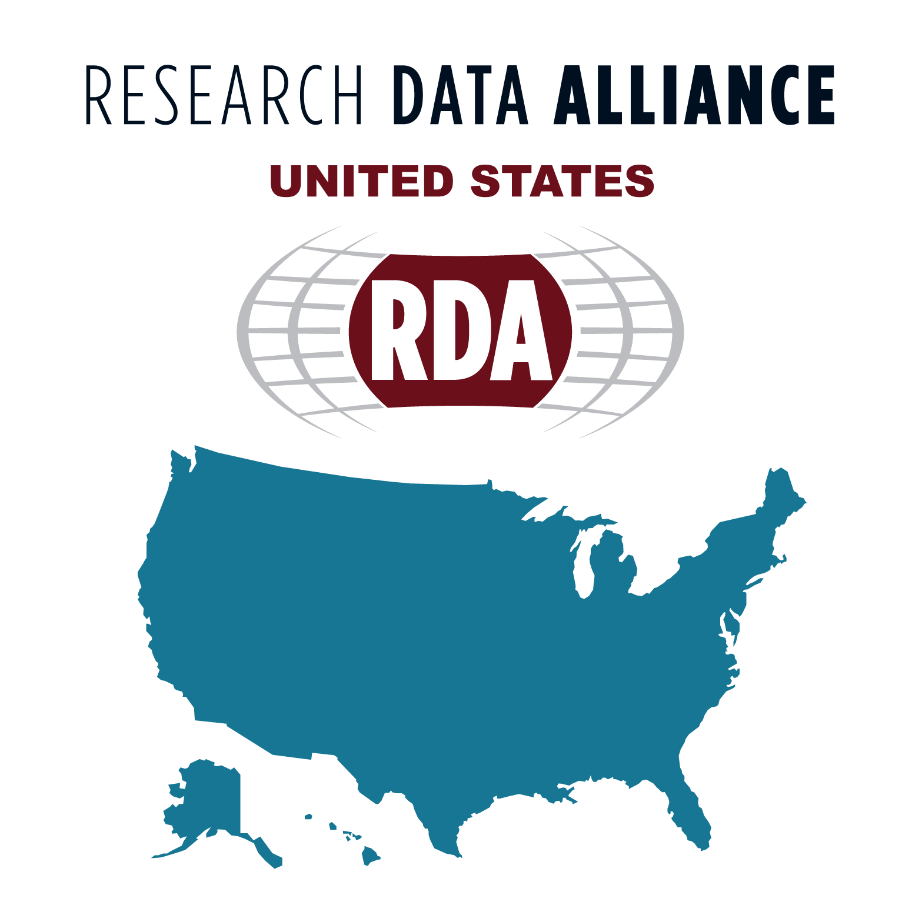
Along the Border: Term Overlap Among 5 Matportal Ontologies
Scott McClellan, Yuan An, Jane Greenberg, Xintong Zhao
Metadata Research Center, Drexel University
NSF-OAC 2118201
NSF-OAC 1934649
IMLS/RE-246450-OLS-20

Slide 2
Background and Method
Current focus on FAIR data standards
Term overlap directly relates to Interoperability aspect
Research goals of the study
Measured the degree of term overlap for a sample of MS ontologies from MatPortal
Examined the types of semantic ambiguity across a subsection of MatPortal ontologies
Ranked all ontologies and vocabularies using MatPortal matching tools
URI matching (SAME_URI)
Term matching (LOOM)
Ontology | SAME_URI | LOOM
MSEO | 1563 | 767
BWMD_DOM | 1075 | 543
LPBFO | 1074 | 447
MOL_TENSILE | 869 | 439
MM | 4 | 998
Materials Science and Engineering Ontology (MSEO)
BWMD Domain Ontology (BWMD_DOM)
Laser Powder Based Fusion Ontology (LPBFO)
Molecular Tensile Ontology (MOL_TENSILE)
MaterialsMine Ontology (MM)

Slide 3
Results
Highest rates of URI matches occurred between ontologies connected to Fraunhofer (BWMD_DOM, LPBFO, MOL_TENSILE)
Remarkably all three shared 347 URI matches
Second highest rate of URI matches occurred due to shared use of Basic Formal Ontology
Terminological matches were more evenly distributed between pairs of ontologies
Among LOOM matches, abstract terms predominated

Slide 4
Ontology Match Data
URI Matches among Sample
LOOM Matches among Sample
 | BWMD_DOM | LPBFO | MSEO | MM | MOL_TENSILE
BWMD_DOM |  | 347 | 35 | 0 | 347
LPBFO | 347 |  | 35 | 0 | 347
MSEO | 35 | 35 |  | 0 | 35
MM | 0 | 0 | 0
MOL_TENSILE | 347 | 347 | 35 | 0
Total | 729 | 729 | 105 | 0 | 729
 | BWMD_DOM | LPBFO | MSEO | MM | MOL_TENSILE
BWMD_DOM |  | 17 | 127 | 71 | 6
LPBFO | 17 |  | 126 | 63 | 0
MSEO | 127 | 126 |  | 112 | 126
MM | 71 | 63 | 112 |  | 66
MOL_TENSILE | 6 | 0 | 126 | 66
Total | 221 | 206 | 491 | 312 | 198

Slide 5
Discussion
Small number of institutions providing backbone ontologies could lead to less interoperability, especially if they are geographically distinct
Reliance on upper ontologies such as BFO provide stable support, but over reliance on these can lead to compatibility issues when changing versions
Possible solutions for issues with term overlap:
Intermediary semantic schema such as Simple Standard for Sharing Ontological Mappings (https://github.com/mapping-commons/sssom)
Drexel Metadata Research Center (MRC) initiaitves
YAMZ (Yet another Metadata Zoo) (https://yamz.net)
HIVE-4-MAT (Helping Interdisciplinary Vocabulary Engineering for Materials Science) https://hive4mat.cci.drexel.edu/index

Slide 6
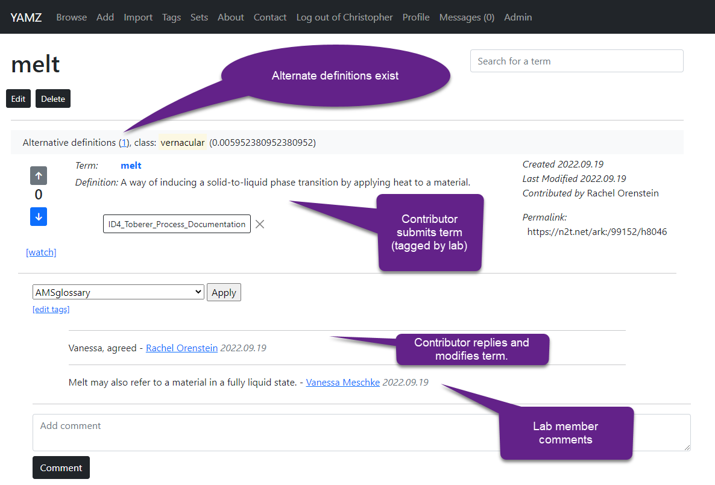
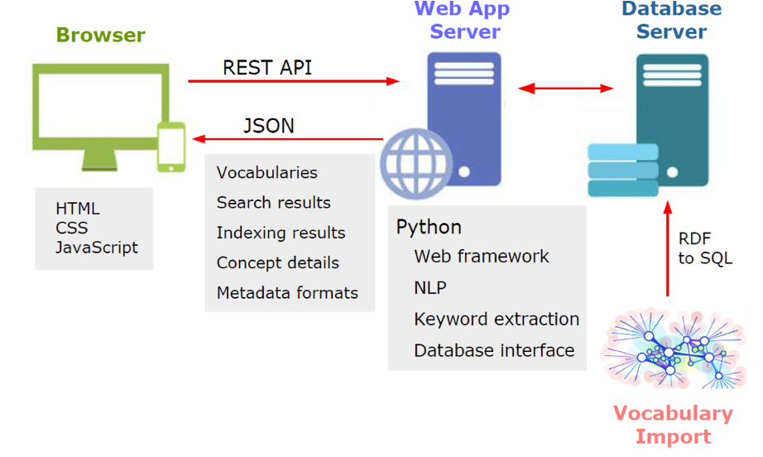
HIVE-4-Materials Science
21+ontologies
YAMZ: YET ANOTHER METADATA ZOO
Greenberg, J., Zhao, X., Adair, J., Boone, J., & Hu, X. T. (2021). HIVE-4-MAT: Advancing the ontology infrastructure for materials science. In Metadata and Semantic Research: 14th International Conference, MTSR 2020, Madrid, Spain, December 2–4, 2020, Revised Selected Papers 14 (pp. 297-307). Springer International Publishing.
Greenberg, J., McClellan, S., Rauch, C., Zhao, X., Kelly, M., An, Y., ... & Toberer, E. (2023). Building community consensus for scientific metadata with YAMZ. Data Intelligence, 5(1), 242-260.

Slide 7
Thank you Questions

